Slide 1
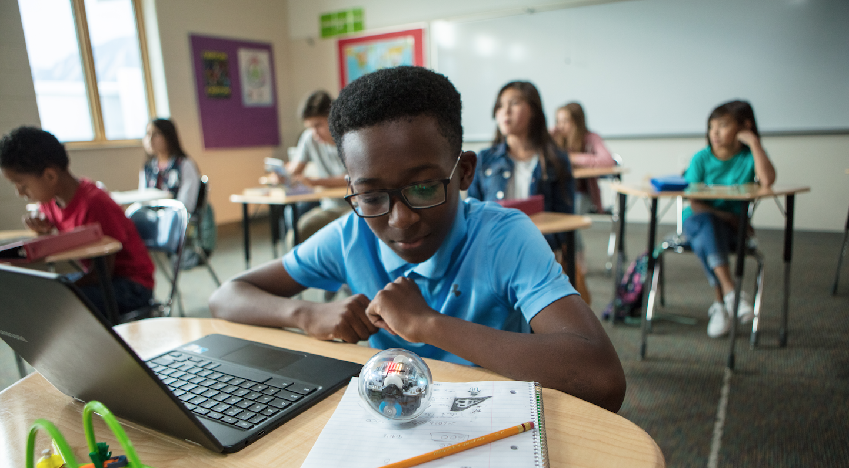
BEST PRACTICES IN HYBRID AND IN-CLASSROOM LEARNING

Slide 2
NATE UBOWSKI
GREG ROUSOS
EDUCATIONAL CONTENT & PROFESSIONAL DEVELOPMENT MANAGER
PARTNERSHIPS MANAGER
Notes:
Add competitions coming soon slide

Slide 3
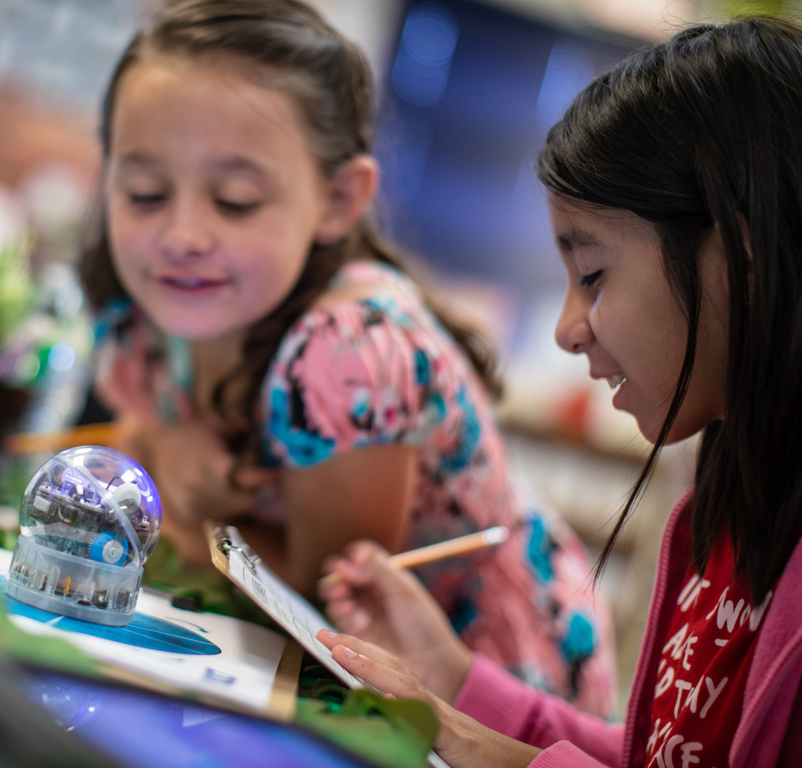
Overview
Intro to Sphero Edu
Our Mission and Approach
Our STEAM tools
Best Practices for Classroom
Best Practices for Hybrid
Q&A - Wrap Up

Slide 4
SPHERO IS TRANSFORMING
THE WAY KIDS LEARN IN THE
CLASSROOM & THE LIVING ROOM
THROUGH CODING, STEAM, AND FUN.

Slide 5
The Sphero Mission
Sphero makes undeniably cool, programmable robots and STEAM-based educational tools that transform the way kids learn, create, and invent through coding, science, music, and the arts.
Sphero goes #BeyondCode and drives kids to turn their imagination into reality. The skills students unlock through play-based learning prepare them to thrive, no matter what subject or career they pursue.

Slide 6
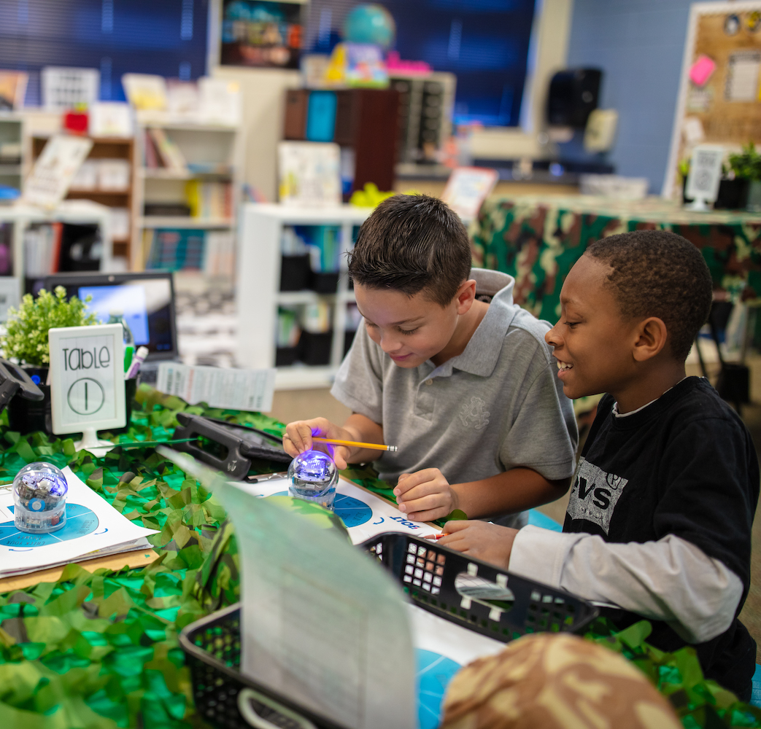
Making Changemakers
Critical Thinking
Collaboration
Communication
Creativity
Curiosity
Community

Slide 7
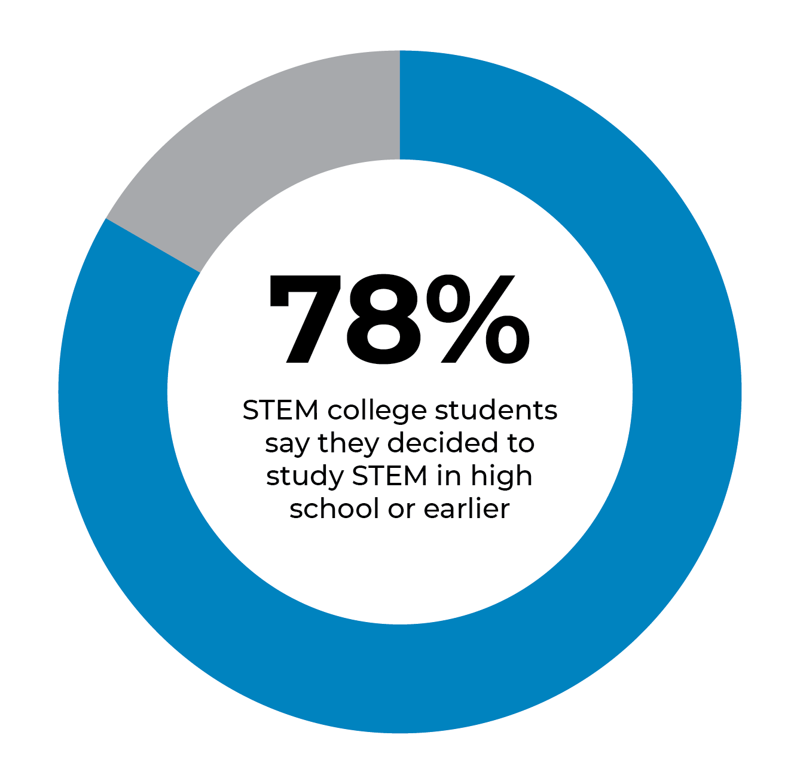
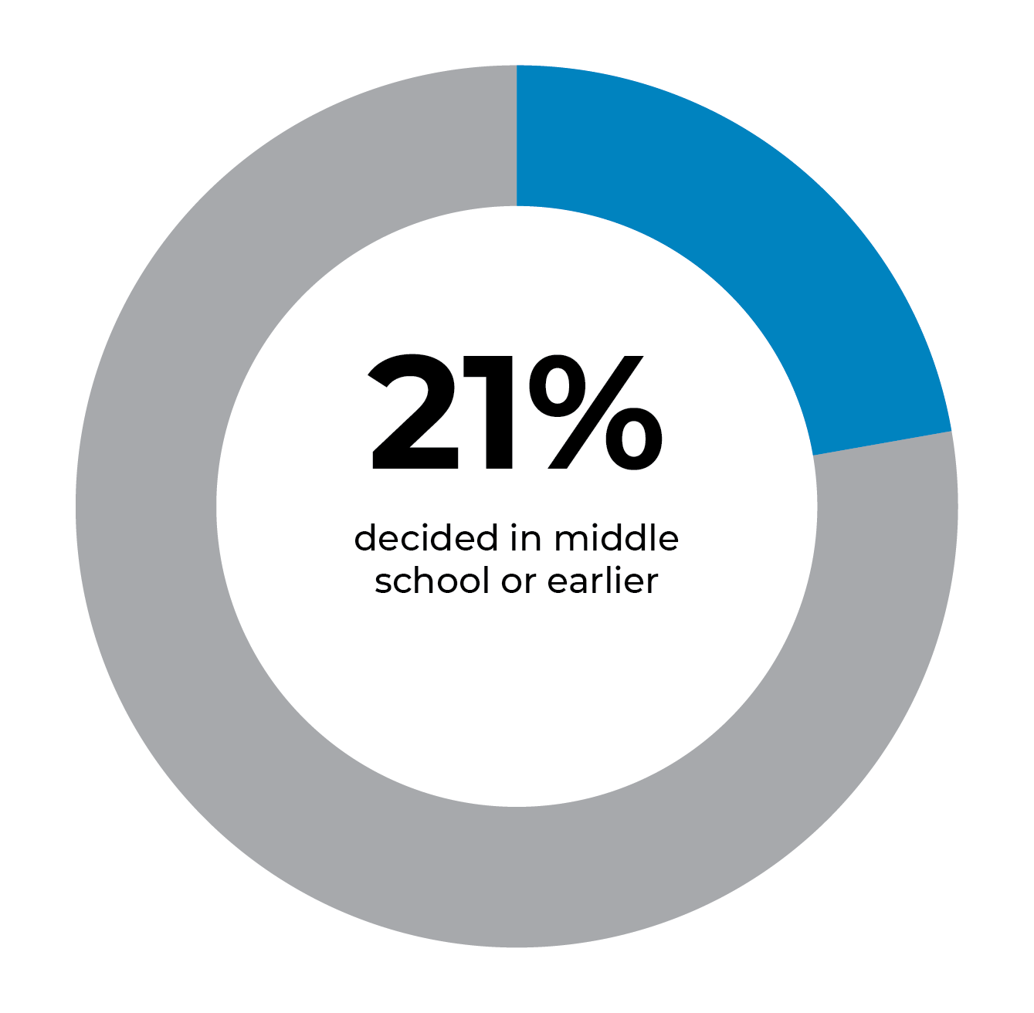
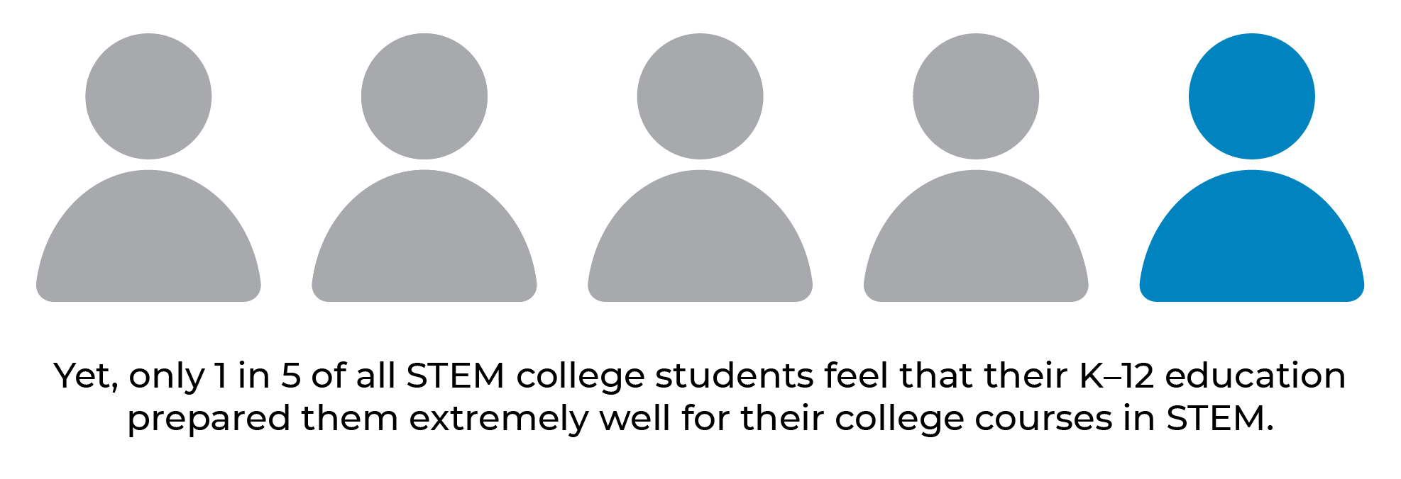
The Importance of STEM
Notes:
World economic forum

Slide 8
SPHERO HARDWARE

Slide 9
The Sphero Approach
Sphero’s collection of robots, educational tools, and STEAM activities work to inspire a new generation by using hands-on, applied learning to teach valuable STEAM principles.

Slide 10
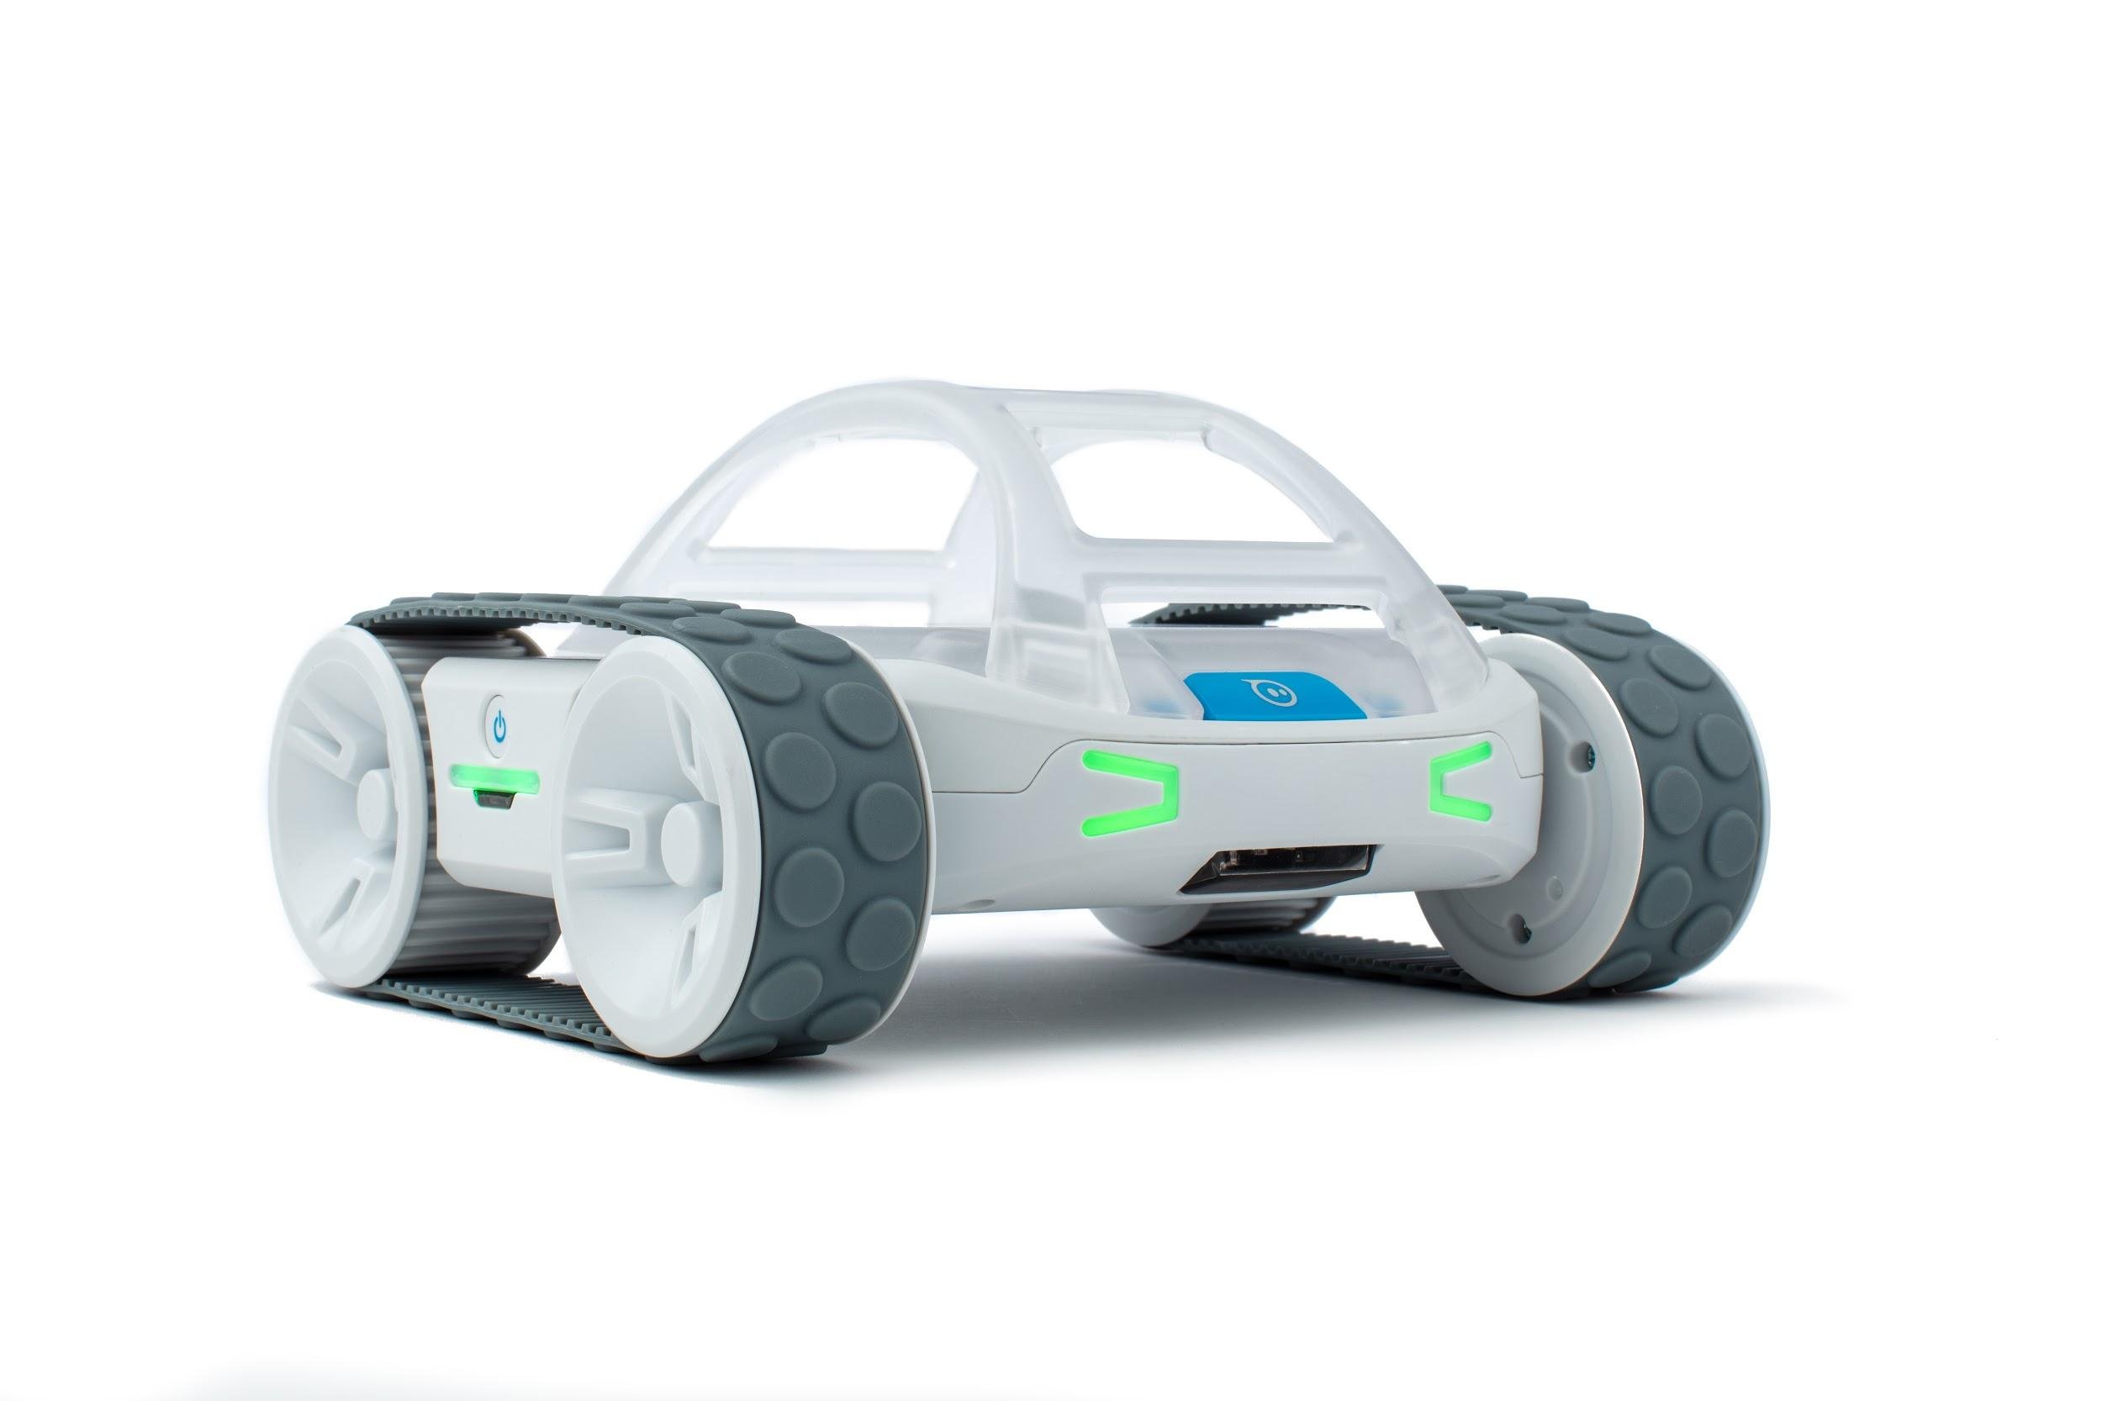
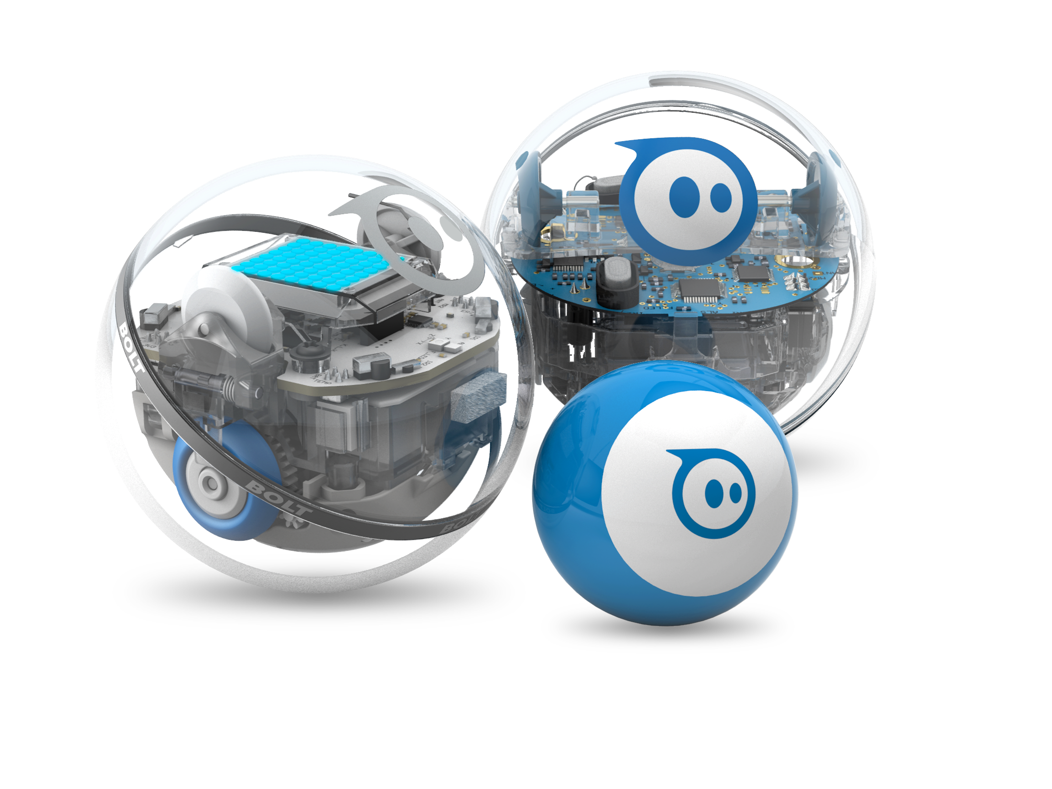
BOLT
Durable, Waterproof
Baseball Size
Magnetometer, Infrared, Ambient Light Sensor and LED Matrix
RVR
Tank-tread robot
All-terrain and Capable
Precision driving
Color Sensor
Expandable with UART

Slide 11
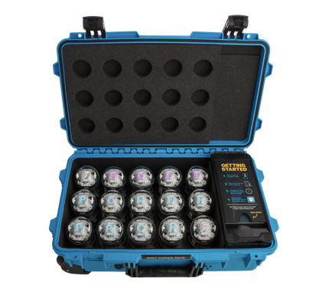
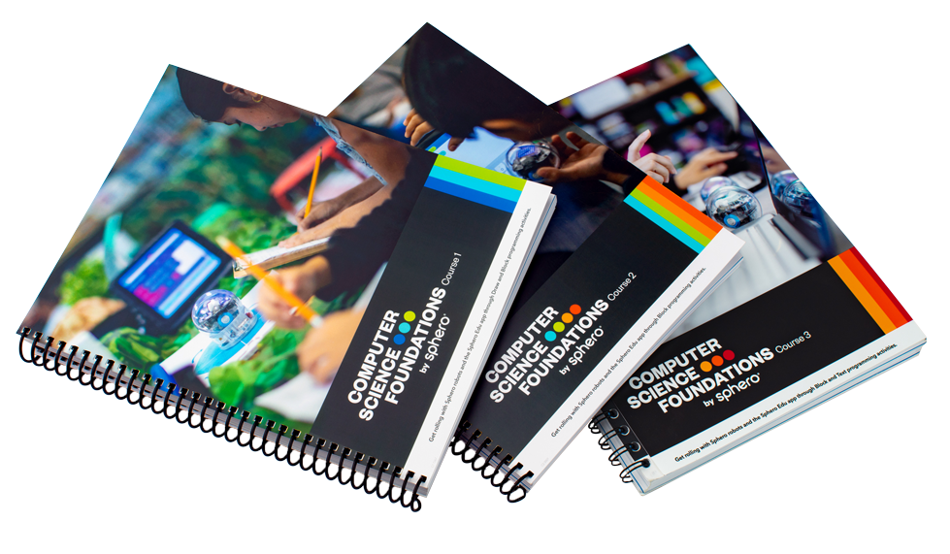
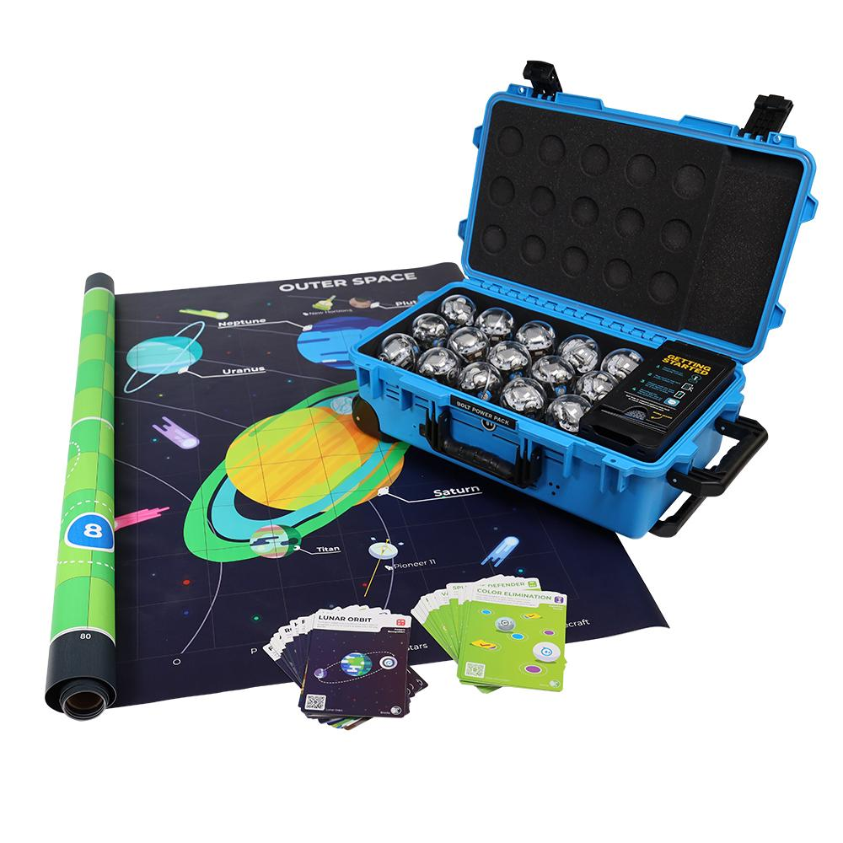
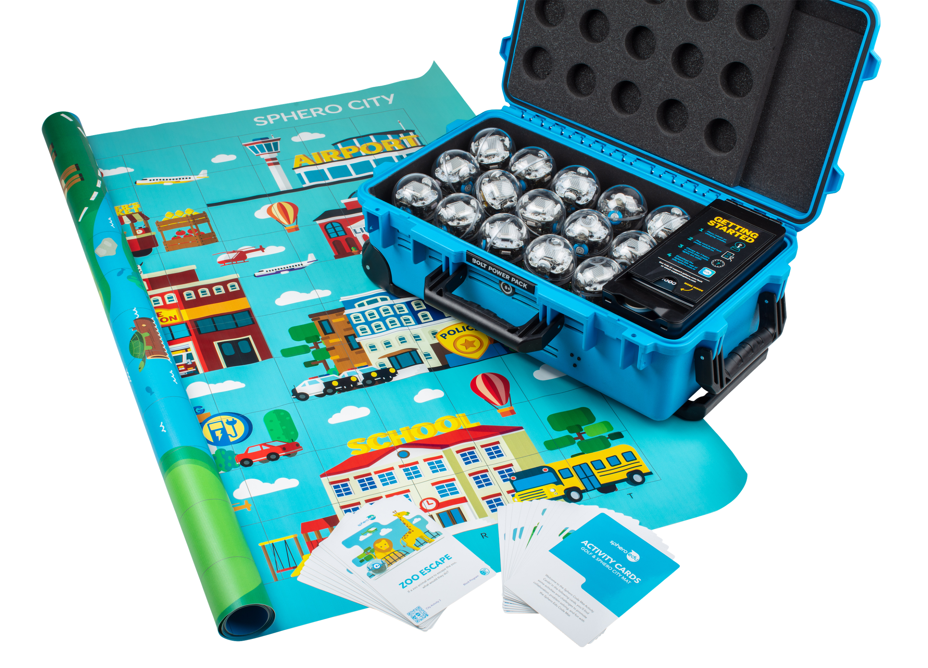
Sphero BOLT Power Pack
Bundles Options
The BOLT Power Pack lets you charge, store, and carry 15 Sphero BOLT robots. This is the top-of-the-line kit for educators fostering collaboration in the classroom with a recommended 2:1 ratio of robots to students, providing plenty of opportunities for creativity in any setting you can imagine.
Computer Science Foundations
Take STEM learning home with the BOLT At-Home Guide
+ BOLT Power Pack
Key Features
Tech Specs
LED Matrix
Infrared Communication
Advanced Sensors
Program 3 Ways
• Durable UV-coated clear plastic shell
• Bluetooth Smart connection (100 foot range)
• Inductive charging (6 hour charge for 2+ continuous hours of play)
• Height: 73mm / Width: 73mm / Weight 200g
^{• Top speed: 4.5 MPH}
BOLT Power Pack + Code Mat
Notes:
Add code mat + pp bundle

Slide 12
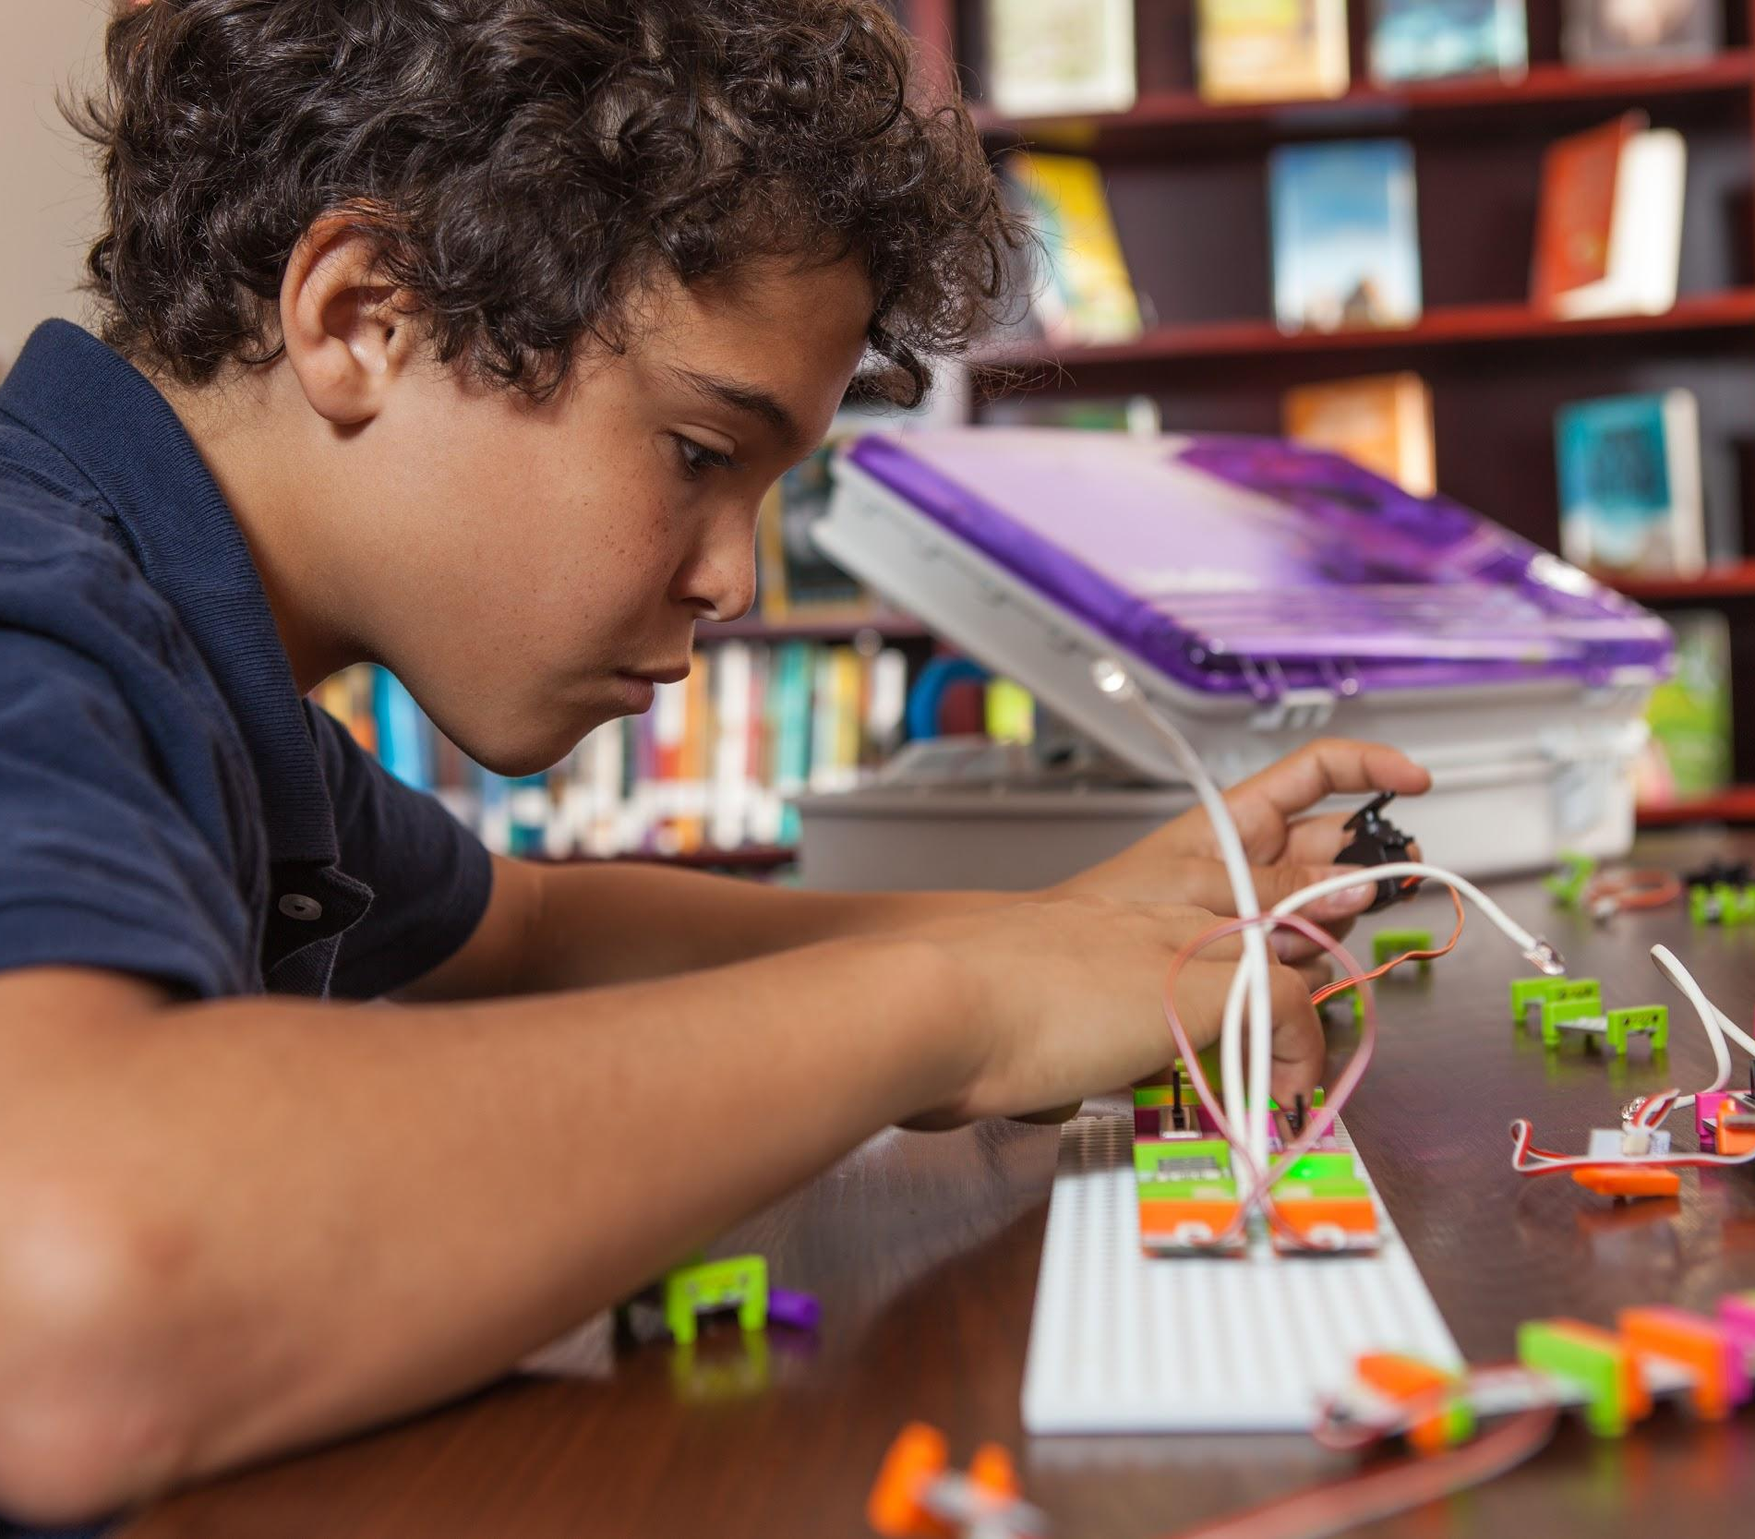
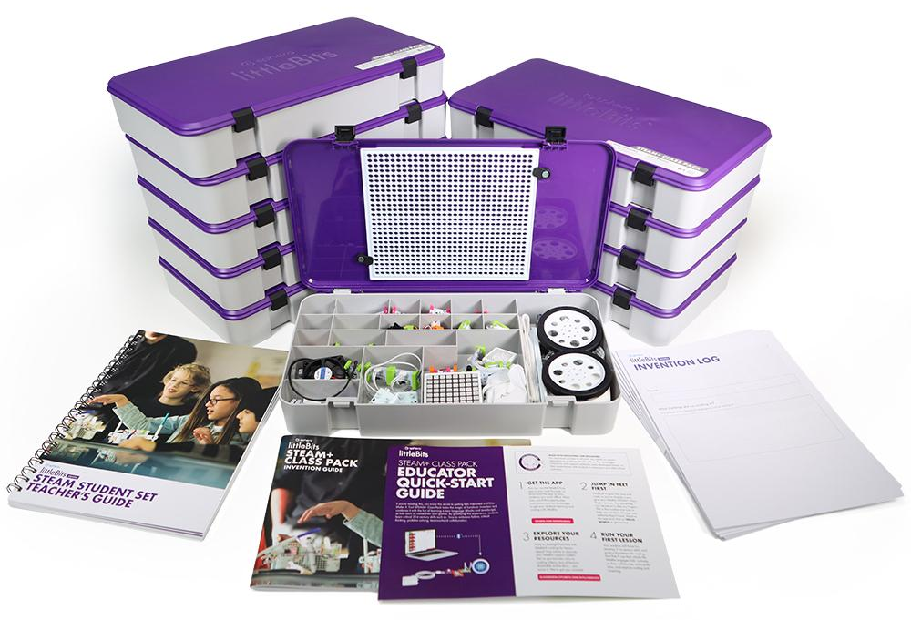
littleBits is a hands-on learning system of electronic building blocks that allows students of all ages to create with technology. Our snap-together Bits are easy to use and simple to understand. Perfect for grades K-12 and suitable for cross-curricular instruction.

Slide 13
SPHERO IN YOUR CLASSROOM

Slide 14
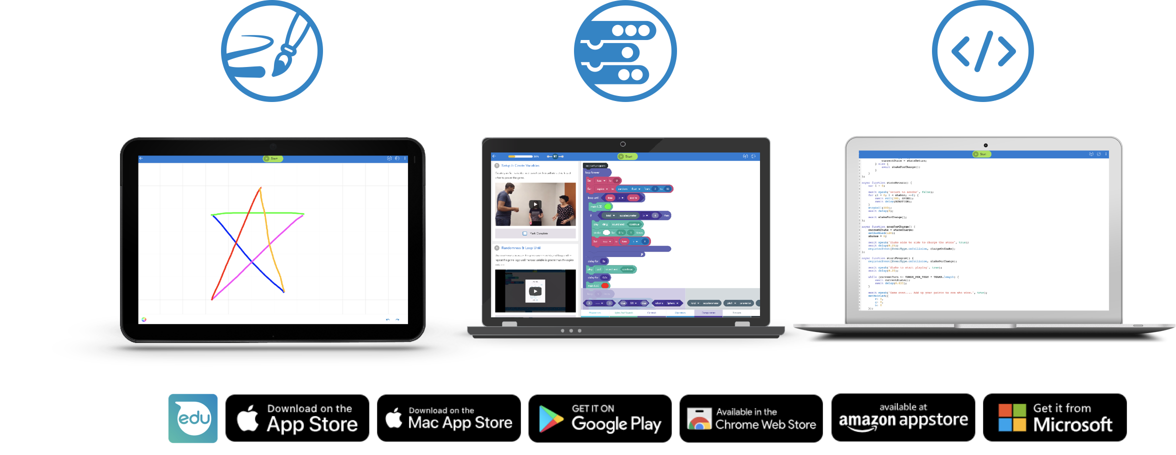
The Sphero Edu App
Sphero has created over one hundred standards-aligned STEAM and Computer Science lessons and activities in the Sphero Edu App that can be teacher-led or self-guided.
Notes:
Programming, activities (like sales book)

Slide 15
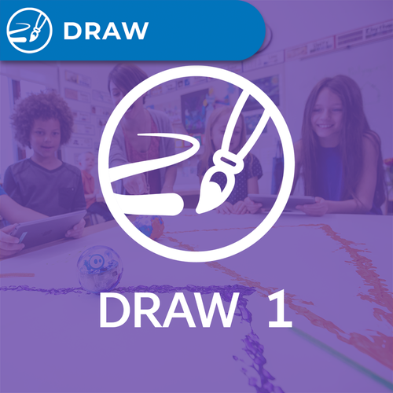
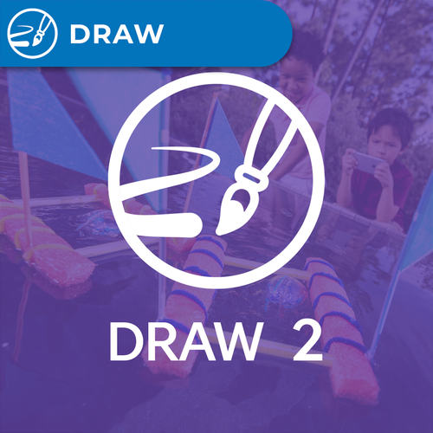
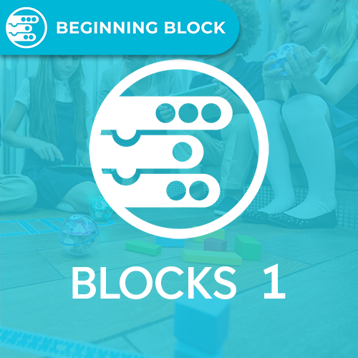
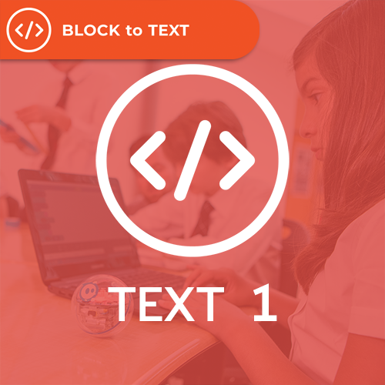
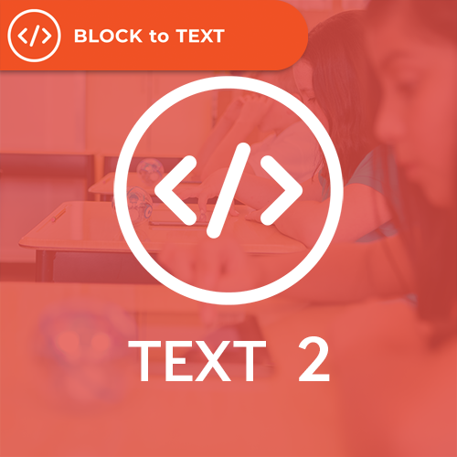
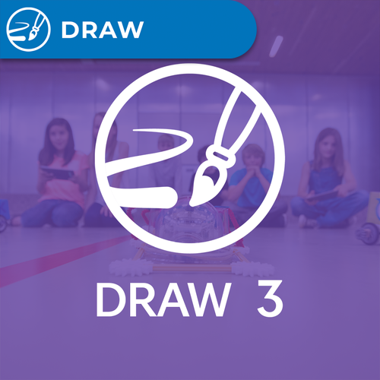
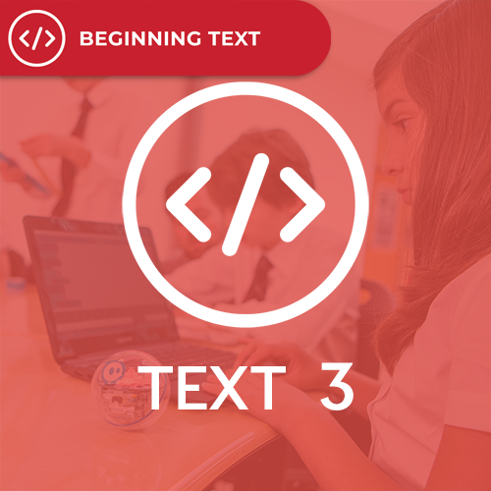
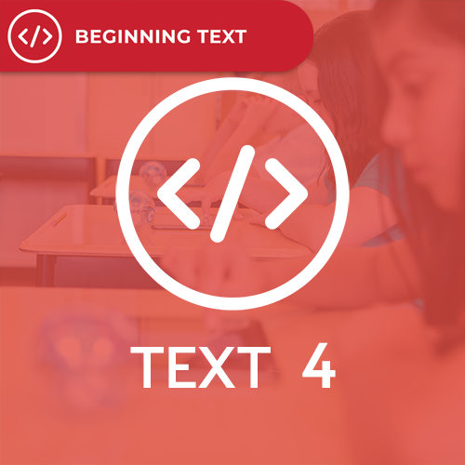
Getting Started
Notes:
Thumbnails of Draw Blocks, Text

Slide 16
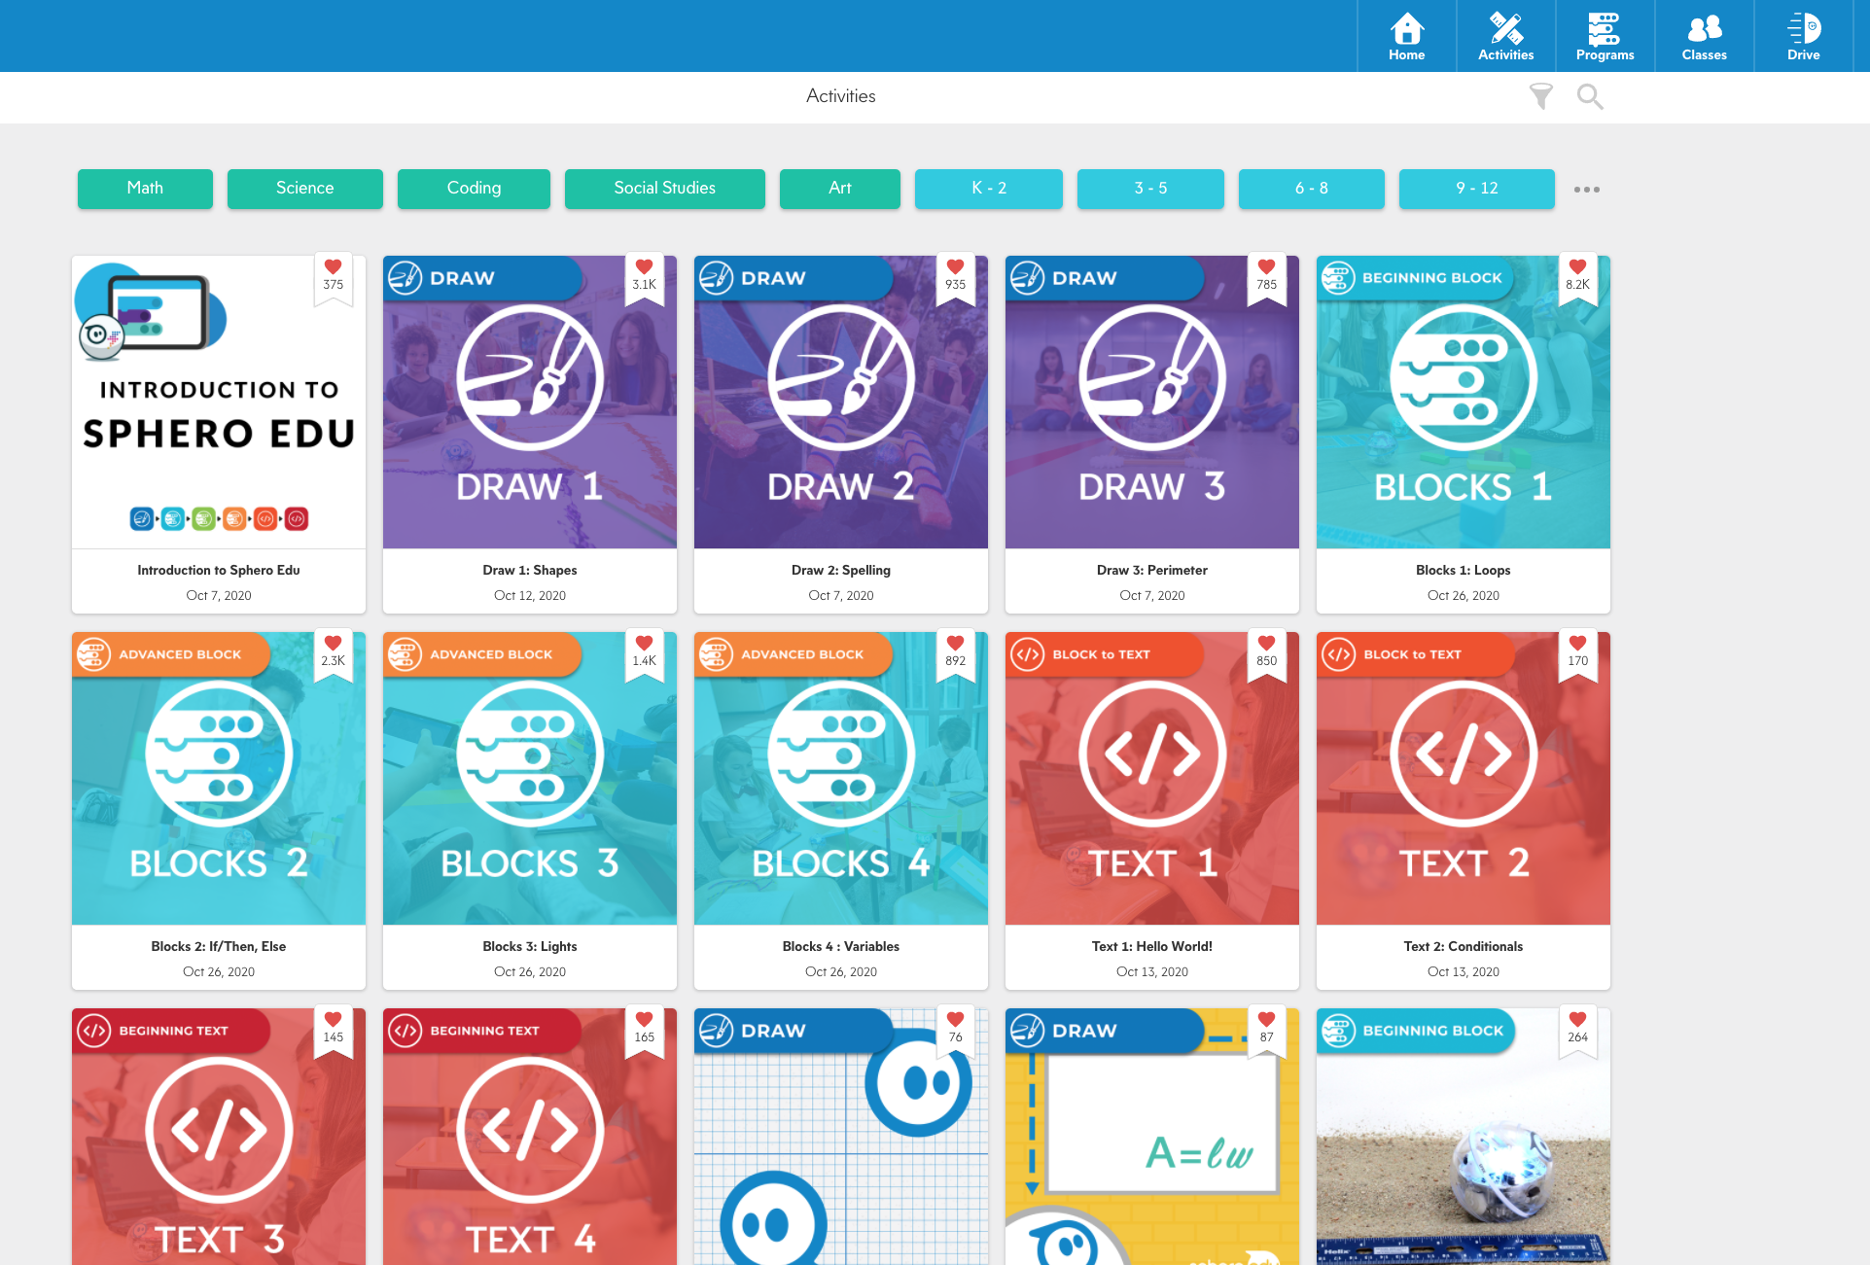
Searching for Activities
ACTIVITIES
By Sphero
Community
Quick Filters
Most frequently used tags for filtering activities.
Click for a quick search/filter
Filter
Filter activities by:
Robot Type
Duration
Grades
EDU Standards
Tags
Search
Use your own search terms to search activities

Slide 17
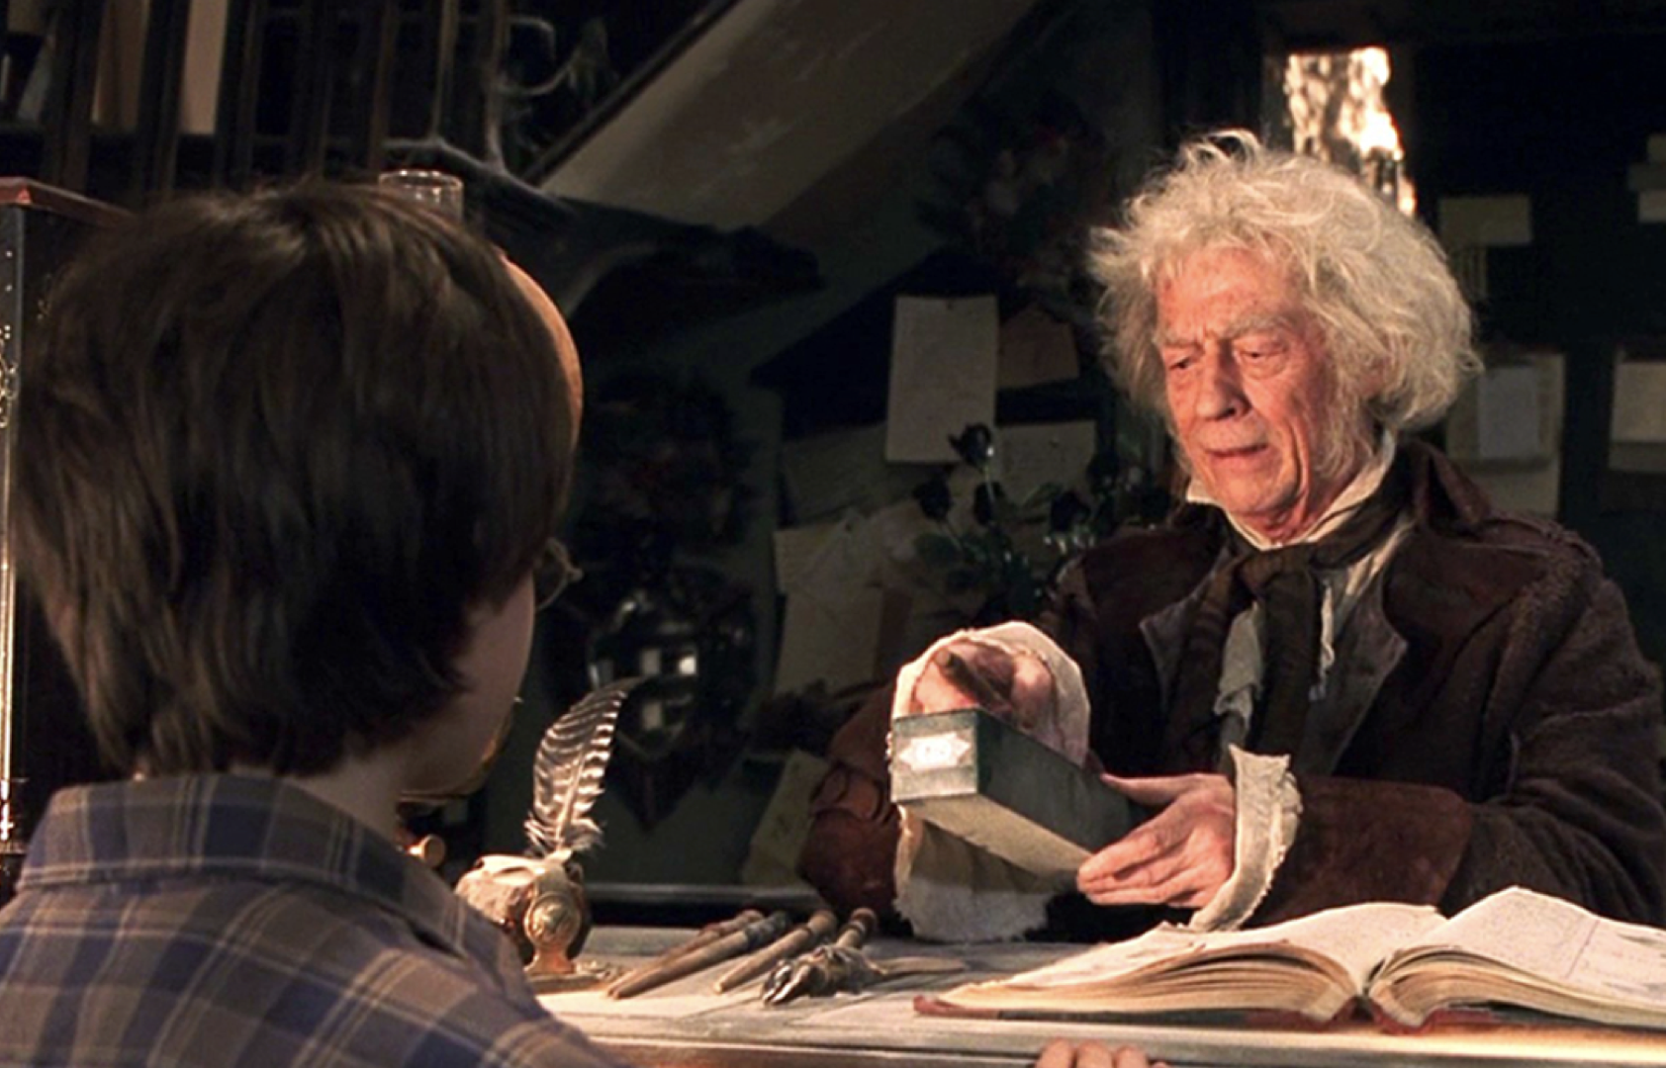
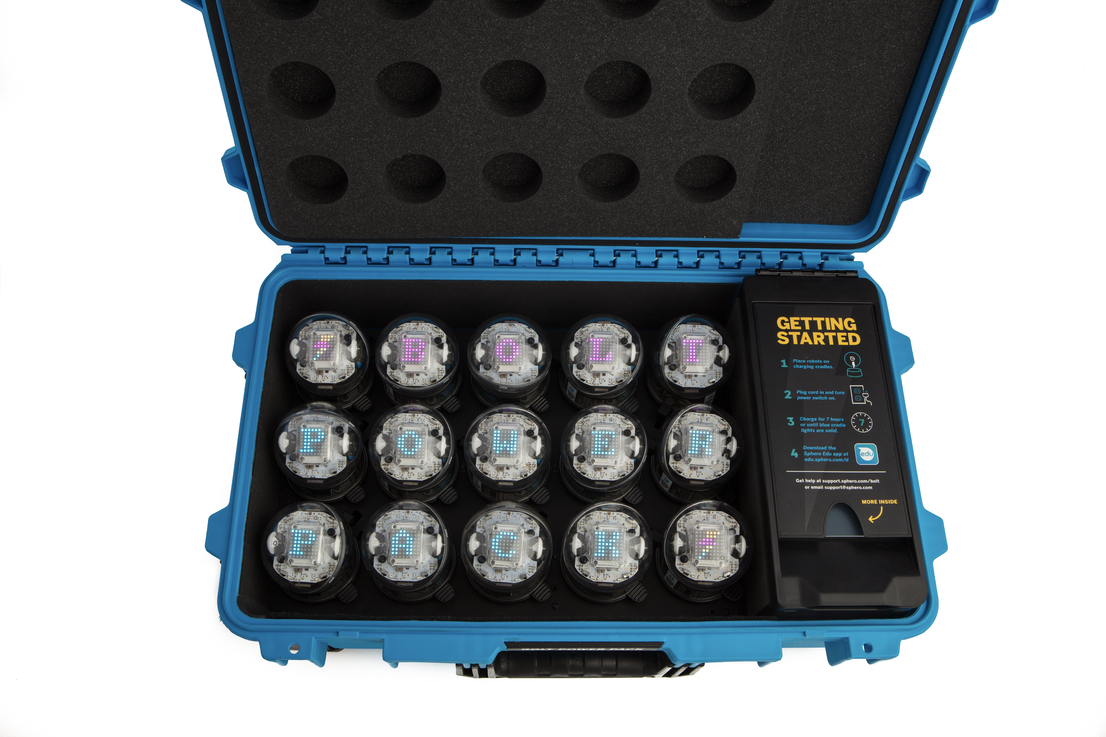
Robot Best Practices
Charge when needed
Deep sleep for storage
No need to label
Distance helps when pairing

Slide 18
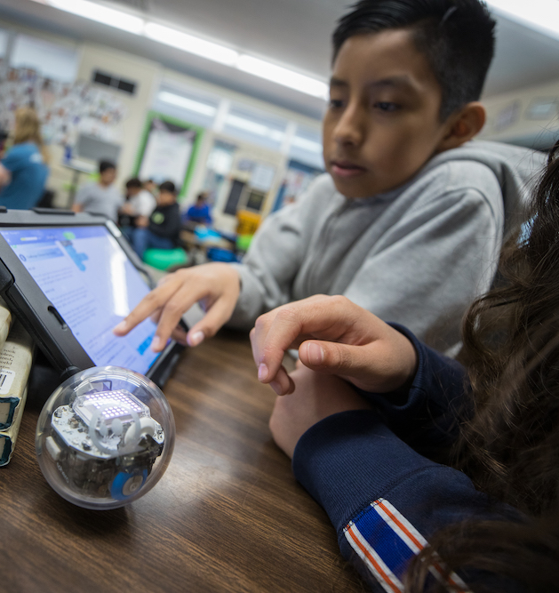
Classroom Best Practices
2:1 or 3:1 Student to Robot ratio.
Pair Programming
Allow time for play and invention
Space for movement vs. Tabletop programming

Slide 19
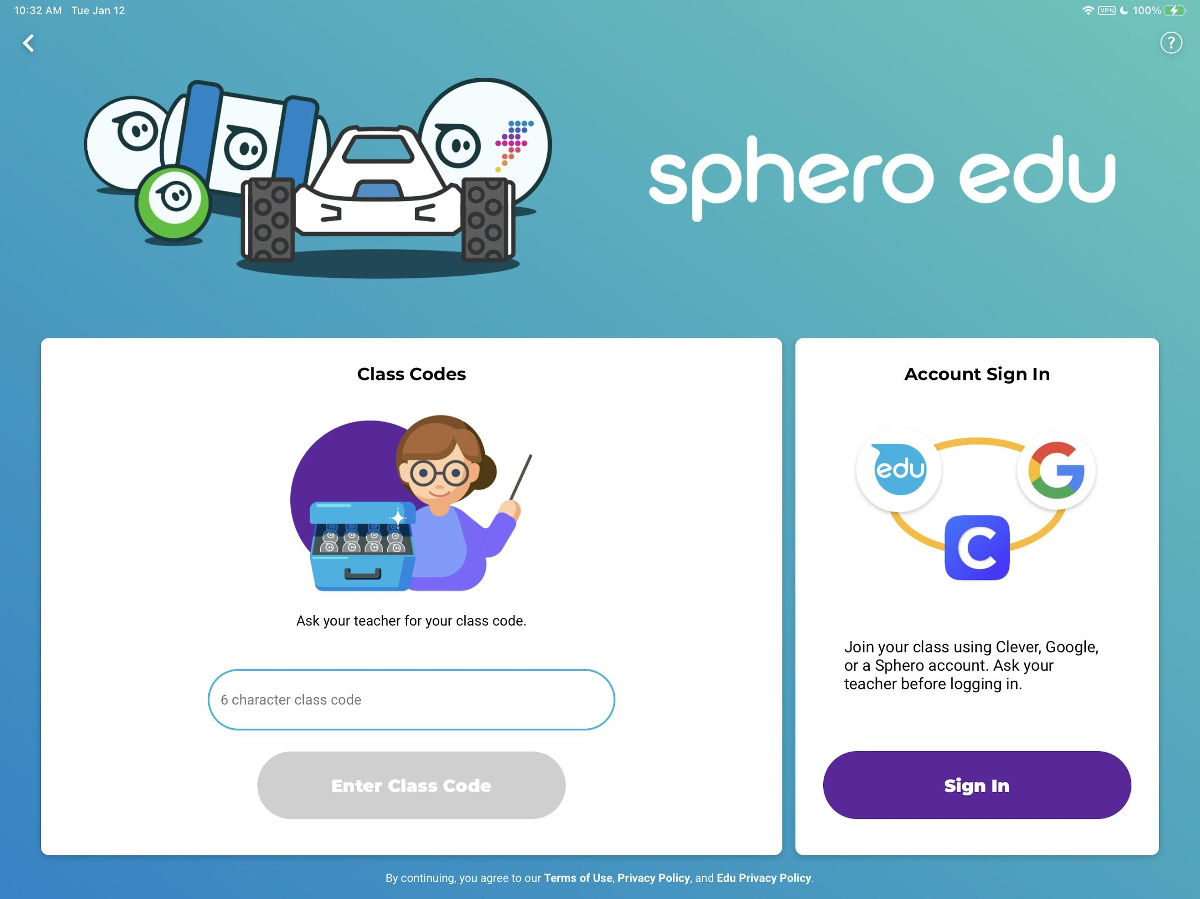
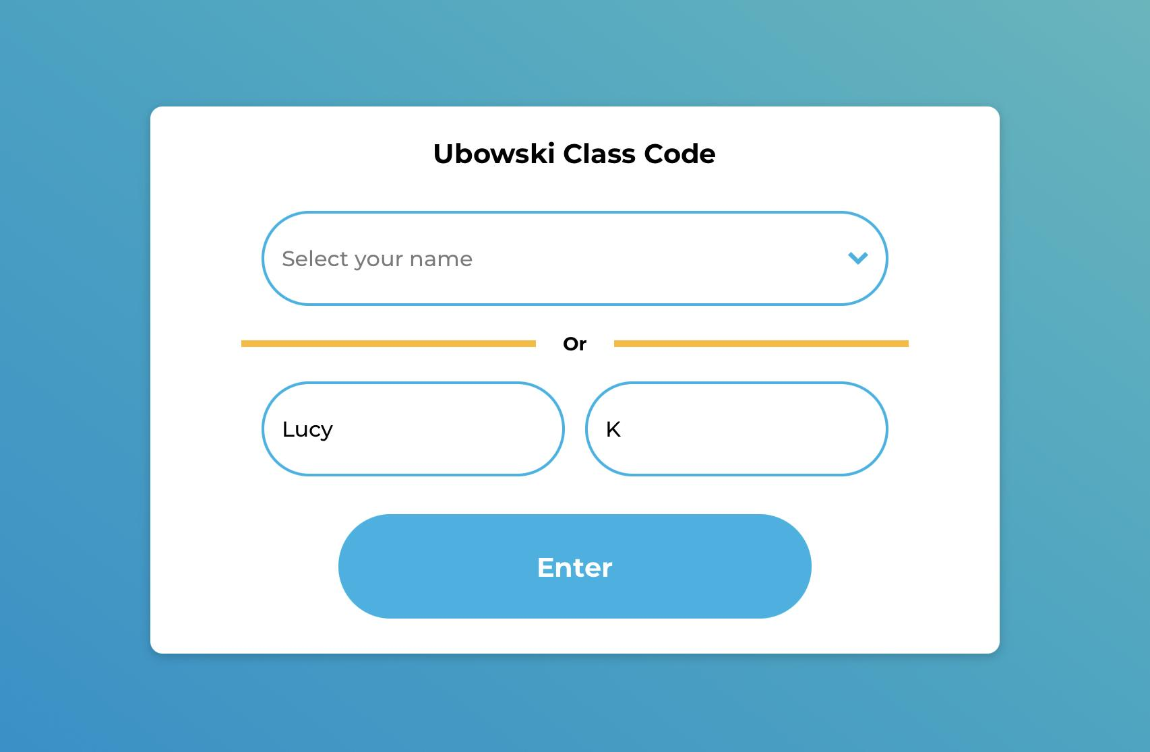
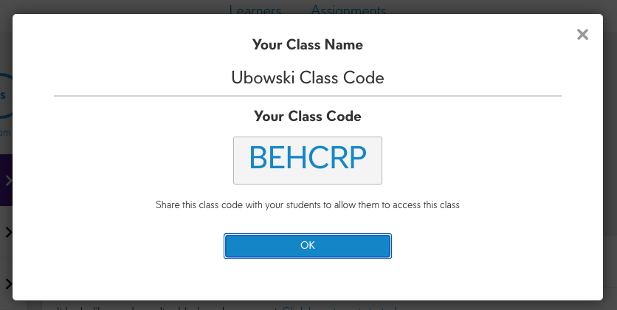
Class Codes
Easily assign activities
Students can share programs with a teacher
Students can share programs with the class

Slide 20
sphero.com/pages/socially-distanced-with-sphero
SPHERO IN A HYBRID SETTING

Slide 21
Power Pack Disassembly

Slide 22
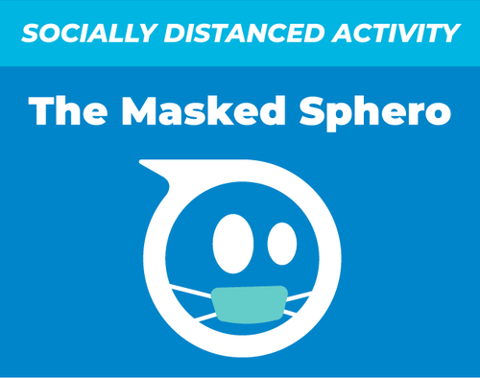
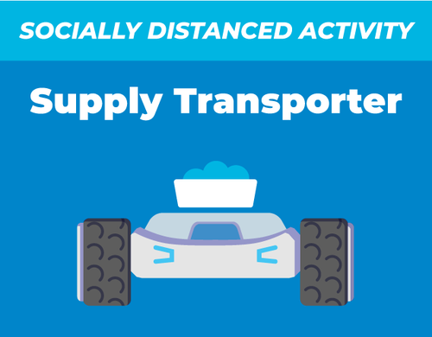
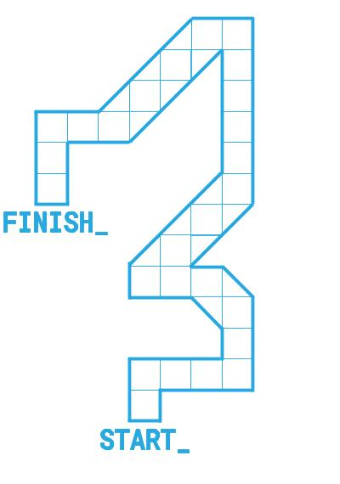
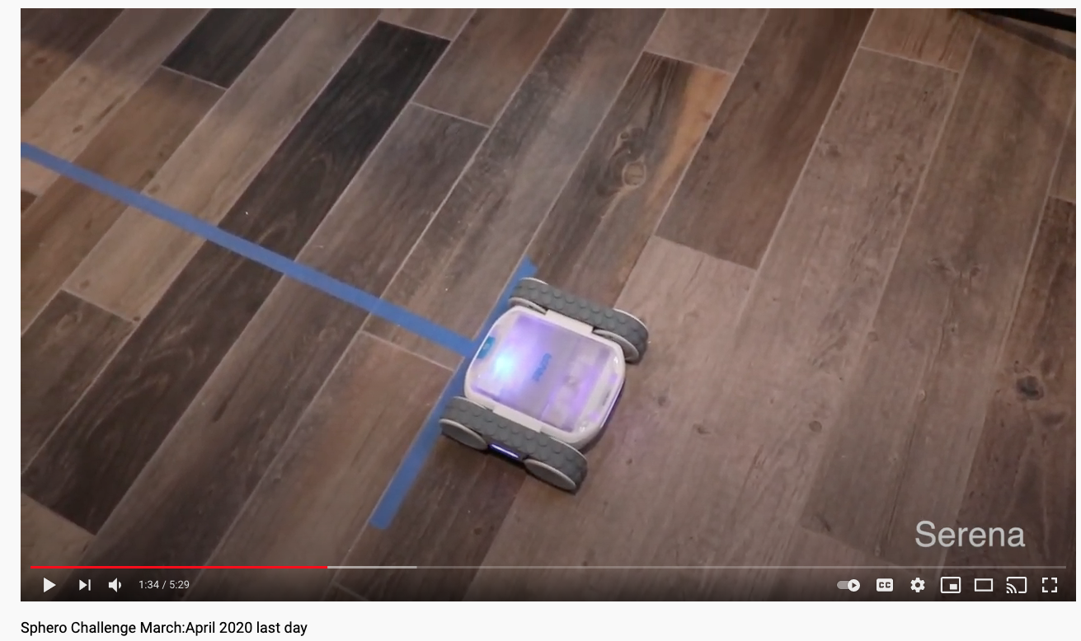
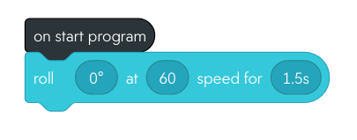
Strategies for Hybrid learning
Create a lending library
Digital Pair Programming
In-person Driver; Virtual Navigator
Debug a problem or build an algorithm
Virtual Challenges
Obstacles/Mazes
Debug Contest
Utilize digital tools to create shareable videos
Notes:
Keep it organized! Use Sphero storage containers, plastic containers, or backpacks.
Make sure that Sphero and littleBits kits are clearly labeled. Consider adding a list of contents to each kit.
Use Google Forms as a way for students to request kits.
Consider using Google Sheets or Excel to keep track of student requests and equipment that is checked out.
Think about having “drop off/pick up” hours that have been communicated to families in advance. A designated time and location can help with contactless pickup/drop off.
Consider having students/families sign an agreement about caring for technology (many school districts already keep a technology form on file).
Let kids have the kits long enough that they can explore and create, while also being sustainable for teachers managing pick up/drop off (1-2 weeks per student).
Consider adding 1-2 line activity suggestions or laminated activity cards into your Sphero/ littleBits kits and STEAM related books!

Slide 23
Class Codes
Siloed Student App Experience
Students can share programs with a teacher
Students can share programs with the class

Slide 24
Q & A
@spheroEdu - Twitter
@Sphero - Instagram
education@sphero.com

