Slide 1
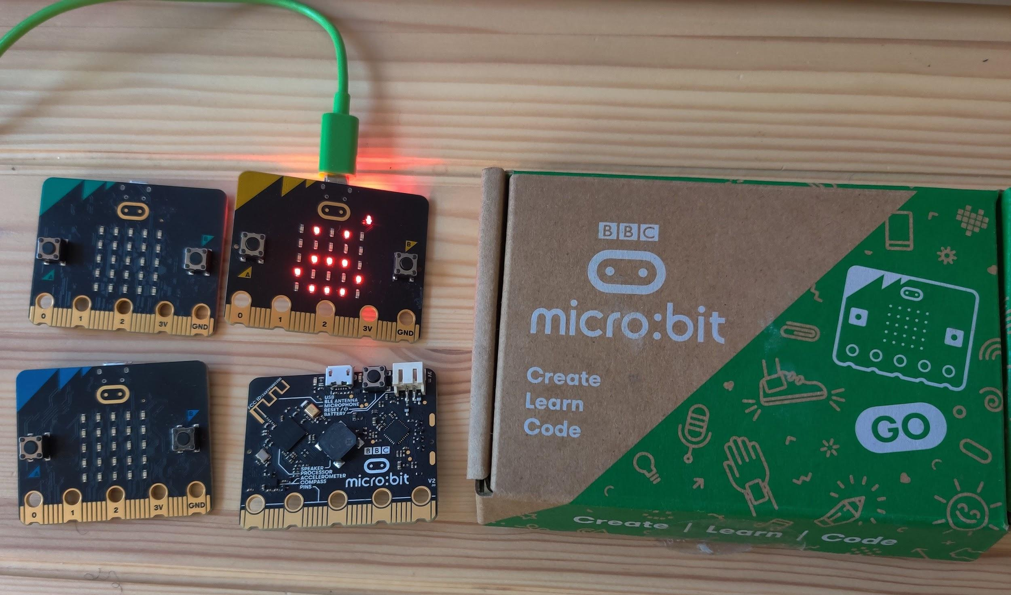
Introduction to the micro:bit
Diane Horvath and Katie Henry

Slide 2
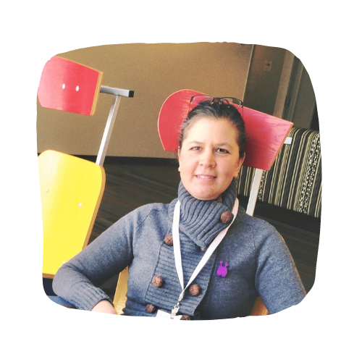
Katie Henry, M.Ed
Head of Partnerships, North America
Micro:bit Educational Foundation
Former elementary and middle school teacher
Diane Horvath, M.Ed
Technology Integration/MakerSpace Specialist Medfield Public Schools (MA) #MicrobitChampions
@microbit_edu @katiehenrydays
@techmonstaah
@techmonstah

Slide 3
Goals
What is a micro:bit?
Teach with micro:bit classroom
Explore 18 units, 79 activities & more
Answer your questions
what is a micro:bit? micro:bit classroom explore activities

Slide 4
skills
ideas
smile
what is a micro:bit? micro:bit classroom explore activities

Slide 5
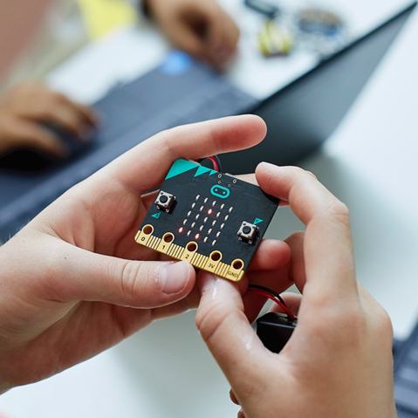
What is a micro:bit?
25 million students
70 countries
250+ accessories
Python, JavaScript, MakeCode, Scratch, and more
what is a micro:bit? micro:bit classroom explore activities

Slide 6
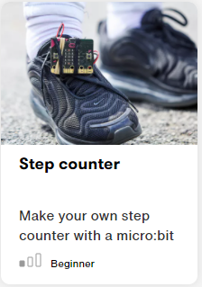
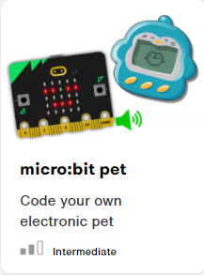
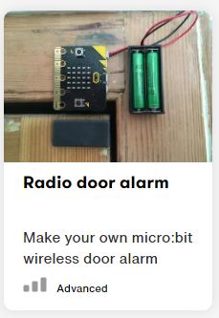
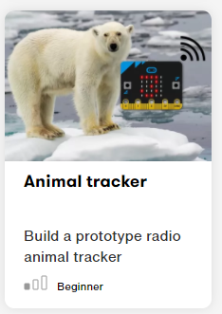
Students create technology with the micro:bit

Slide 7
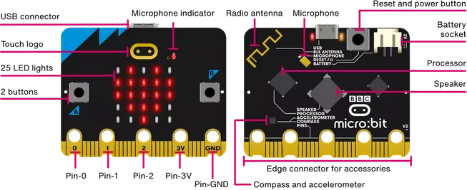
What is a micro:bit?
what is a micro:bit? micro:bit classroom explore activities

Slide 8
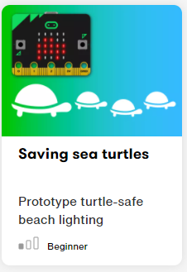
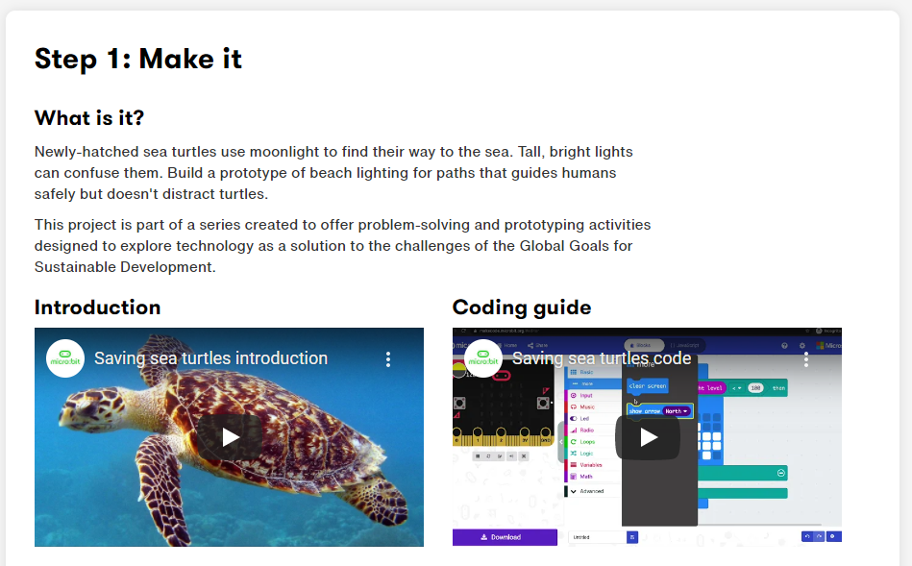
What is a micro:bit?
Let’s code!
what is a micro:bit? micro:bit classroom explore activities

Slide 9
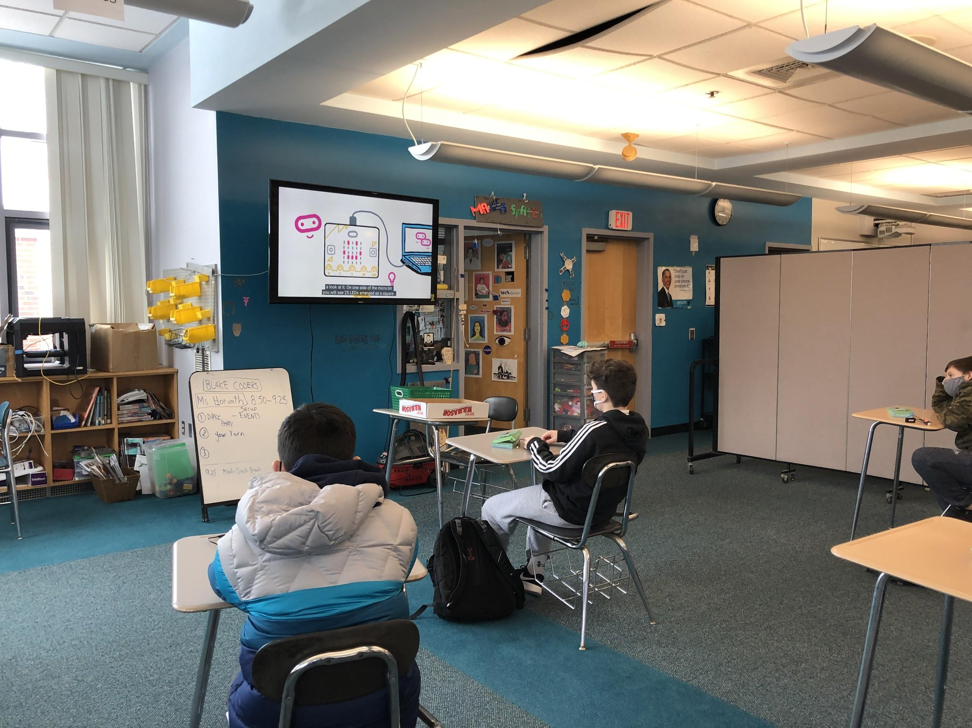
In the Classroom
MAKECODE.MICROBIT.ORG
Entry Points
Scaffolding Choice Independence Cross Curricular
Digital Workflow

Slide 10
Rock Paper Scissor
Classic Non-Tech Game Teaches Conditionals, LED displays, Input 3 Parts: Code, Flash to Device Play
40 Minute class

Slide 11
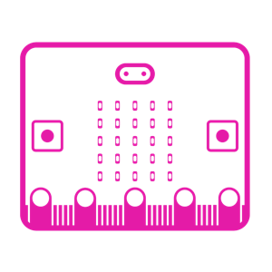
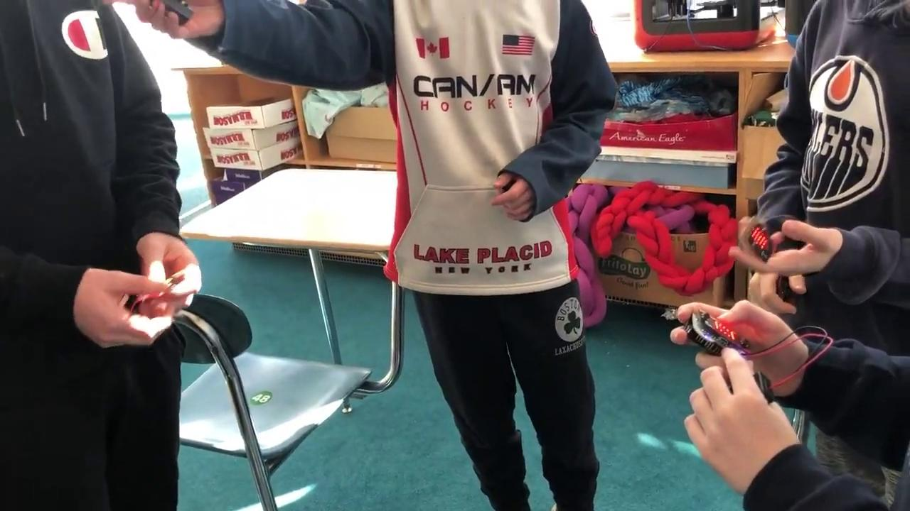
Rock Paper Scissor
Options for Playing:
Tournament Style
Remote shares screen + In-Person on Webcam
Hand vs. Micro:bit

Slide 12
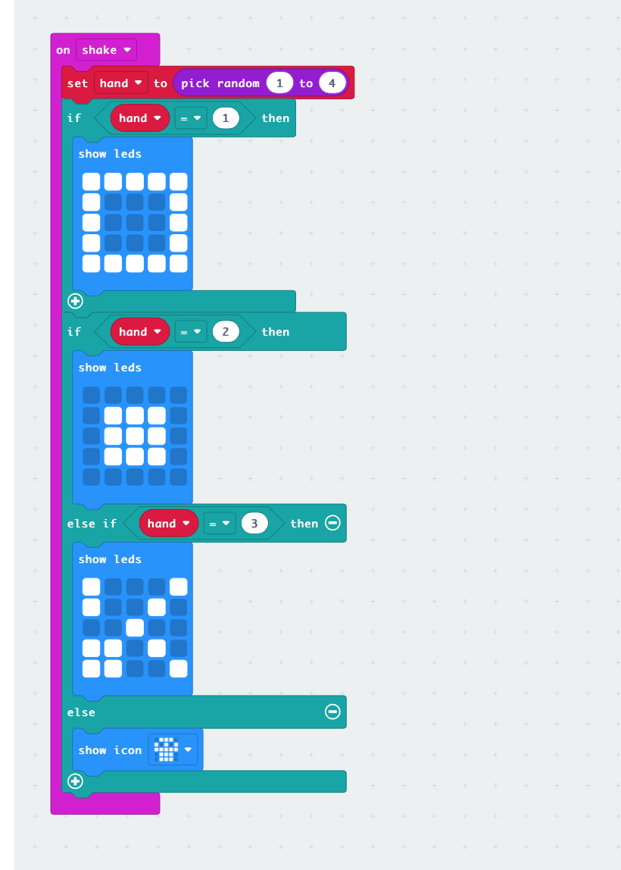
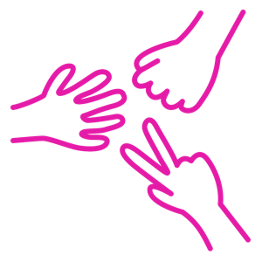
HACK Rock Paper Scissor
Easily build upon code to demonstrate understanding, creativity and engagement.
Hack peers code by sharing & editing!

Slide 13
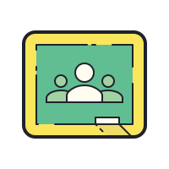
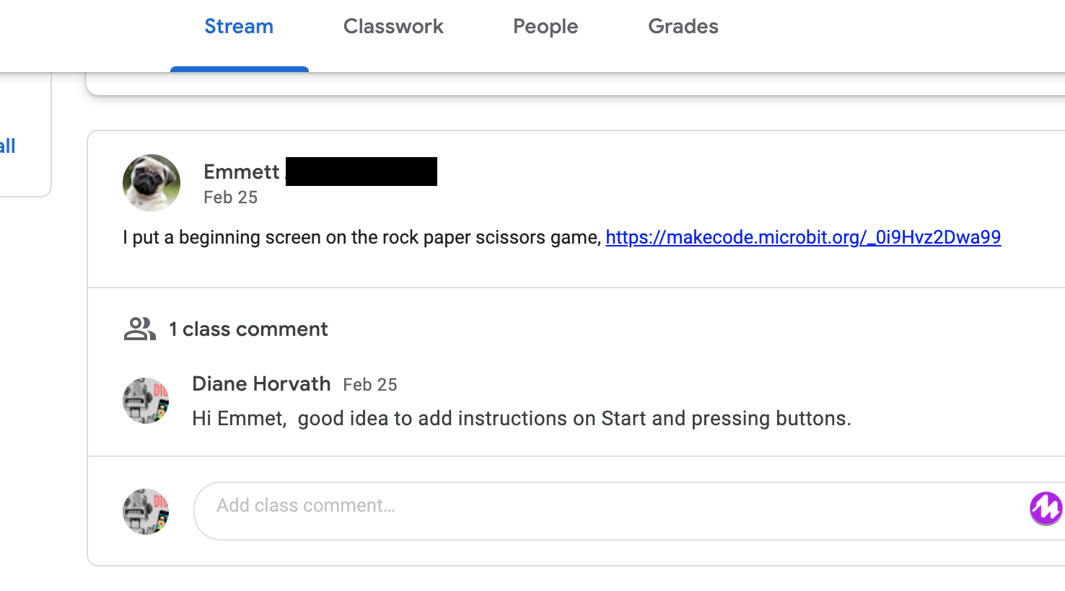
SHARING: Rock Paper Scissor
PUBLISH LINK TO COPY & PASTE IN GOOGLE CLASSROOM STREAM
Easy & In place
Add to Stream for peers to access, view, change and play.
Check code as a group.
Leave each other Feedback.

Slide 14
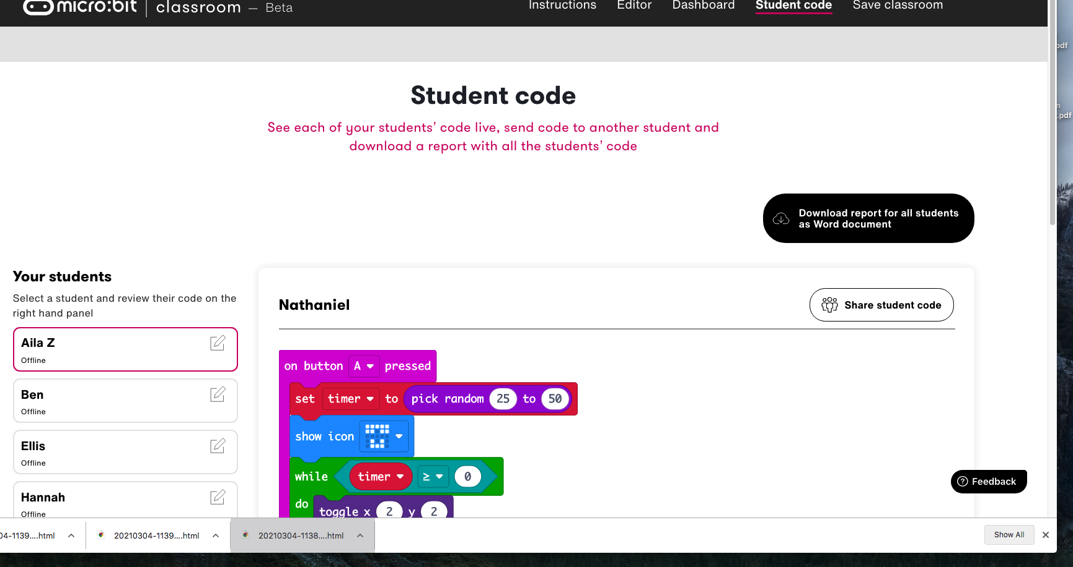
CODING WORKFLOW
Micro:bit Classroom
Real-time access to seeing students code.
Share code to & from students directly.

Slide 15
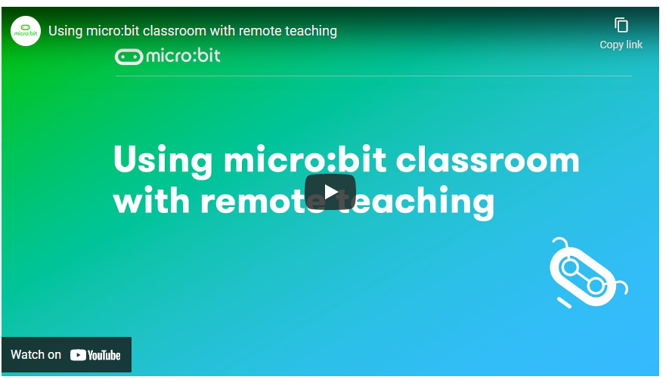
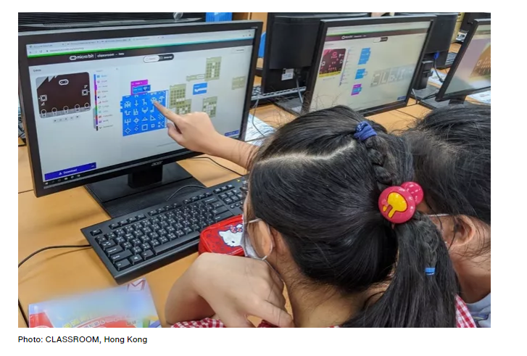
How can I teach with the micro:bit?
micro:bit classroom
what is a micro:bit? micro:bit classroom explore activities

Slide 16
micro:bit classroom
Organize and manage a remote classroom
push out code (MakeCode or Python)
collaborate
collect assignments
No student accounts
Virtually “look over a student’s shoulder”
help troubleshoot remotely
Let’s code!
what is a micro:bit? micro:bit classroom explore activities

Slide 17
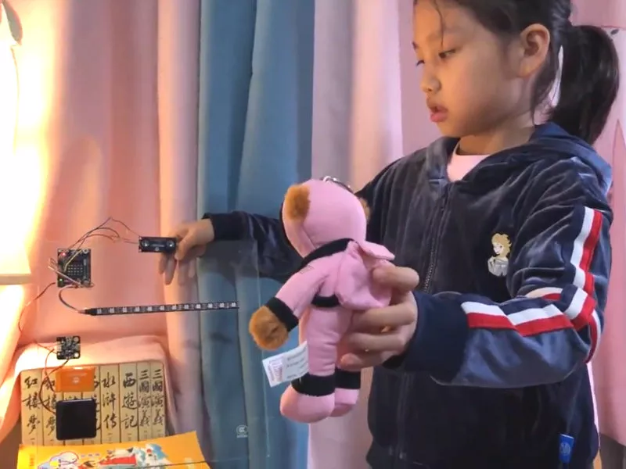
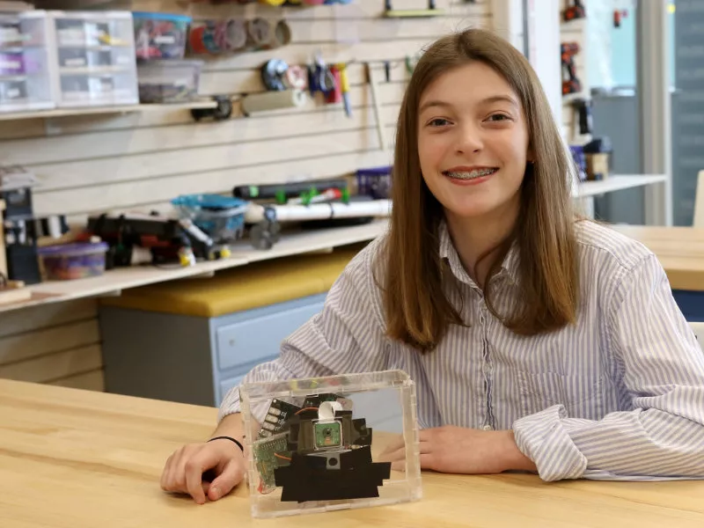
micro:bit do your :bit challenge
Bird-safe glass
Prevent deforestation
what is a micro:bit? micro:bit classroom explore activities
Notes:
​​

Slide 18
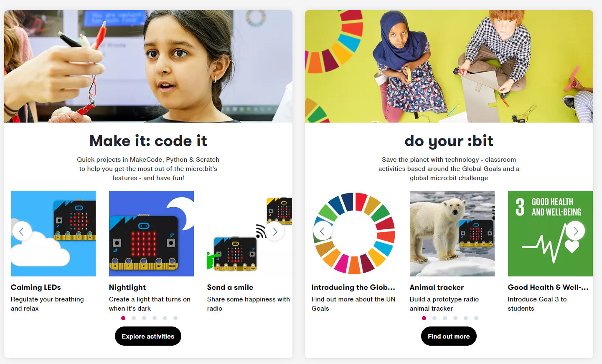
What activities and projects are there?
what is a micro:bit? micro:bit classroom explore activities

Slide 19
skills
ideas
smile
what is a micro:bit? micro:bit classroom explore activities
what is a micro:bit? micro:bit classroom explore activities

Slide 20
Questions?
Thank you
@microbit_edu
what is a micro:bit? micro:bit classroom explore activities

