Slide 1
Sarah FitzHenry
Learning and Community Manager
Jenna Kindler
Business Manager
Social Emotional Learning with Robotics

Slide 2
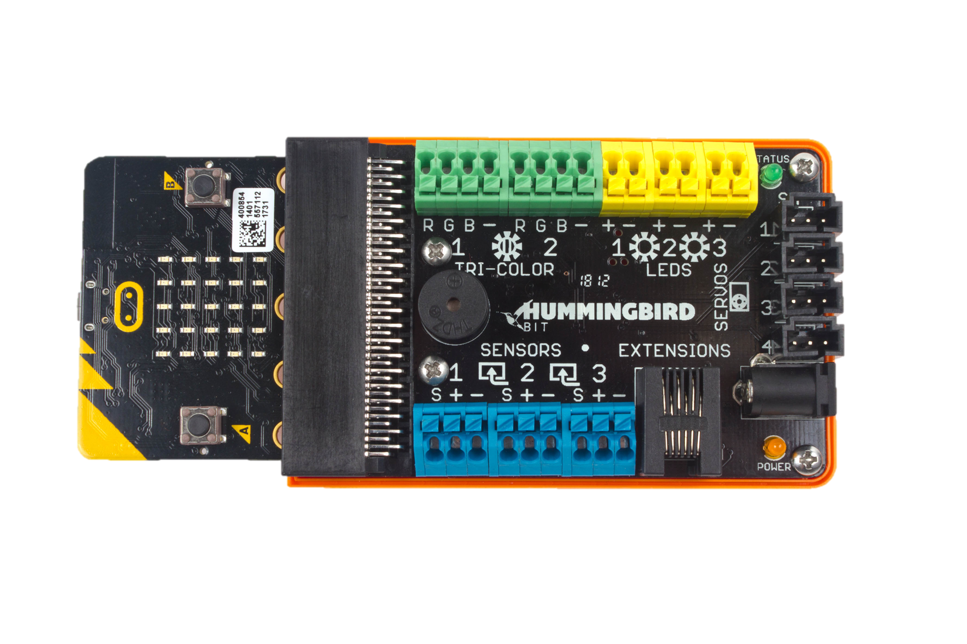
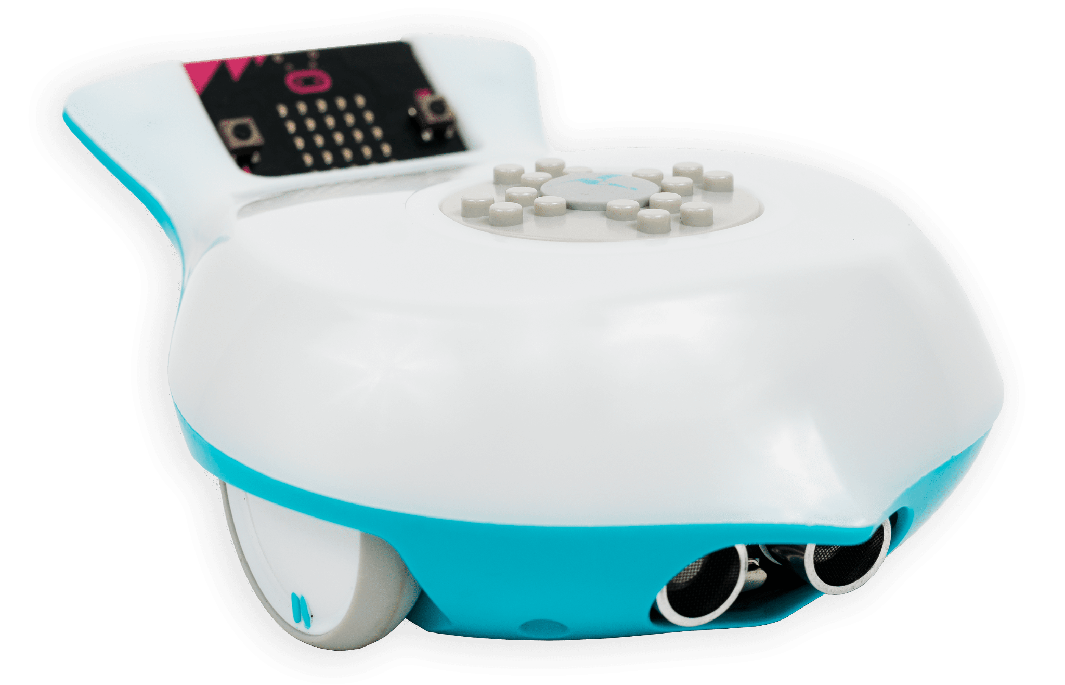
Outline
Link to slides: https://bit.ly/BirdBrainSEL
Meet BirdBrain Technologies
Meet our robots
Highlighting SEL through robotics
Accelerated learning through robotics
Free teacher resources

Slide 3
BirdBrain Technologies
Spun out of the Robotics Institute at Carnegie Mellon University
Created to promote gender equality and diversity in computer science and robotics
Research is funded by the National Science Foundation
Believe that the best way to reach students is by supporting teachers - which is why all of our resources are FREE!
Eleven year-old company based in Pittsburgh, with remote workers along the east coast
Believe that robotics is fun, creative, and for everyone!

Slide 4
Our mission is to inspire
deep and joyful learning
in all students through creative robotics.
BirdBrain’s Mission

Slide 5
Learning materials
Free classroom- tested and standards-aligned learning materials, including programming tutorials, and lesson plans.
Low Floor & High Ceiling
Absolute beginners can build or program a robot
in minutes, but continue learning advanced engineering & programming for years.
True Interdisciplinary Learning
Integrate robotics and computer science into subjects from ELA to ecology, math to music,
and beyond.
Breaking Stereotypes
Our products were created to promote gender equality and diversity in computer science and robotics.
Professional Development
Our team of educators provide virtual professional development, including classroom and school district integration planning.

Slide 6
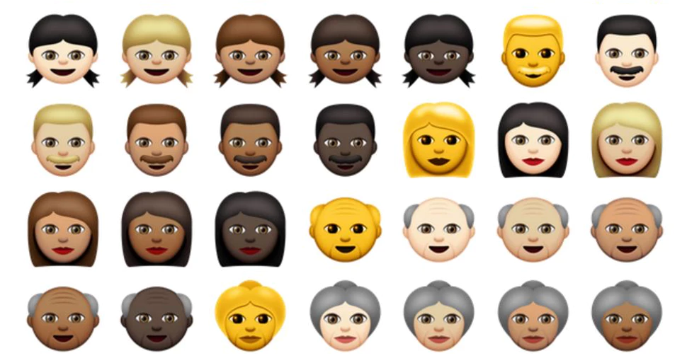
Robotics is...
Collaborative
Creative
For EVERYONE!
Engaging

Slide 7
Robotics means...
Innovation
Real-World Connection
Patience & Persistence

Slide 8
Let’s meet the robots!

Slide 9
Finch Robot 2.0

Slide 10
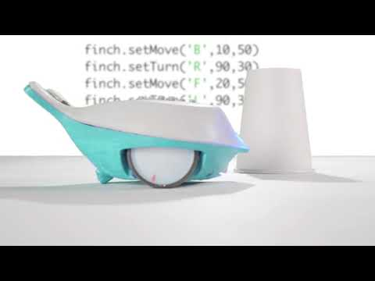
Finch Robot 2.0
Bring CS to life from kindergarten to college
Integrates 10 years of teacher feedback about Finch 1
Flexible across multiple devices and programming languages
Incredibly versatile robot that grows with students

Slide 11
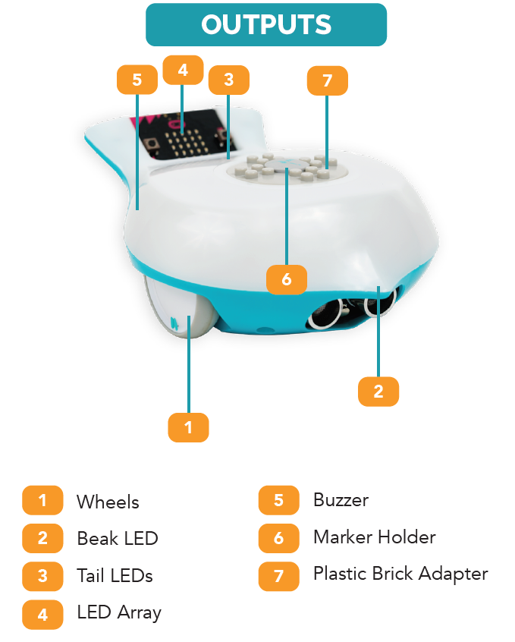
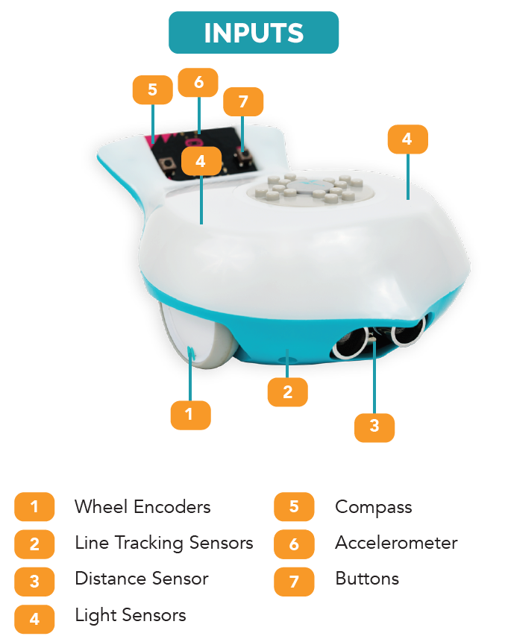
The Finch Robot 2.0 - Features

Slide 12
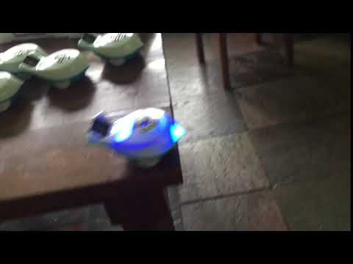
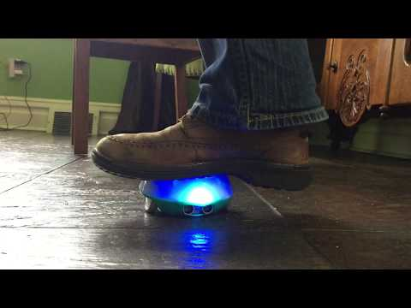
Finch Robot 2.0 - Features
Durable Design
Built around BBC micro:bit
7+ hour battery
Comes with 30+ activities, PD courses, and coding tutorials, all free!

Slide 13
Hummingbird Robotics Kit

Slide 14
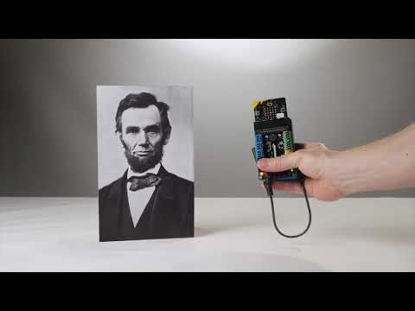
Hummingbird Robotics Kit
Hands-on CS for 4th grade and up
21st century skills and STEAM in every classroom, and every subject!
No experience required
Designed to work with friendly and familiar craft materials, recycled materials

Slide 15
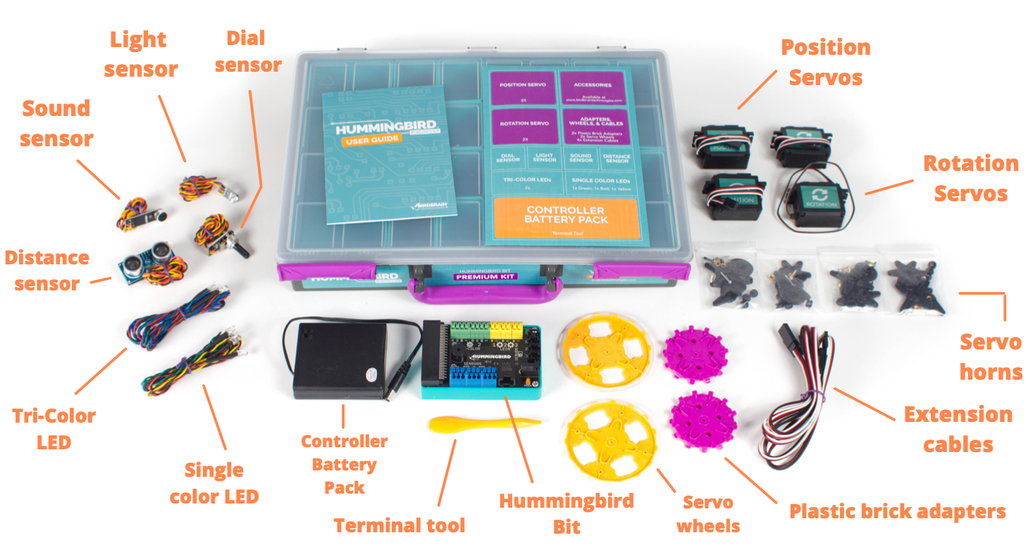
Hummingbird Features

Slide 16
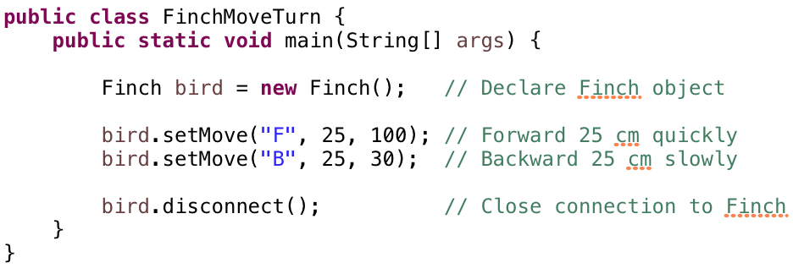
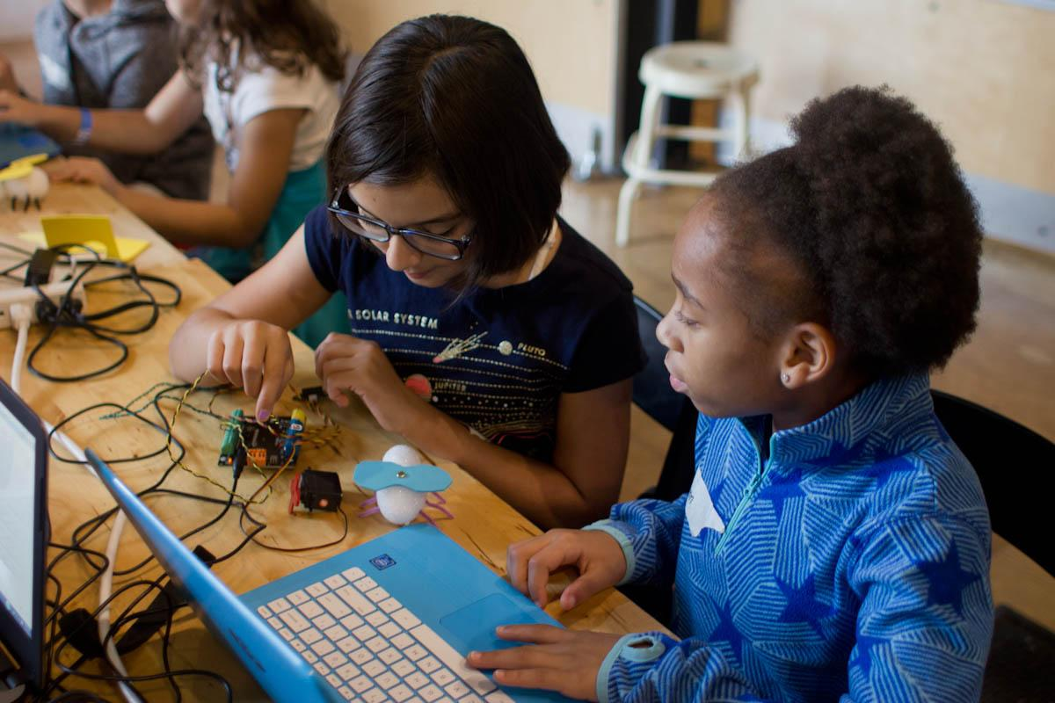
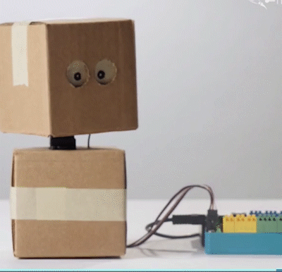
Incredible Flexibility
For All Classrooms
With Any Materials

Slide 17
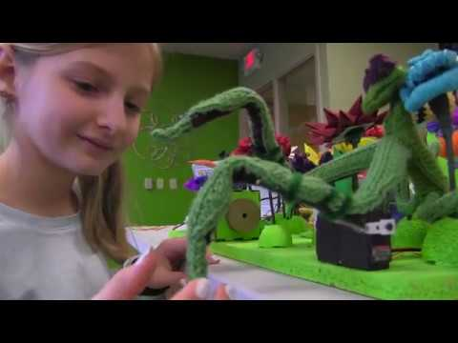
Learning with BirdBrain

Slide 18
Low Floor,
High Ceiling

Slide 19
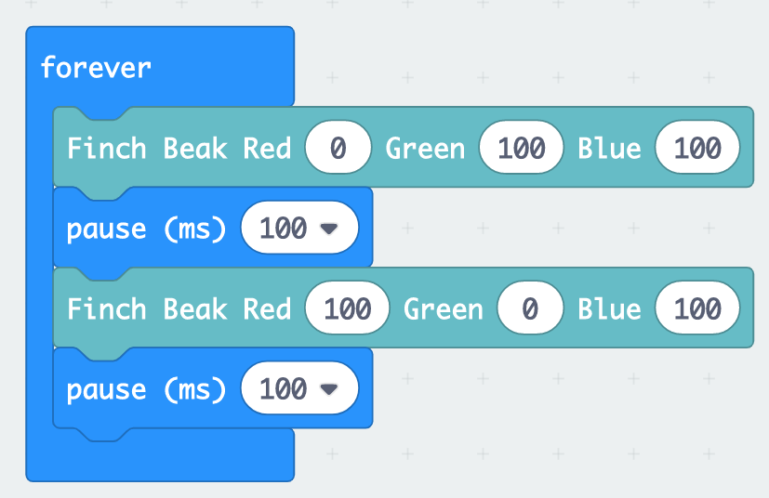
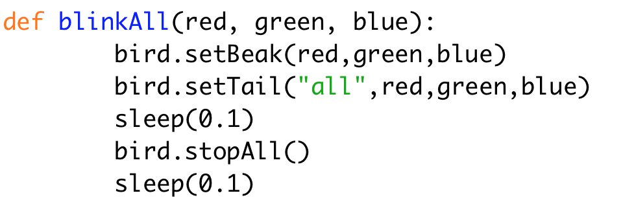
Low Floor, High Ceiling:
Coding languages
Icon-Based
Block-Based
Text-Based

Slide 20
Low Floor, High Ceiling:
Projects

Slide 21
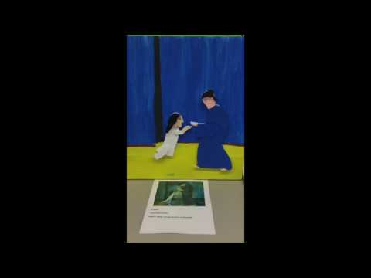
Low Floor, High Ceiling:
Projects

Slide 22
SEL & Robotics

Slide 23
Quick check in:
How do you feel about using robotics in your classes and/or classroom?

Slide 24
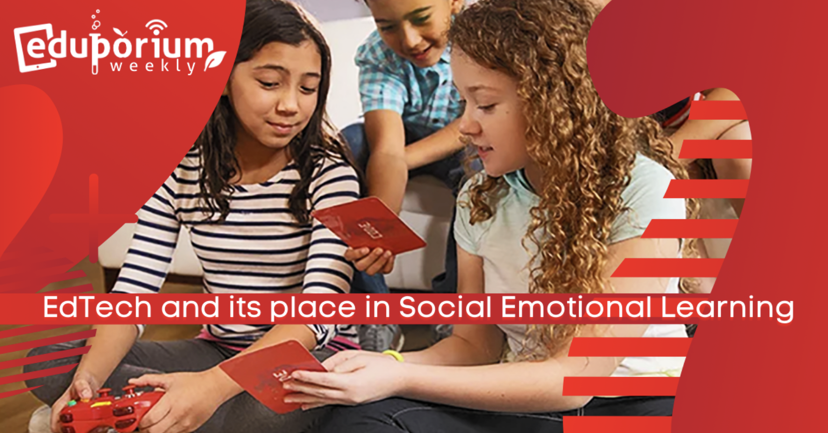
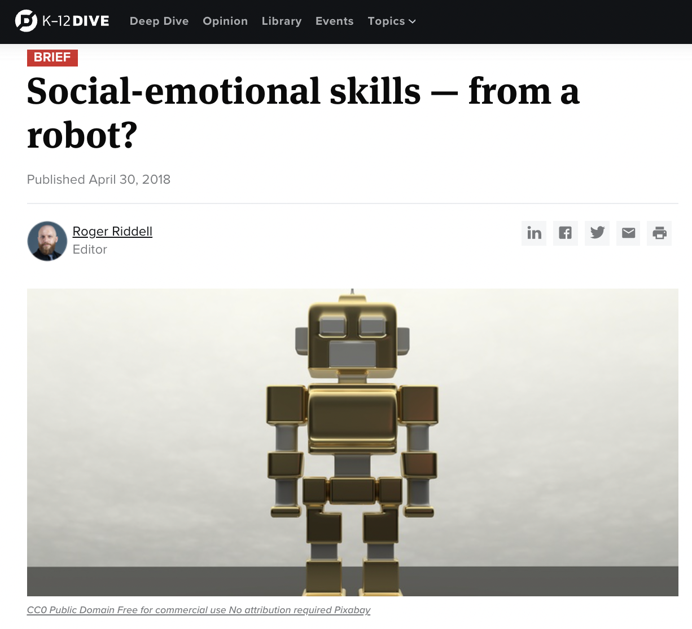
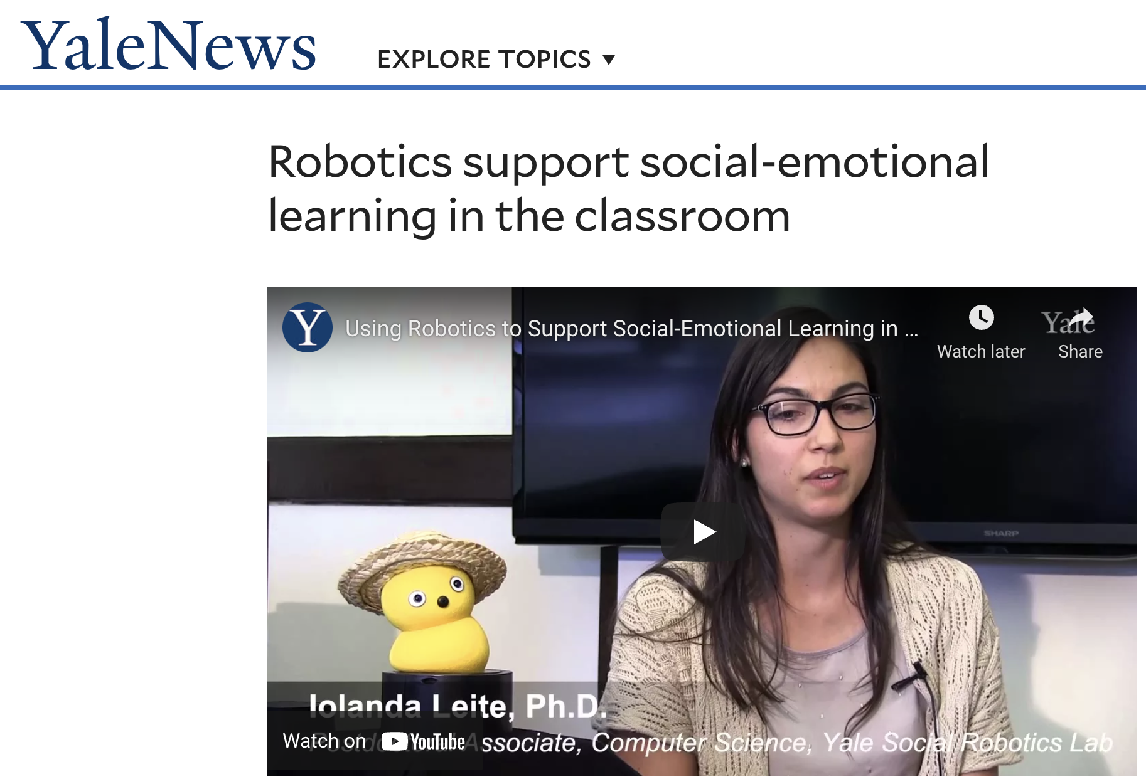
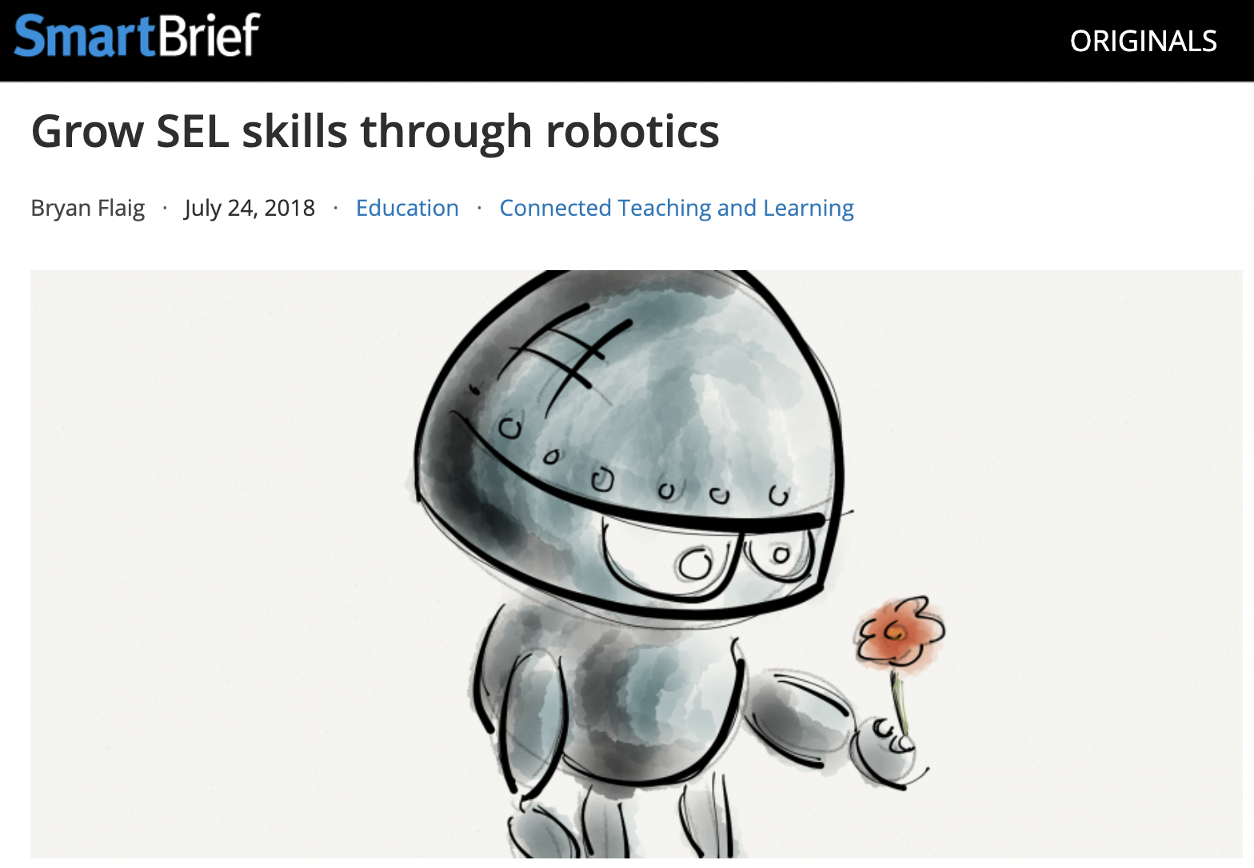
...because it works!

Slide 25
“STEM skills aren’t the only lessons students learn from robotics. Each time students set out on a robotics challenge, they are also building critical SEL skills like persistence, collaboration, critical thinking, creative innovation, and teamwork. The list goes on.
As teachers, we’re tasked with molding the next generation of leaders, engineers, doctors, and scientists. And yeah, that’s an important job. But you know what’s also important? Teaching kids how to be good collaborators, thinkers, problem-solvers, and citizens.”
Gilman, Abigail. “It Turns out Learning Robotics Teaches Valuable Social Skills.” We Are Teachers, 24 Oct. 2019, www.weareteachers.com/robotics-sel-skills/.

Slide 26
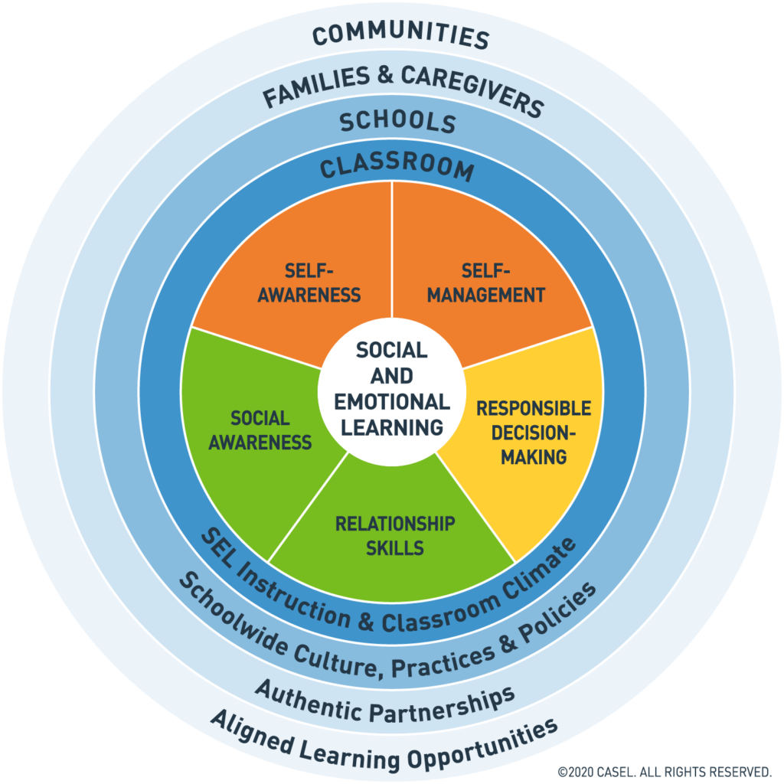
What is Social Emotional Learning?
(Source)

Slide 27
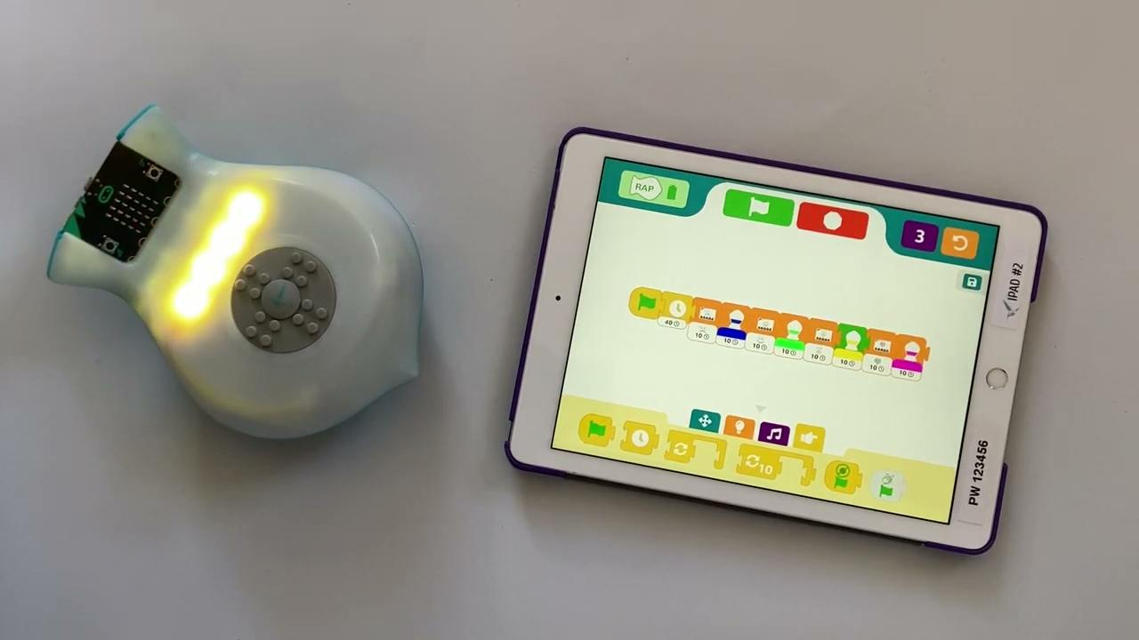
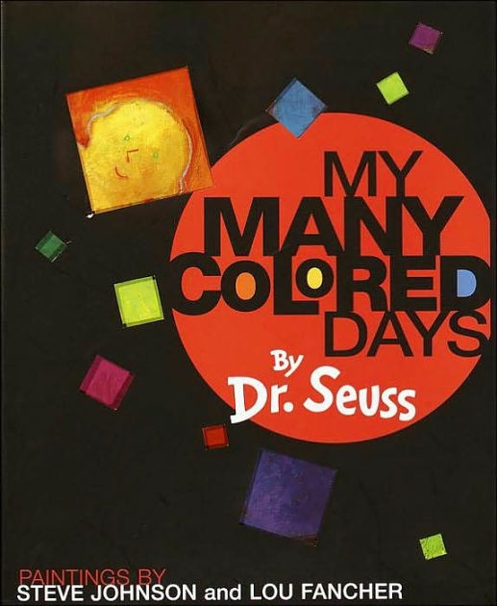
Self Awareness
What am I feeling?
Is it normal? Is it okay?
How can I best communicate how I feel?
How can I let someone know if I need help?

Slide 28
Self Awareness
Who am I?
What parts of my identity do I want to share? How do I want to share them?
What communities am I a part of? Where do I belong?
How can I share what I’m passionate about?

Slide 29
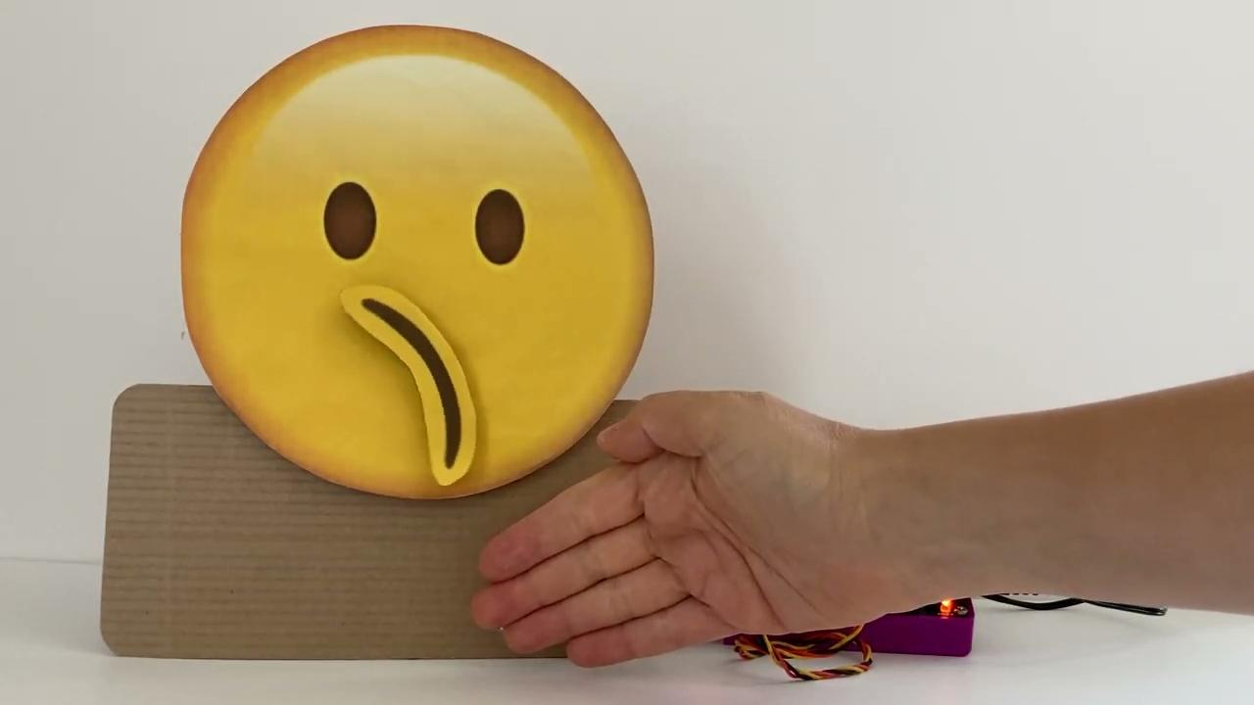
Self Management
Am I calm? Do I feel out of control?
Am I expressing my emotions appropriately and clearly?
How can I help to regulate myself?
How can I tackle this challenge or task?
How can I focus and finish my work?

Slide 30
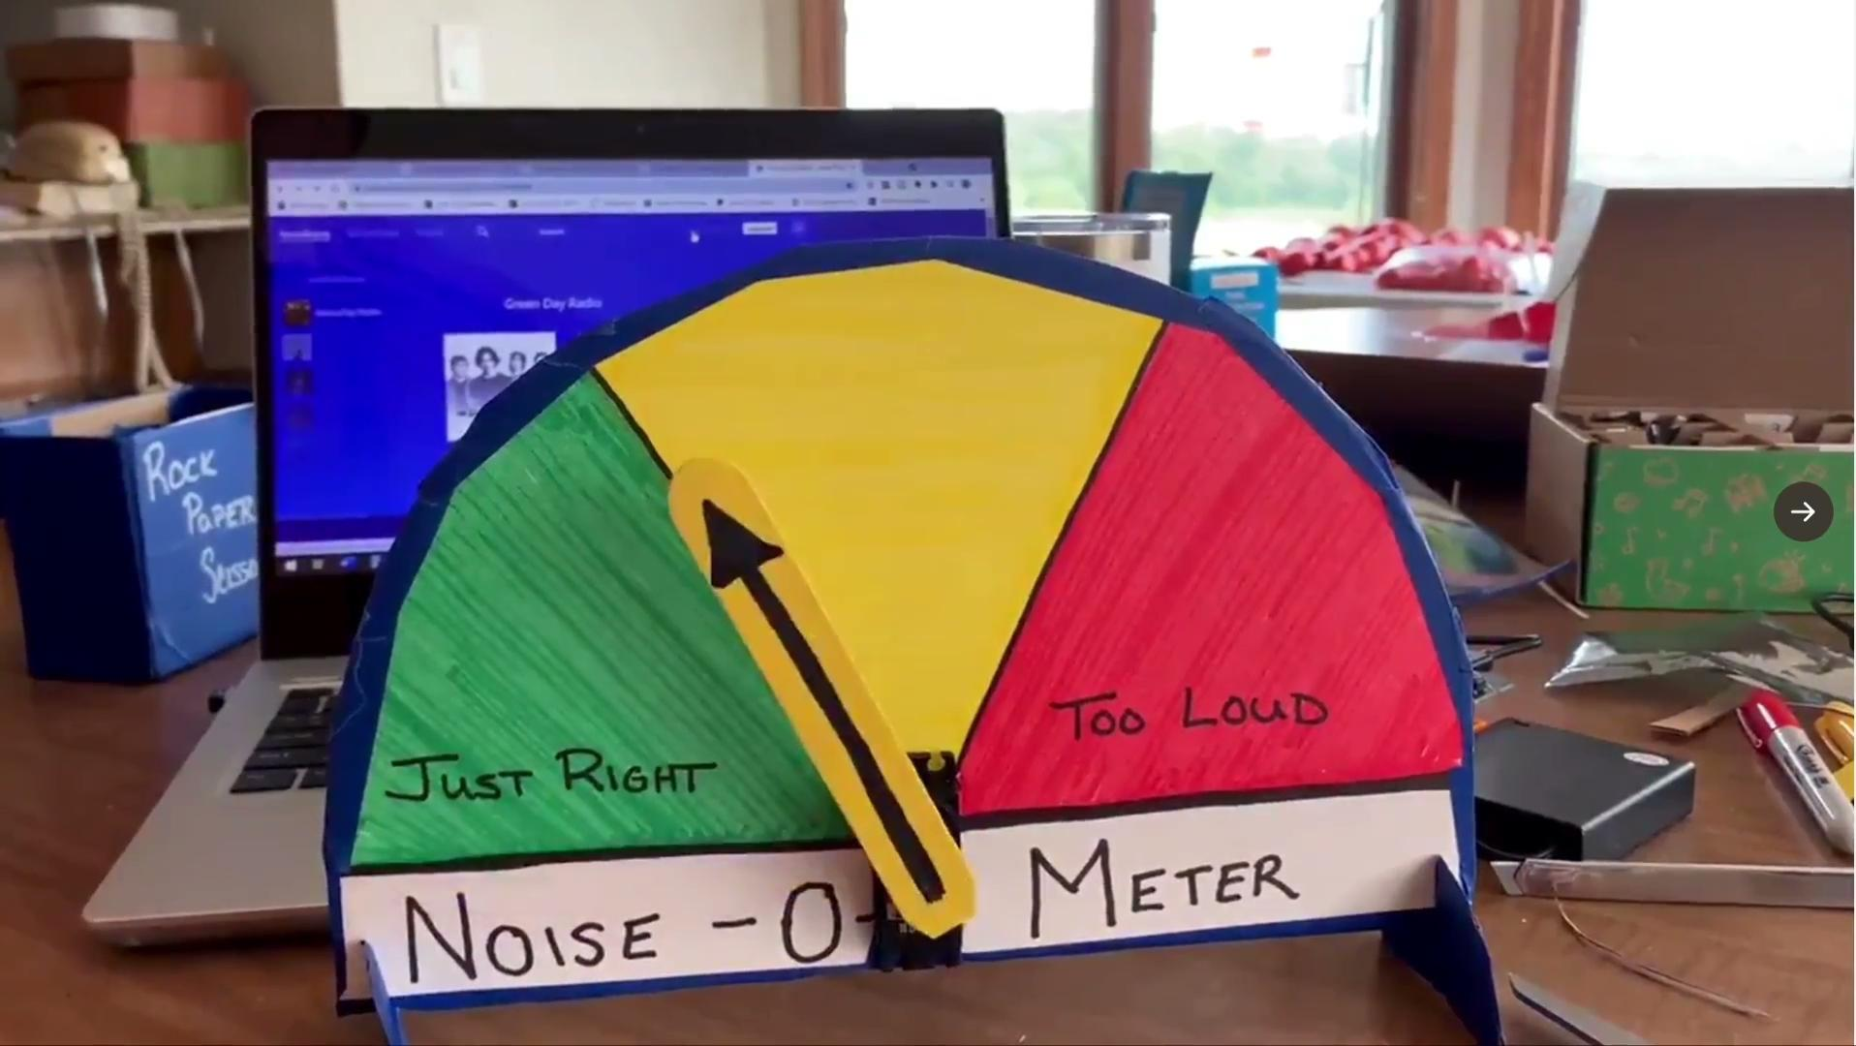
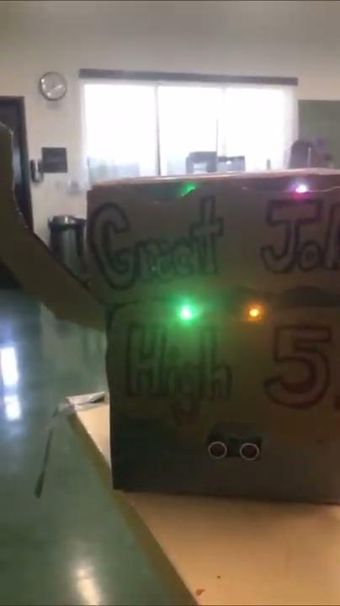
Responsible Decision Making
How do my actions impact me, my community, and the world?
What are the emotions behind this decision?
What possible approaches or solutions can I consider?
What have I learned from my past decisions that might be helpful?
Did my actions help me reach my goal?

Slide 31
Relationship Skills
How is that person feeling? How can I be sure?
What does a strong and healthy friendship look and feel like? How can I build one?
How can I resolve a conflict with a friend or teammate?
What makes communication effective?
How can I be a good leader and teammate?

Slide 32
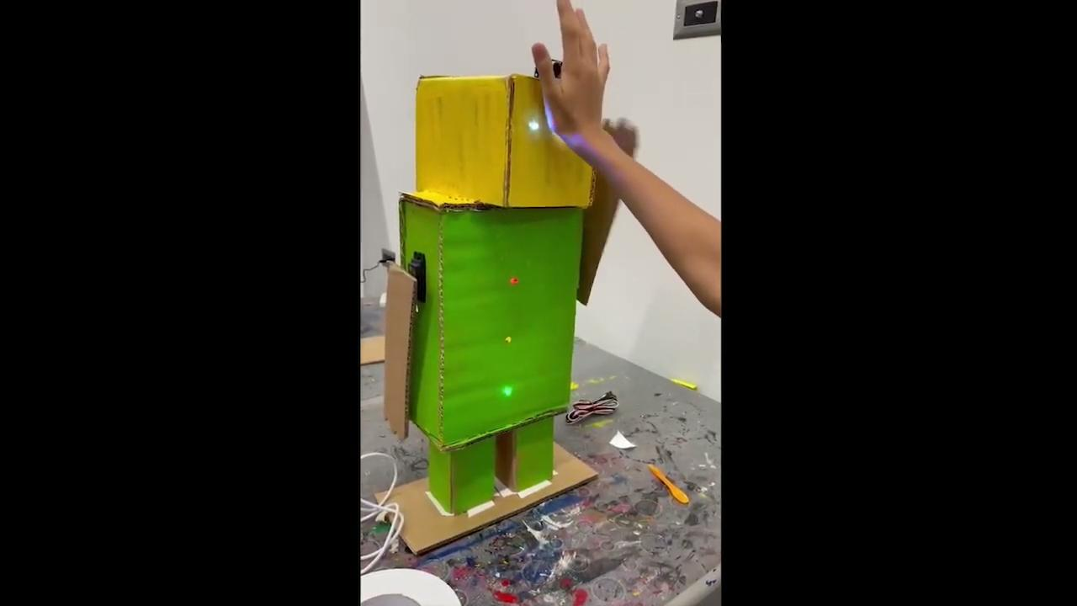
Social Awareness
What does this look and feel like from a different point of view?
Am I getting the whole story? What other perspectives do I need to consider?
What does it feel like to step into someone else’s shoes?
How would I feel if I was there/that happened to me?

Slide 33
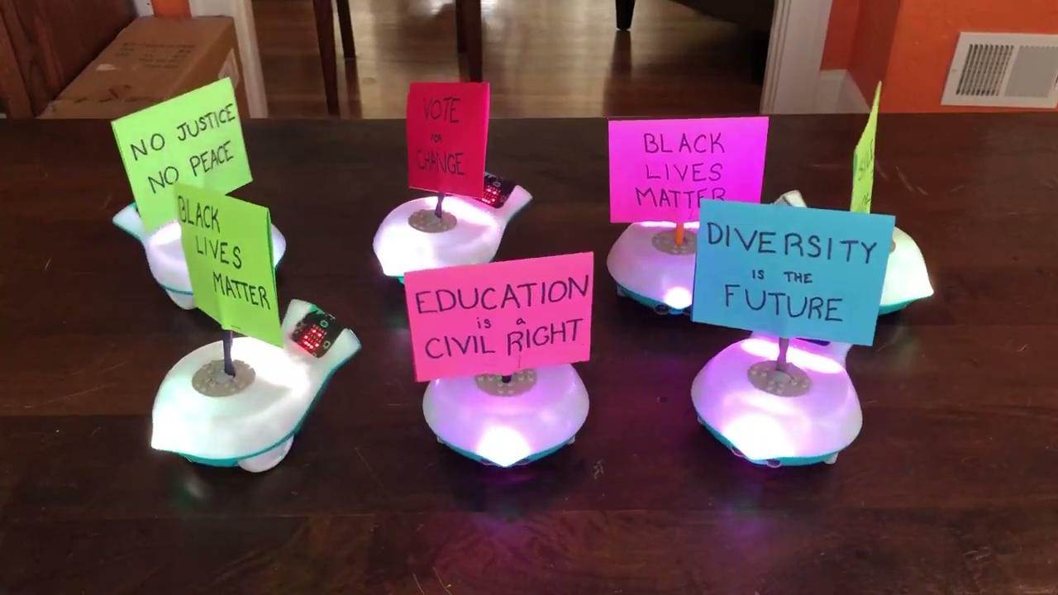
Social Awareness
How can I help someone that needs a hand?
What is the social norm? Do I agree with it?
What is my role in this global/national/community issue?
Where does change come from? Who does it come from?
Can I make a difference? How?

Slide 34
Questions about
SEL and robotics?

Slide 35
Accelerated Learning & Robotics

Slide 36
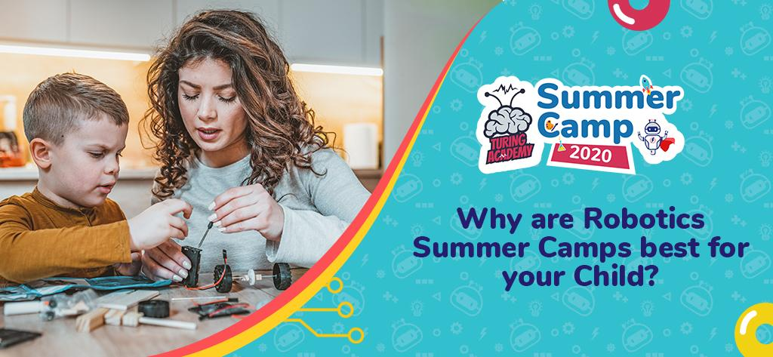
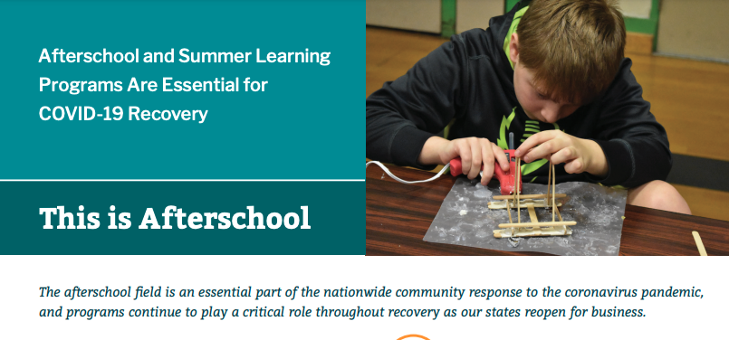
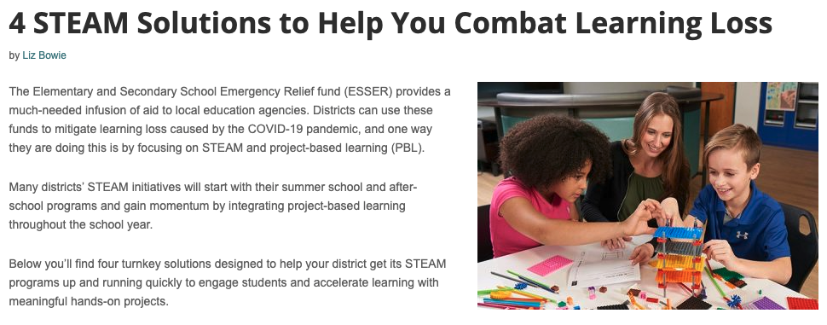
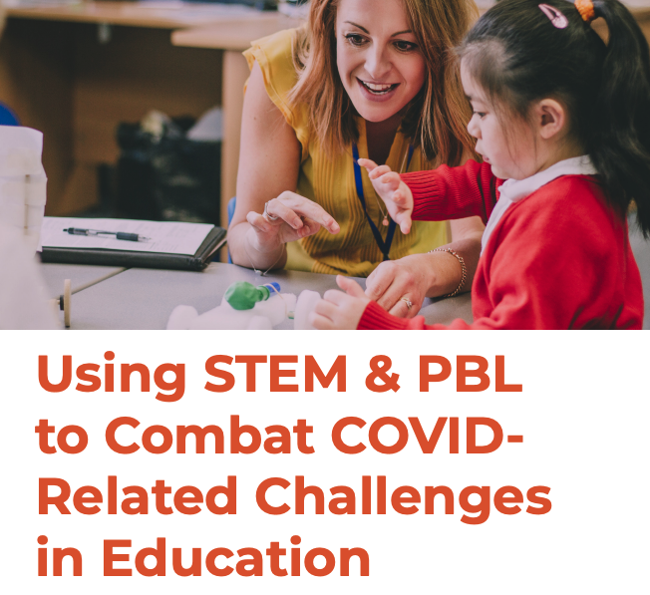
...why robotics?

Slide 37
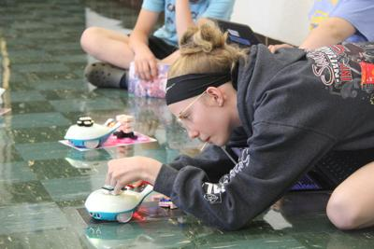
Increased Engagement
Hands-on and project based, for incredible student engagement and motivation

Slide 38
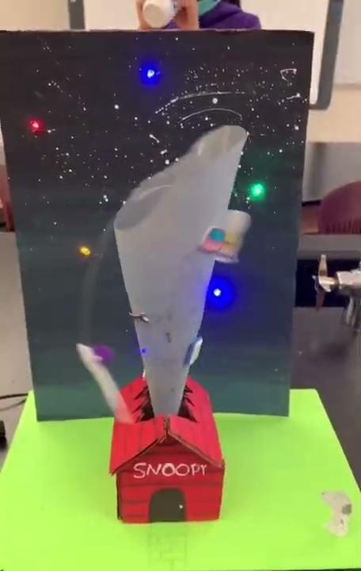
Interdisciplinary Learning
Get the most out of instructional time and student curiosity by connecting multiple content areas, electives, specials/resource classes… there is no limit!
Science, English Language Arts, Art, STEM
English Language Arts, Drama, STEM

Slide 39
Natural Real-World Connections
Brainstorming and prototyping solutions to real-world problems makes students feel connected, important, and creates thoughtful, successful global citizens

Slide 40
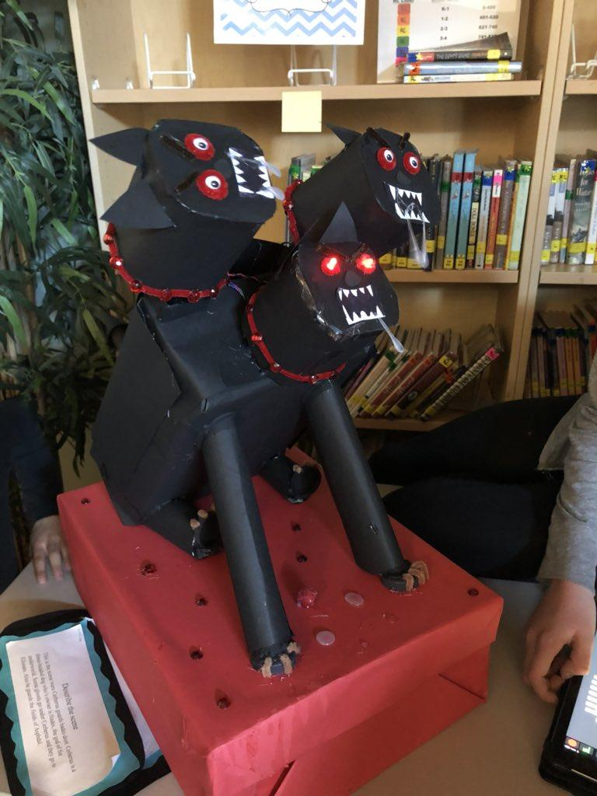
Authentic Assessment Opportunities
Honor and celebrate students’ unique identities with myriad opportunities to showcase learning.

Slide 41
Did you know?
Educational technology tools can be purchased with funds from:
Title I
Regional & Corporate Grants
ESSER II Jan 2022 (Coronavirus Response & Relief Supplemental Appropriations Act)
ESSER III March 2022 (American Rescue Plan)
Grant Assistance
Research-based Statements
Demo Program
aintech

Slide 42
Free Learning Materials

Slide 43
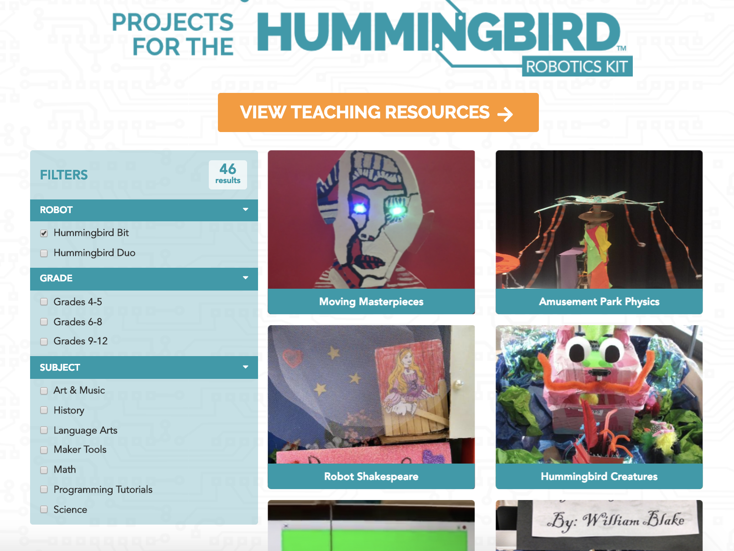
Hummingbird Projects
Hummingbird Projects

Slide 44
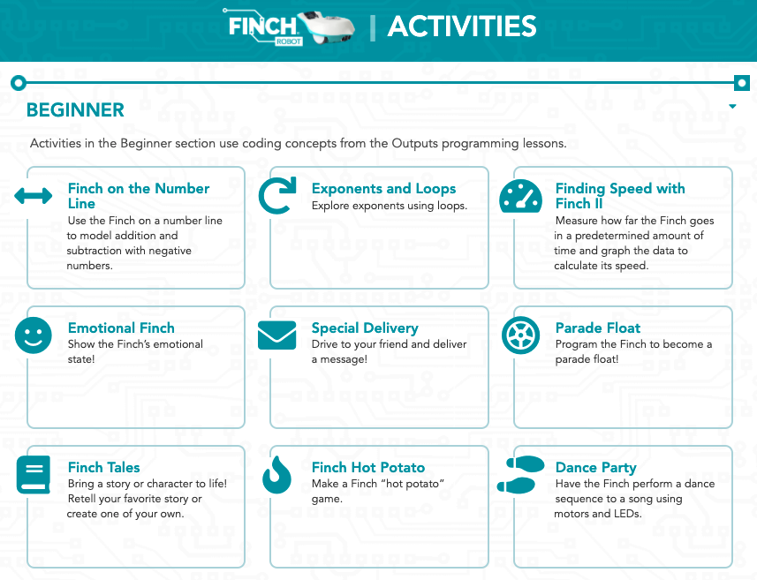
Finch Activities
Finch Activities

Slide 45
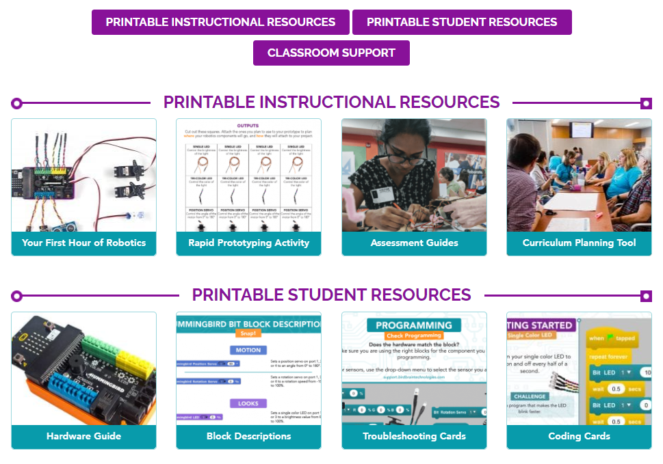
Resources
Hummingbird
Finch

Slide 46
Free Professional Development
Hummingbird
Finch

Slide 47
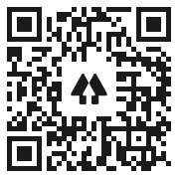
Questions?
Contact Us!

