Slide 1
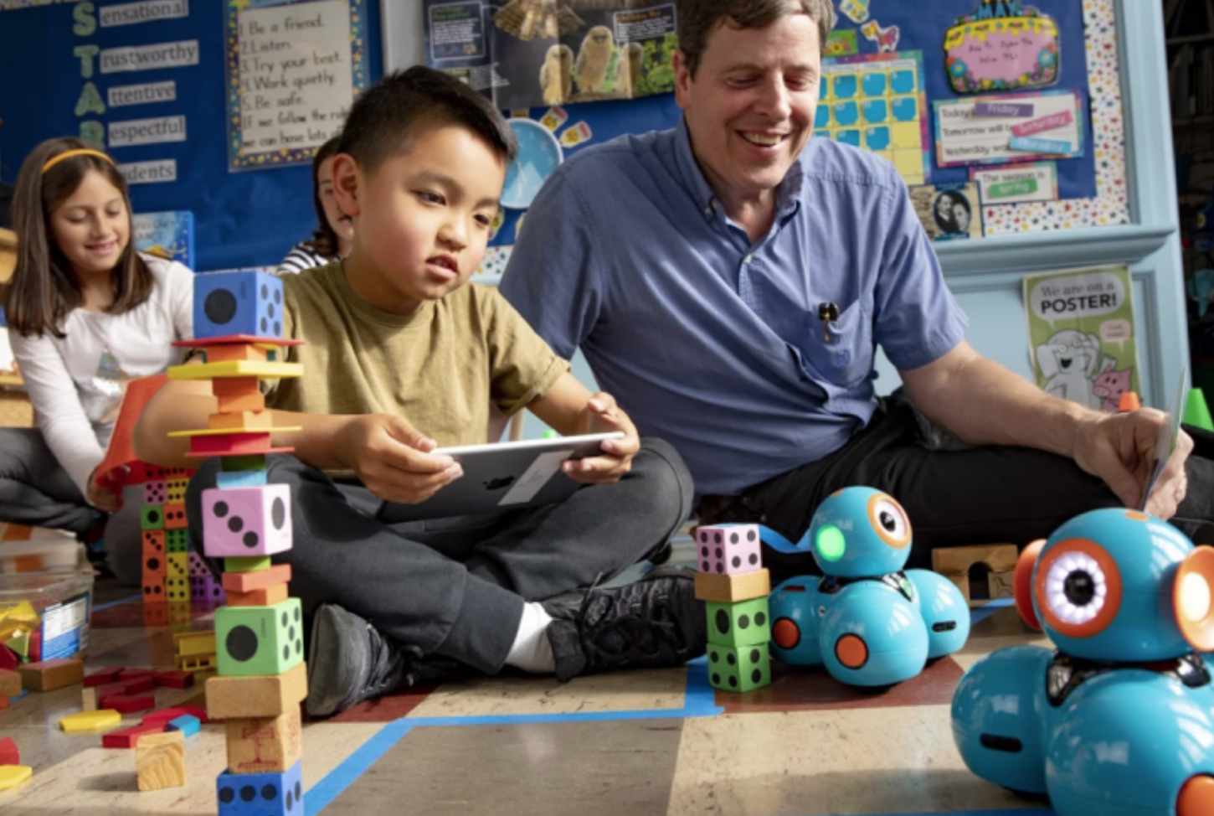
Learning loss? Not with Wonder Workshop

Slide 2
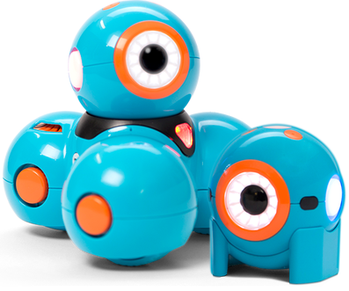
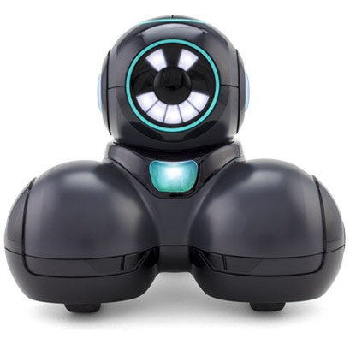
We are Wonder Workshop
Headquartered in San Mateo, California
Makers of the award-winning Dash, Dot and Cue robots, apps and curriculum
Dash, Dot, Cue, and their companion apps are COPPA compliant and COPPA certified. Wonder Workshop works with kidSAFE, which is one of a very few organizations approved by the FTC to confer COPPA Certification, which is reviewed annually under the Safe Harbor program
Our mission is to inspire every home and classroom to be a place of innovation–where children, parents, and teachers solve problems of the future using our tools and curriculum
www.makewonder.com
Notes:
Founded in 2012, Wonder Workshop is a dynamic startup made up of passionate and motivated team members. Although we began in the obligatory Silicon Valley garage, with ideas jotted down on the necessary napkin manifesto, Wonder Workshop has grown up and is headquartered in sunny San Mateo, CA, with offices around the globe. And our small, but mighty robots have reached far and wide.
https://www.makewonder.com/about/

Slide 3
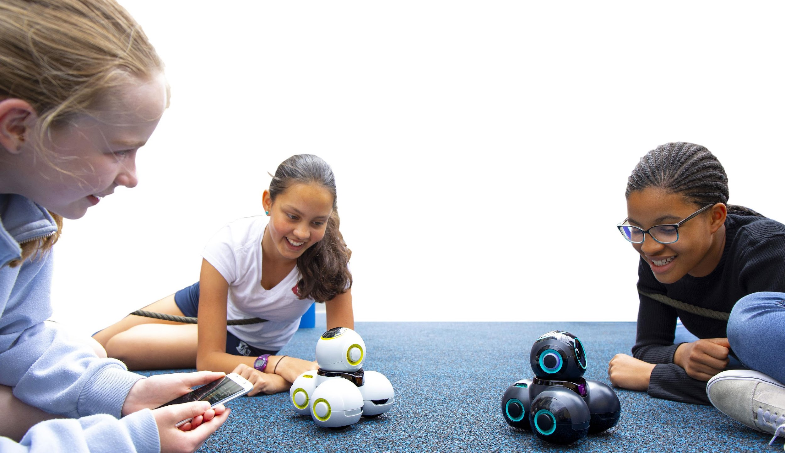
Why teach with Robotics?
Engagement
Coding
Critical Thinking
Collaboration
Communication
Perseverance
Computational
Thinking
Mathematical reasoning
Creativity
Design Thinking
Problem Solving
Robotics has been shown to be a superb tool for hands-on learning, not only of robotics itself, but of general topics in science, technology, engineering, and math (STEM)*
Engineering
Source: Code.org 9/2018
Notes:
6 reasons for coding in K-5 classrooms by Team ISTE (International Society for Technology in Education) Coding for kids: Reasons kids should get started, and how they can find success from iDTech - the world's go-to summer STEM educator.

Slide 4
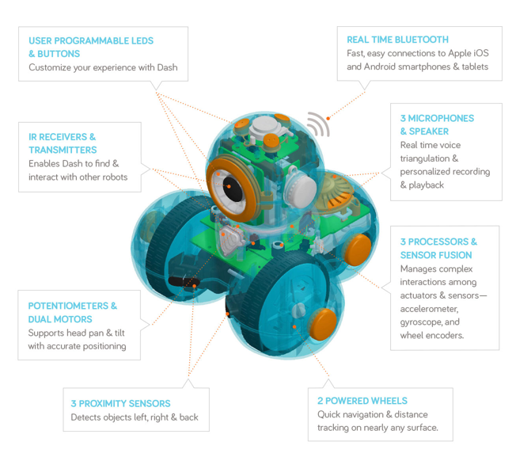
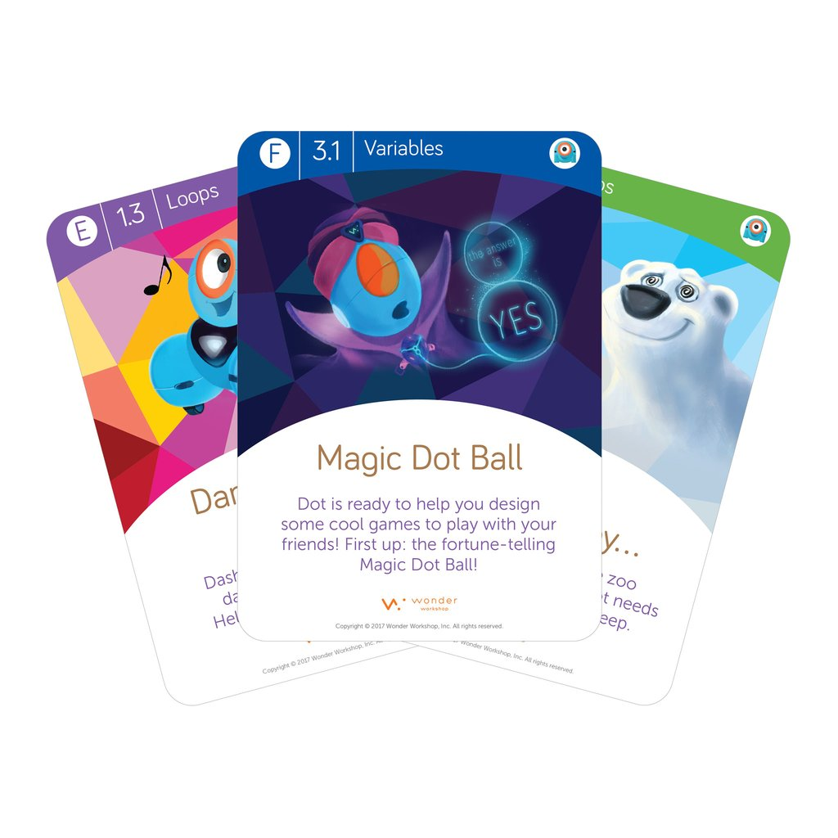
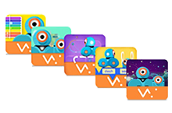
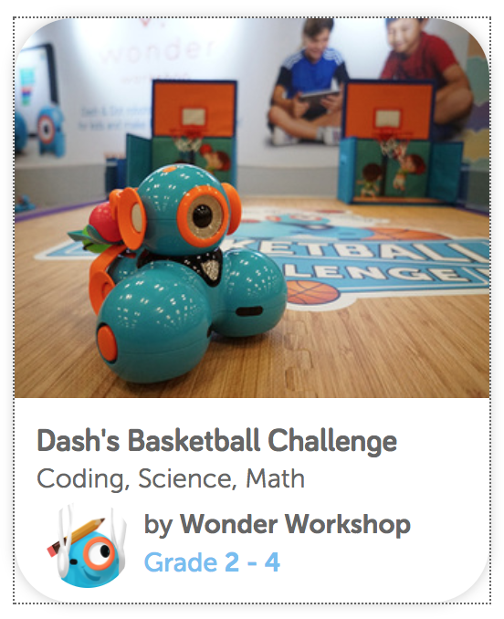
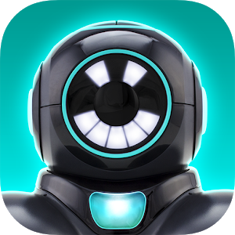
Implemented Solid Solution Strategy
A combination of free and easy-to-use apps, technically advanced yet rugged robots, and aligned curriculum for students as young as 5
Notes:
Our apps (Go, Path, Xylo, Wonder, Blockly and Cue) are FREE and collect no student data “Go” and “Path” apps are non-reading apps - perfect for pre-K and younger learners.
Learn more about our apps online https://www.makewonder.com/apps See our curriculum offerings online: https://education.makewonder.com/curriculum

Slide 5
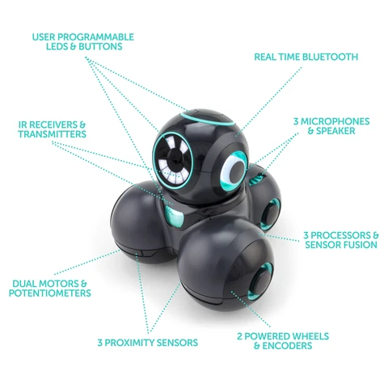
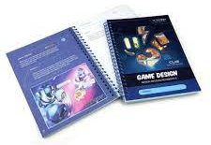
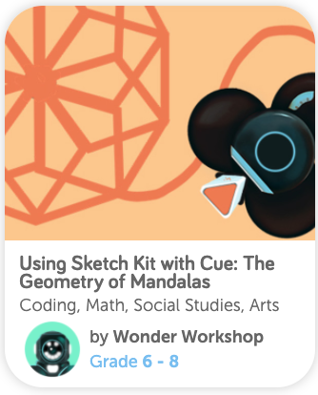
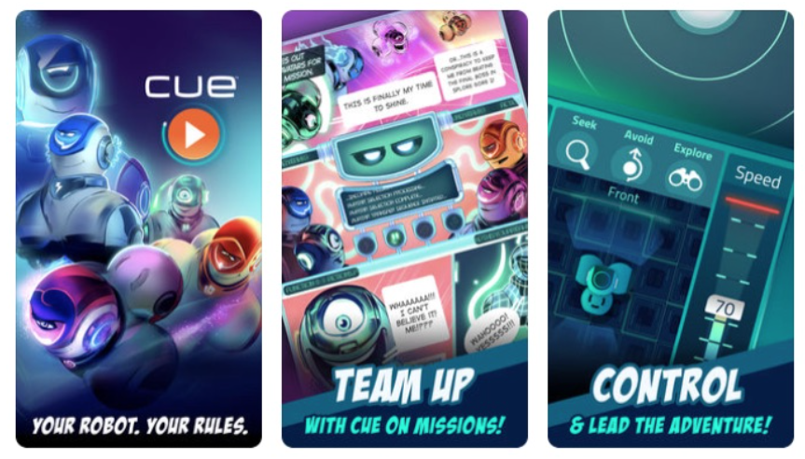
Implemented Solid Solution Strategy
A combination of free and easy-to-use apps, technically advanced yet rugged robots, and aligned curriculum for students up to 8th grade
Notes:
Our apps (Go, Path, Xylo, Wonder, Blockly and Cue) are FREE and collect no student data “Go” and “Path” apps are non-reading apps - perfect for pre-K and younger learners.
Learn more about our apps online https://www.makewonder.com/apps See our curriculum offerings online: https://education.makewonder.com/curriculum

Slide 6
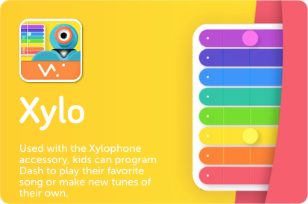
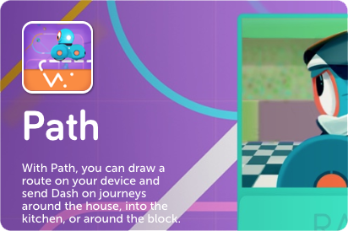
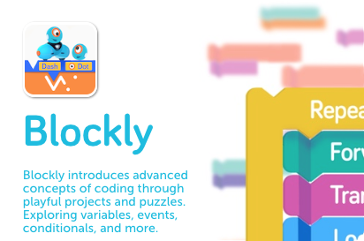
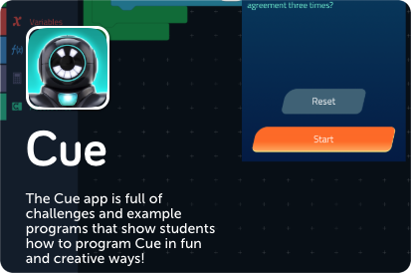
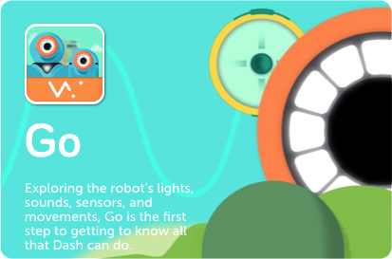
Hours of coding in the palm of your hand.
Prek-2nd grade non reading apps
2nd-5th grade apps
6-8th grade app
The free in-app challenges give kids hundreds of hours of STEM learning in fun and engaging ways. Kids can give Dash, Cue, and Dot voice commands, explore sequences, loops, functions and variables.
Notes:
The free in-app challenges give kids hundreds of hours of STEM learning in fun and engaging ways. Students can give Dash, Cue, and Dot voice commands, explore loops, events, conditionals, variables and sequences. It’s more than learning to code. Our robots and their companion apps offer kids an open-ended learning platform that makes tech knowledge simple and accessible, helping kids grow into confident creative architects.
The apps are available in the Apple App Store, Google Play Store, Microsoft Store, and the Amazon appstore. To determine if your device will run our apps please visit our compatibility page: https://www.makewonder.com/compatibility/

Slide 7
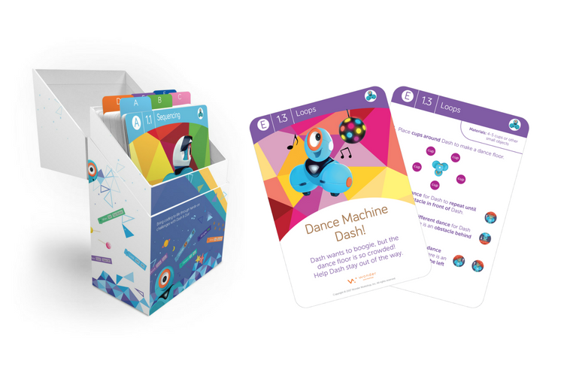
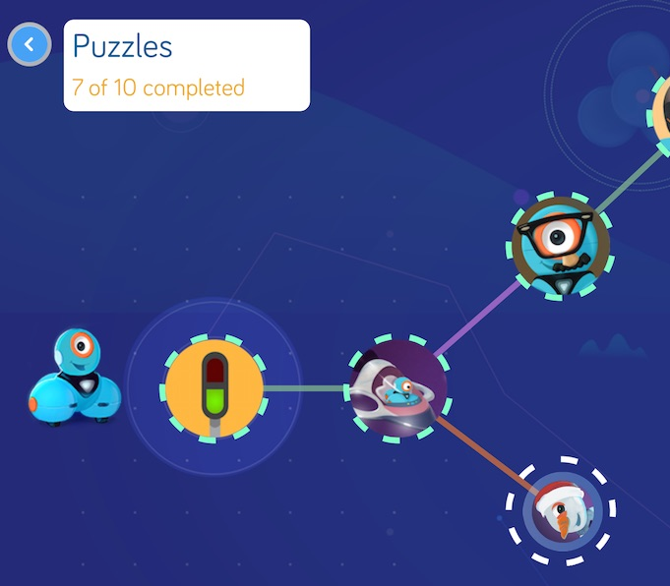
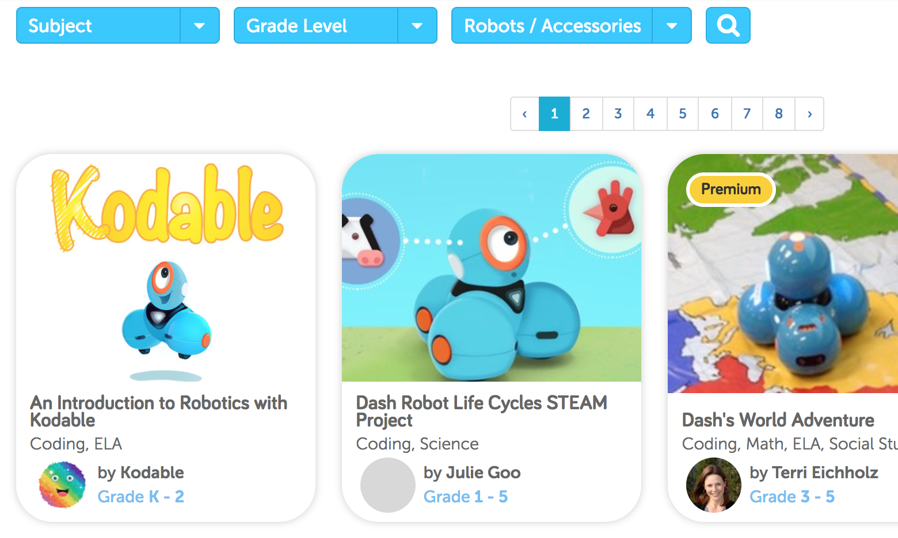
Curriculum K-5
Puzzles built into our apps introduce students to the basics. Challenge cards aligned to CSTA and ISTE standards and more than 100 lessons are available online in our searchable library
Our comprehensive curricular resources enable teachers to help students practice computational thinking and 21st-century skills.
Notes:
The Path, Blockly, Wonder and Cue apps all contain basic challenges to properly introduce students to the basic functions of the robot. This is the very best way to teach yourself to use our robots. Download the app, connect the robots, complete the puzzles, it’s that easy :) To learn more about our Challenge Cards and Teachers guide visit our website: https://education.makewonder.com/curriculum/learn-to-code To learn more about our Code to Learn Lesson Library visit our website: https://education.makewonder.com/curriculum/code-to-learn Detailed Concepts and Standards Alignment PDF
TEKS Alignment

Slide 8
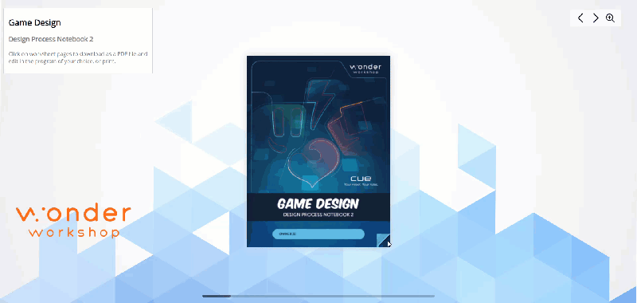
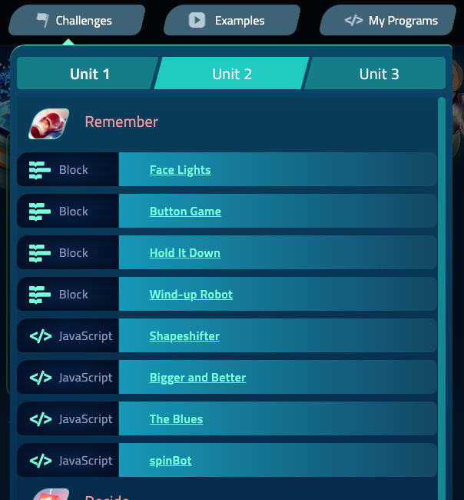
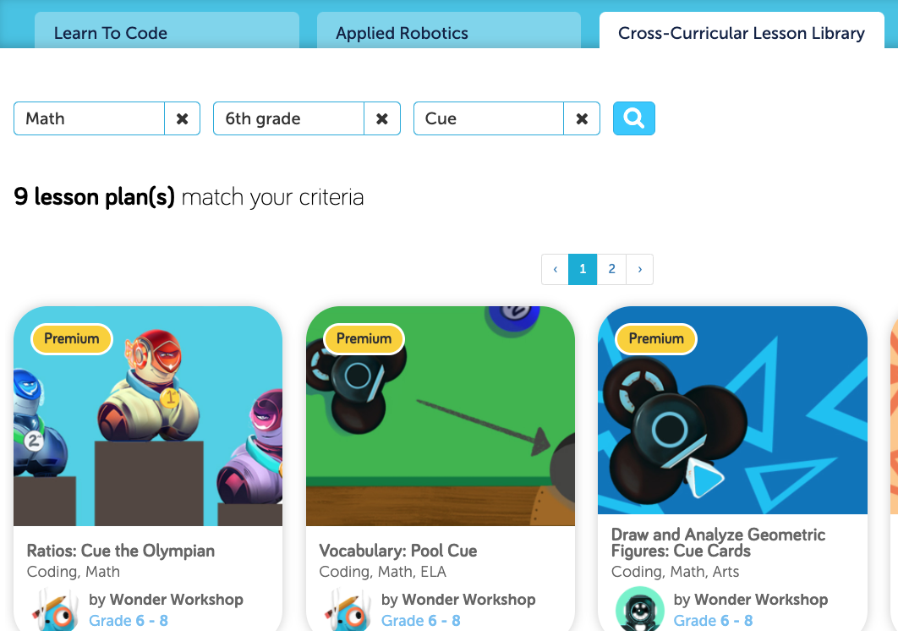
Curriculum 6-8
Wonder Workshop’s comprehensive curricular resources enable teachers to help students practice robotics and coding concepts with Cue.
Design Process Student Notebooks and Teacher Curriculum Guides in FlipBook format
In-App Challenges
Online Lessons
Our comprehensive curricular resources enable teachers to help students practice computational thinking and 21st-century skills.
Notes:
The Cue app has an extensive set of challenges to properly introduce each tool in sequence. Once mastered, the Cue Applied Robotics can be introduced. To learn more about our curriculum for Cue visit our website: https://education.makewonder.com/curriculum/appliedrobotics To learn more about our Code to Learn Lesson Library visit our website: https://education.makewonder.com/curriculum/code-to-learn?page=1&product=Cue

Slide 9
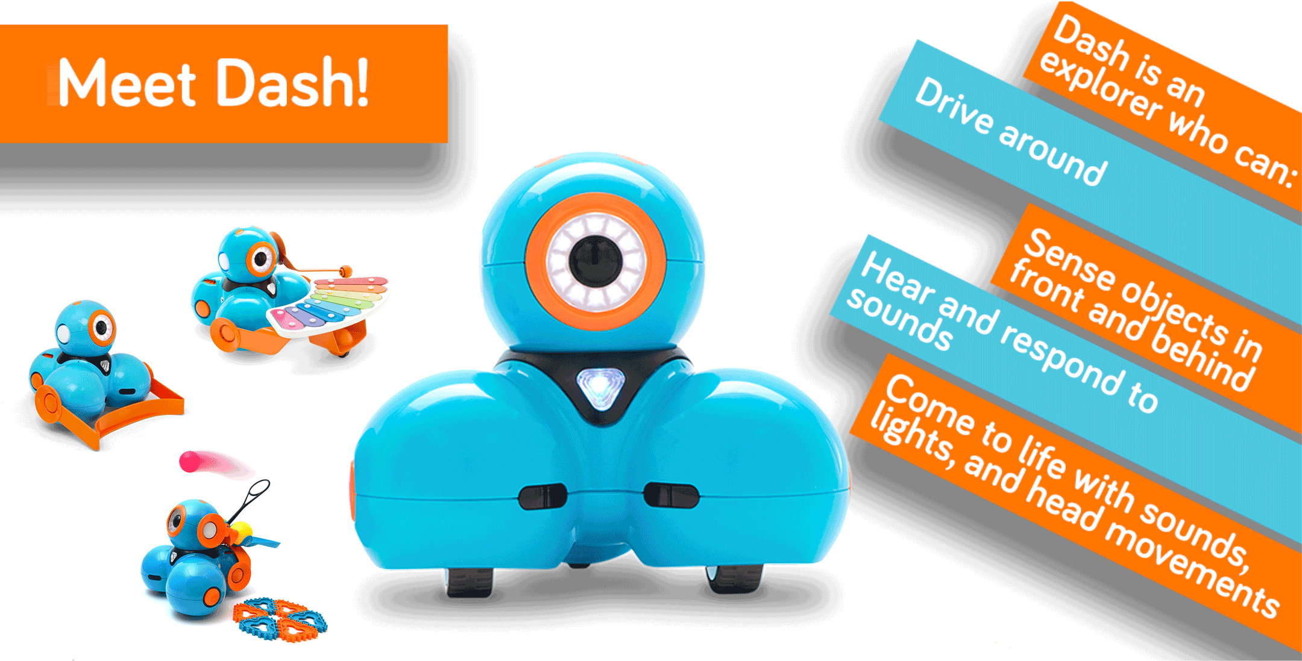
Grades Pre-K - 5th
Notes:
For more info on Dash, visit our website: https://www.makewonder.com/getting-started/dash/

Slide 10
Grades Pre-K - 5th
Notes:
For more info on Dot, visit our website: https://www.makewonder.com/dot

Slide 11
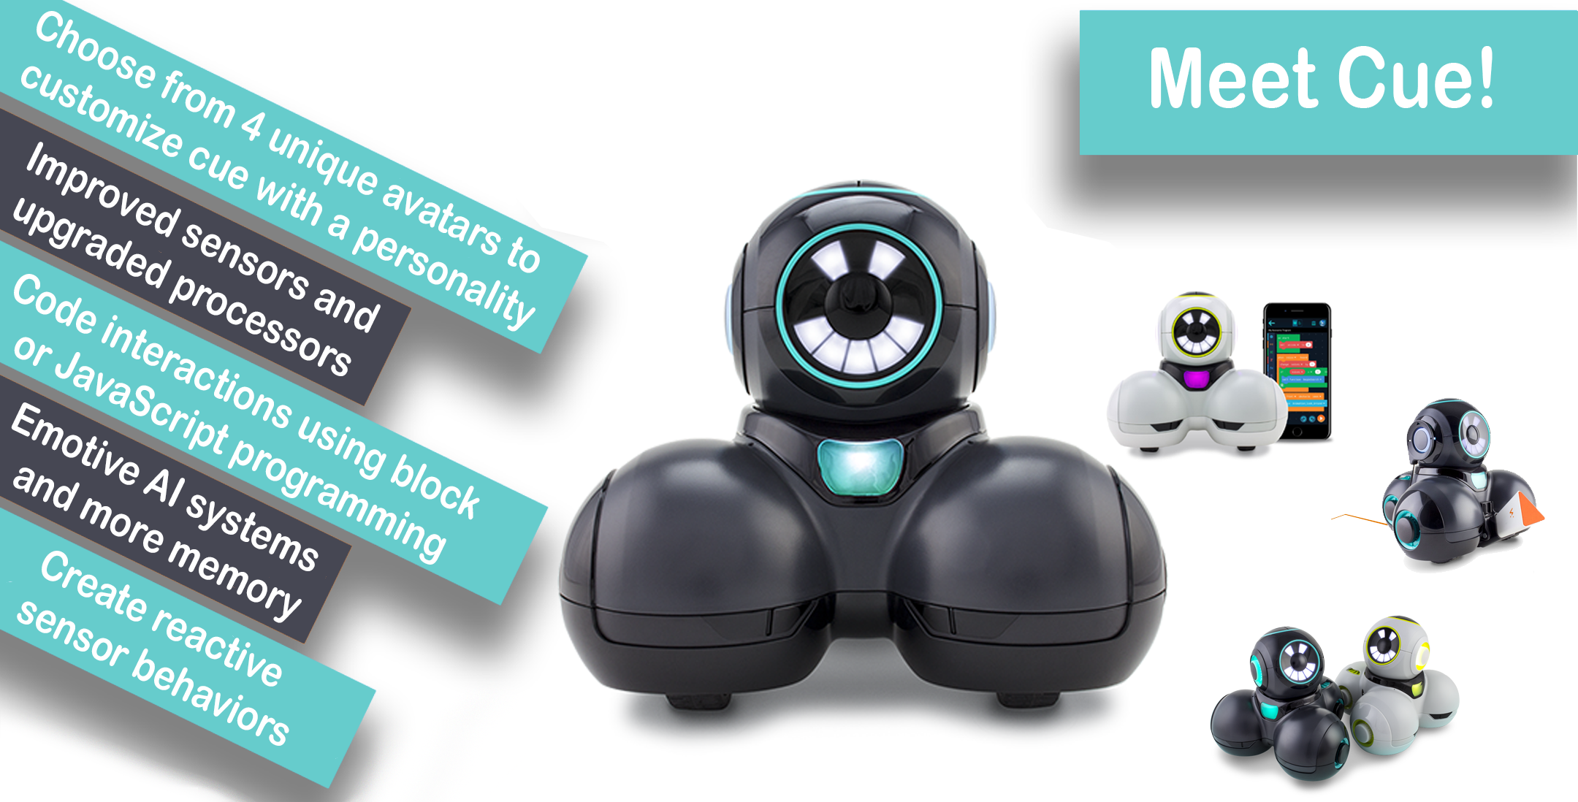
Grades 6th - 8th
Notes:
For more info on Cue, visit our website: https://www.makewonder.com/cue_the_cleverbot

Slide 12
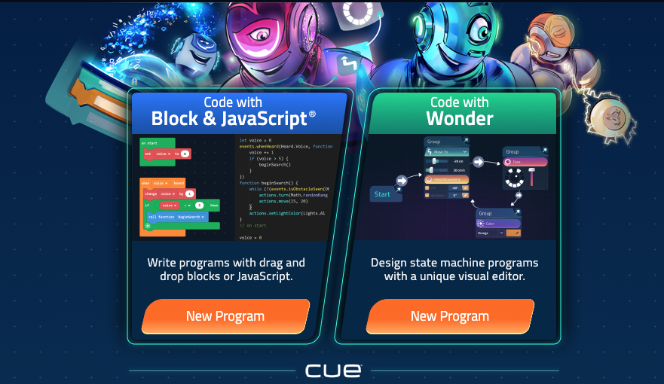
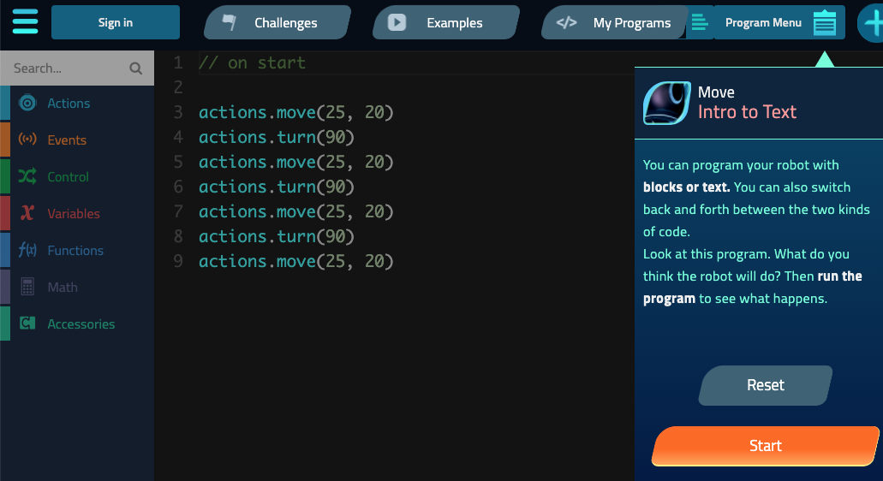
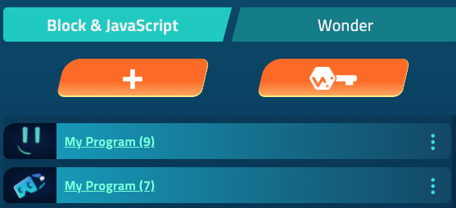
Cue online
The Cue app is available online at code.makewonder.com Users can code in block, javascript or code with Wonder A variety of tools in one app to address students needs as they grow
Notes:
To learn more about Class Connect, our custom learning management system for Dash & Dot, please visit our web pages: www.makewonder.com/class-connect/

Slide 13
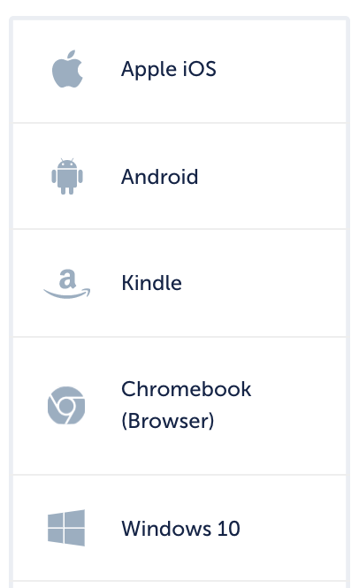
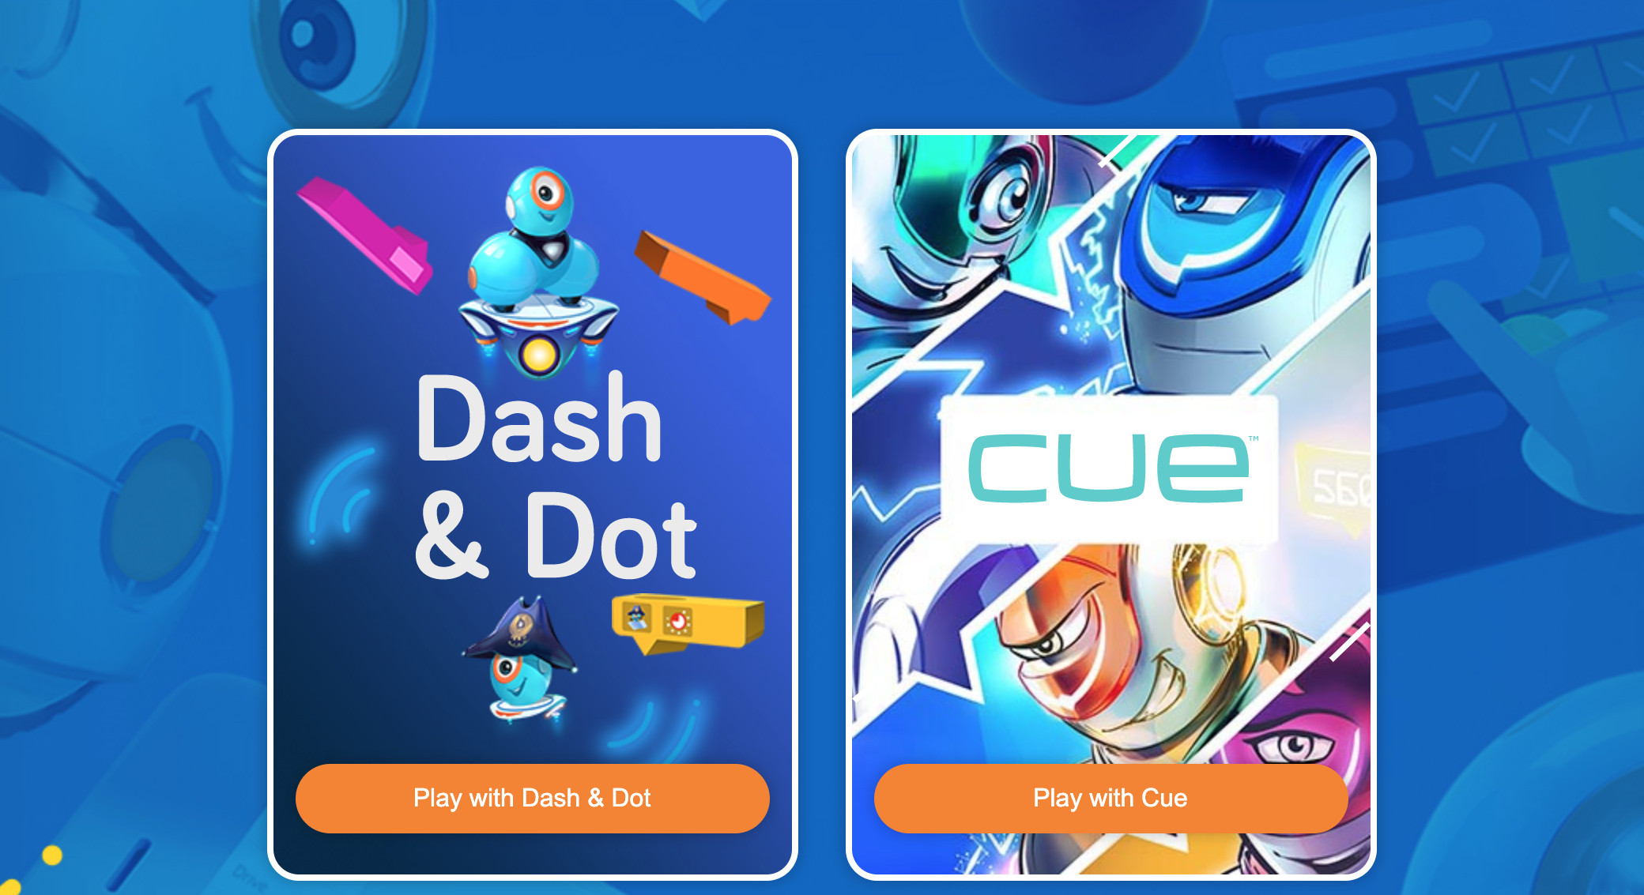
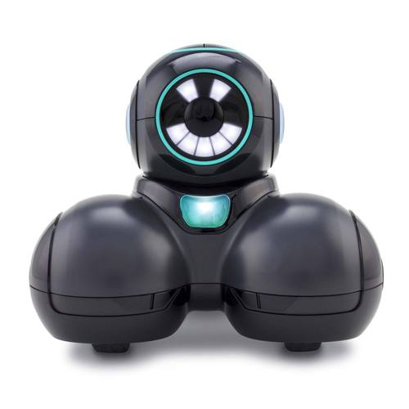
What does it look like in action?
Robust Bluetooth connections with a variety of compatible devices. Android, Apple, Chromebook, Kindle and online.
Driver
Handler
Recorder
Students work in teams of three. Cooperating and collaborating through aligned lessons, challenges and activities.
Notes:
To see if your device is compatible with our robots, visit our website: https://www.makewonder.com/compatibility/
Both the Cue app and Blockly are available online
code.makewonder.com We recommend working in teams of 3. 1. Driver - operates the bluetooth device, start/stop and changing code are the driver’s main responsibilities 2. Handler - handles the robot on the floor. Making sure robot starts from same location, resets obstacles, etc
3. Recorder - Completes any written requirements for a lesson/project. Video records completed projects, or can be in charge of measuring during the exercise (very important)

Slide 14
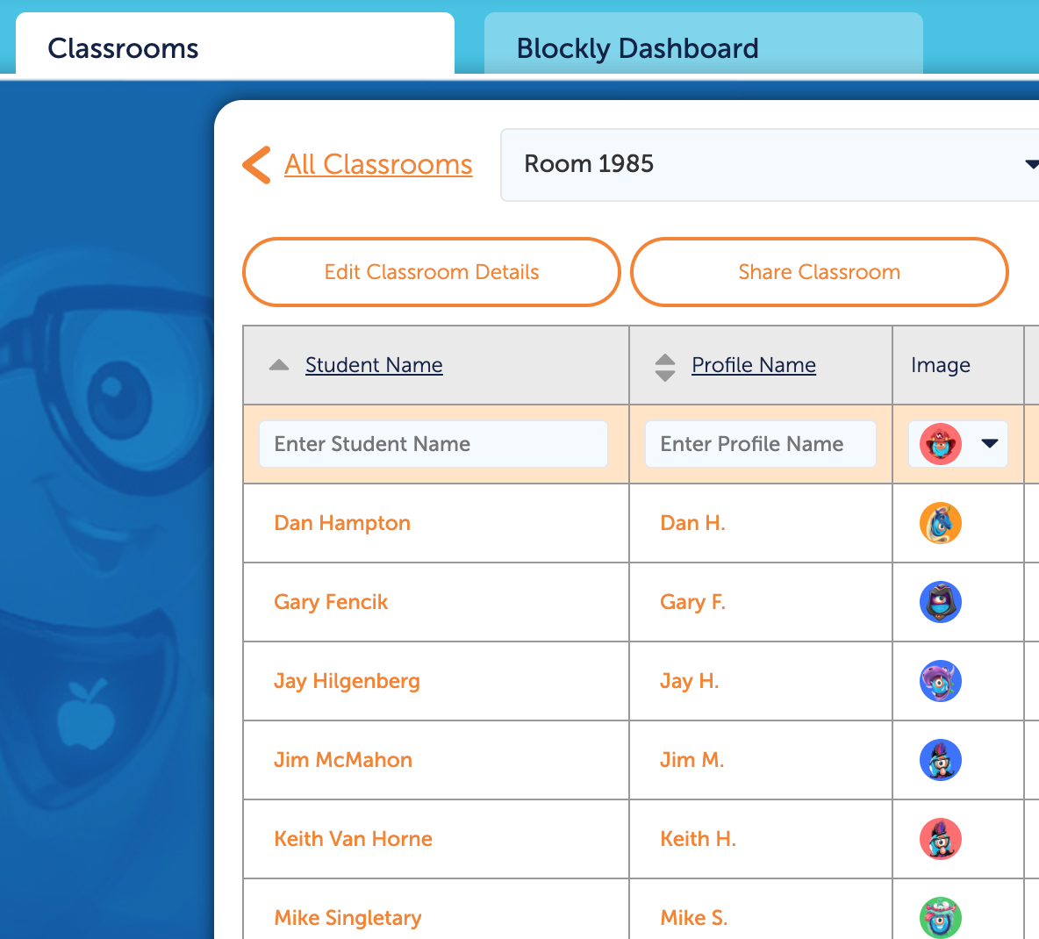
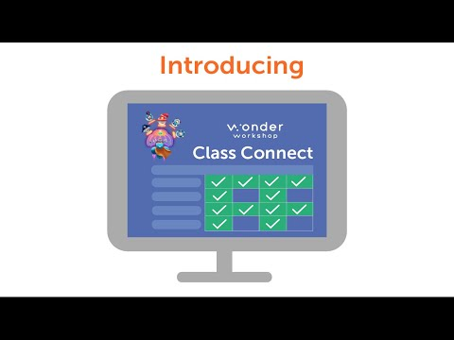
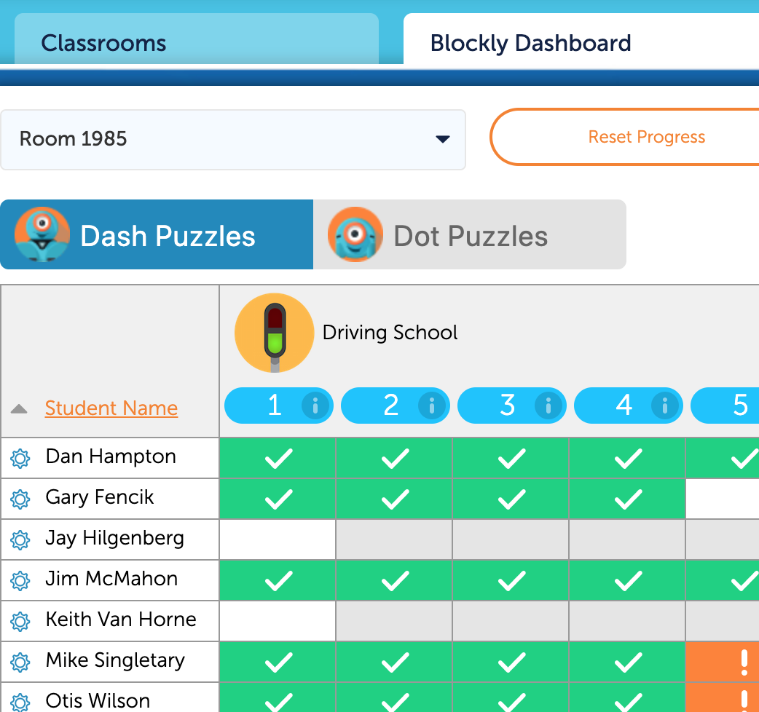
A World of Teaching Coding & Robotics
Class Connect makes it easy to teach with Wonder Workshop’s comprehensive coding and robotics platform.
With Class Connect, you will be set up for success with our entire suite of products and services.
Notes:
Designed for the award-winning Dash & Dot robots and the kid-friendly Blockly programming app, Class Connect gives teachers a tool to understand where students are succeeding and struggling in real time. Gather all your students’ progress in one place, and discover the right standards-based lessons and resources for teaching every concept. FREE trials are available for 30 days - encourage your current customers to give it a try. Video direct link: https://www.youtube.com/watch?v=VciHjiCvONQ

Slide 15
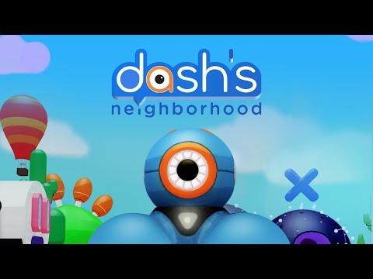
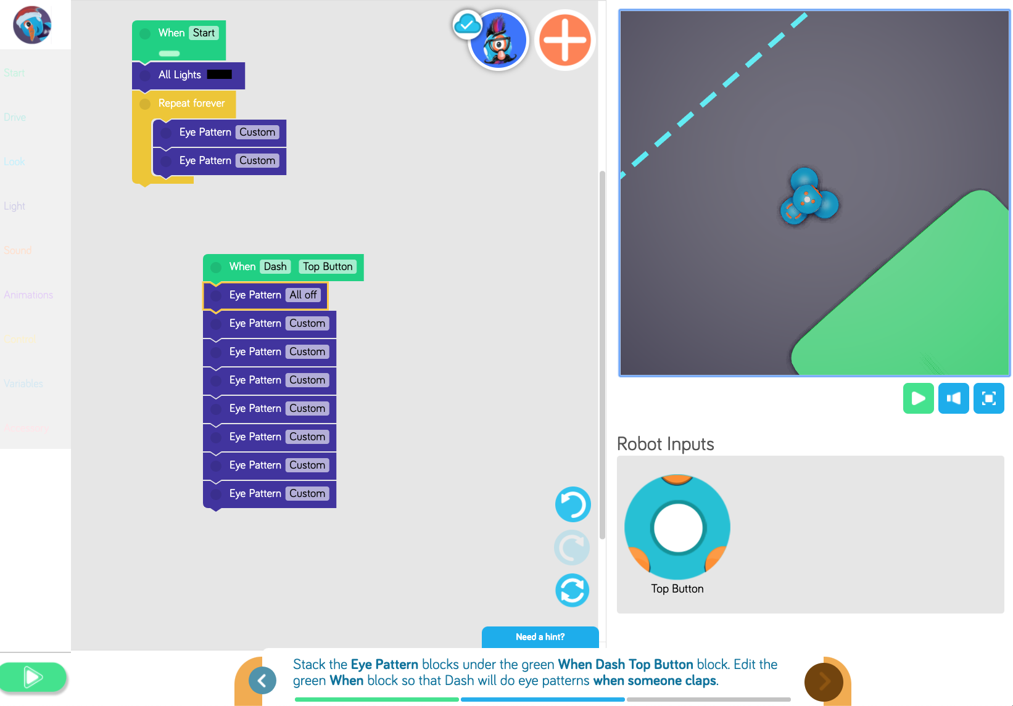
Class Connect & Dash’s Neighborhood
Class Connect subscriptions will give students access to the Dash’s Neighborhood in the Blockly web app
Zoom in - Zoom out, follow Dash on his adventures
The fastest way to introduce coding and robotics to your students
Just open Blockly, every student gets their own Dash robot ready to code on any device
Students can learn to code with Blockly in class and at home, and will be prepared for lessons across all subjects with Dash and Dot, the most engaging K–5 robots
Transition without interruption Switch between coding with an onscreen or physical robot at any time in seconds
Block coding environment
Virtual robot
Inputs and Sensors
With an annual subscription students can learn the six basic building blocks of coding on any compatible device with Blockly puzzles
Notes:
Direct video link: https://drive.google.com/open?id=1pabCoP05dLkd35qdD_v9TMC-2cEy6zNb

Slide 16
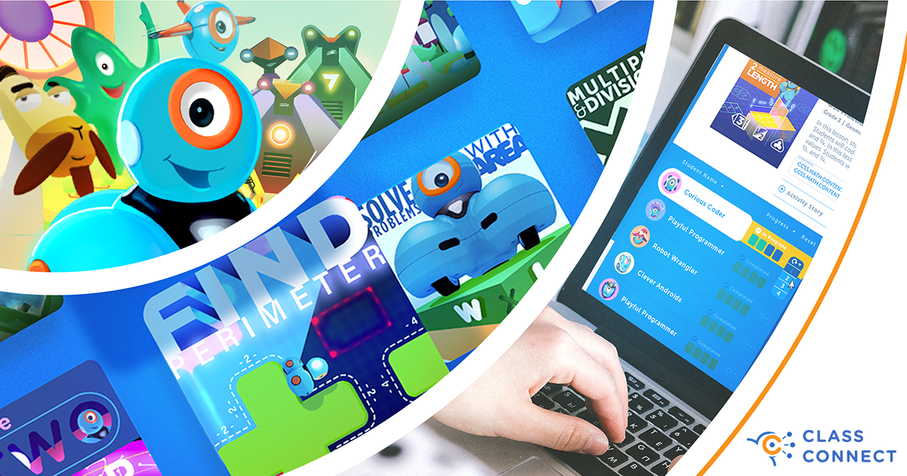
NEW Math Lessons in Class Connect
Brand new, step-by-step activities provide an engaging way for kids to master math standards while coding with their favorite robot, Dash.
Notes:
Now with Math Activities, Class Connect is Wonder Workshop's teacher hub that enables you to Do More With Dash! Use coding to reinforce core curriculum concepts with fun and engaging challenges kids love! Start your free trial! https://makewonder.com/class-connect

Slide 17
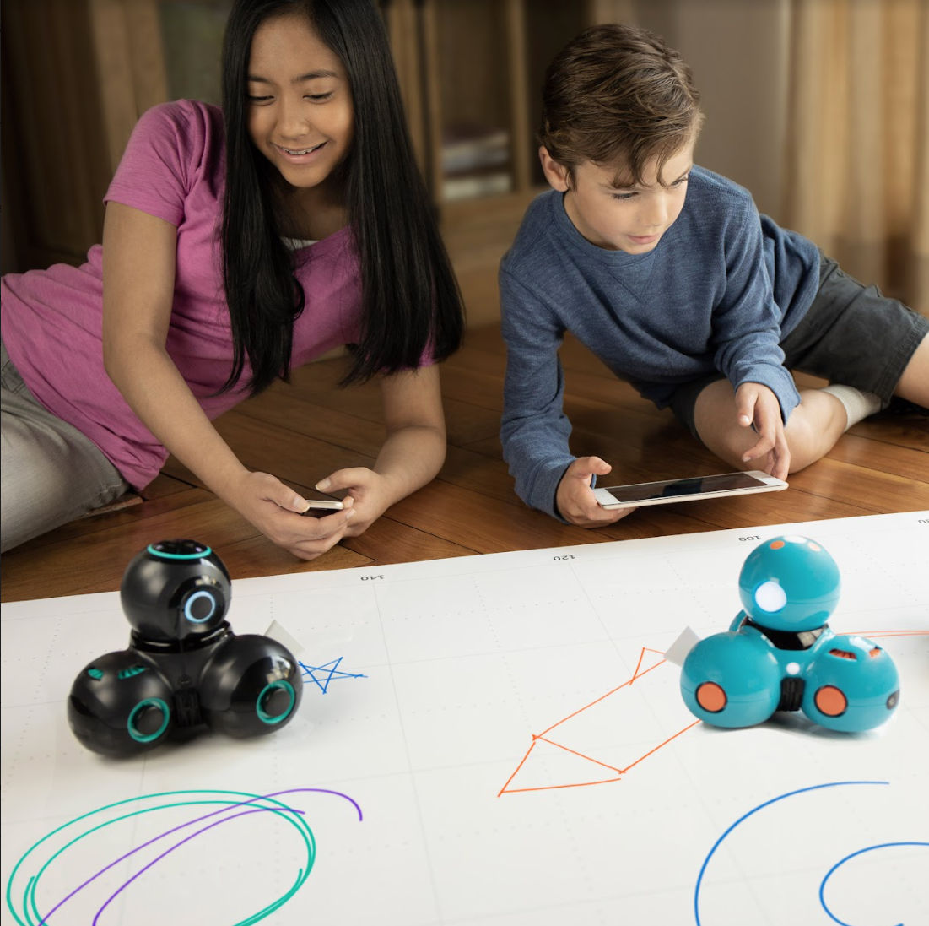
Social and Emotional?
Throughout our entire production process, we aim to spark creativity with kids of all ages to inspire them to learn critical coding skills while having fun. Our robots put the power of play into their hands so they can dream up new adventures while learning to code at every level. Each discovery, each 'wonder moment,' leads to another, all while unlocking a new way of seeing the future.
Notes:
We think of 'wonder' as that feeling you get when your world is opened a little wider. Like riding a bike for the first time, or taking that leap off the high dive… wonder is even more meaningful when you have to work for it. At Wonder Workshop, we’re engineering play to develop the next generation of innovators.

Slide 18
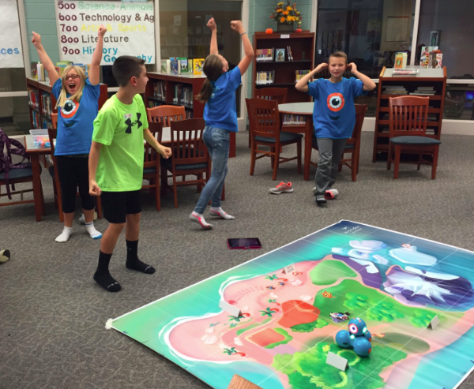
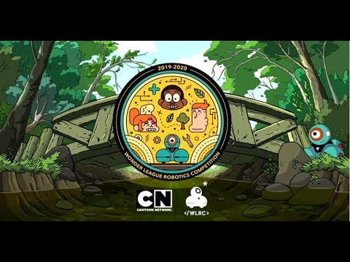
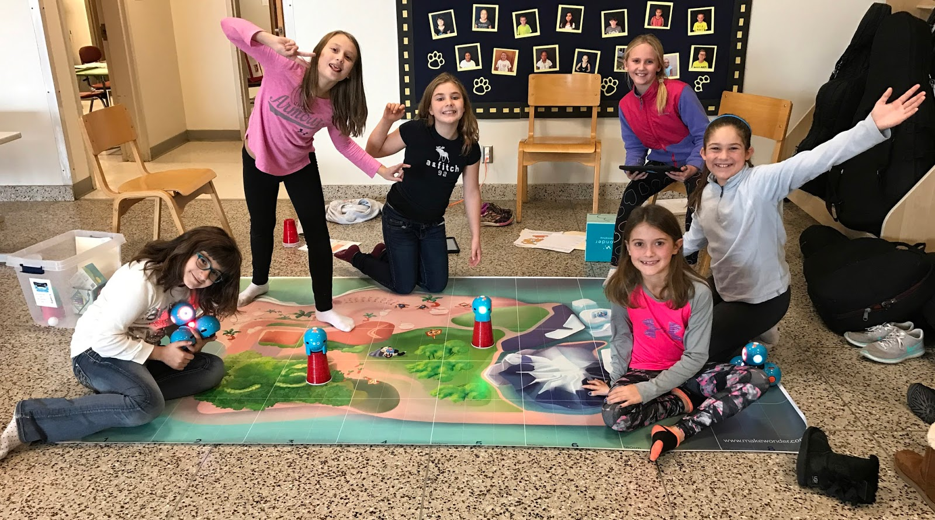
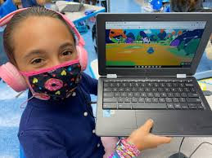
Annual Competition
The Wonder League Robotics Competition is free to join
and is completed from your own classroom or lab
WLRC 2020
3,645 coaches registered
73 countries represented
25,445 students competed 34% under the age of 8 47% were female
Teams of students ages 6-8, 9-11 and 12-14 years old will design solutions for real-world science and technology problems by programming Dash, Dot and Cue
Notes:
To learn more about our annual competition please visit our website: https://education.makewonder.com/robotics-competition To hear from one of the WLRC coaches and her team please visit our YouTube page: https://www.youtube.com/watch?v=MjXBriJQlf8

Slide 19
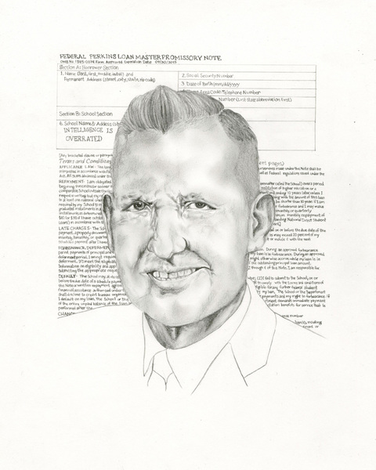
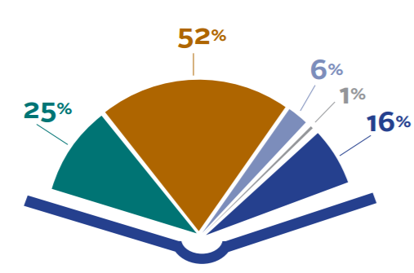
Funding?
Federal funds can be used to support STEM education in many ways
Increase students’ equitable access to STEAM courses and experiences, including out-of-school programs, STEAM-themed schools, and career pathways
Support educators’ knowledge and expertise in STEAM disciplines through recruitment, preparation, support, and retention strategies
Increase student access to materials and equipment needed to support inquiry-based pedagogy and active learning.
Title IV, Part B: 21st Century Community Learning Center Grants
Wonder Workshop provides unique opportunities for STEAM enrichment in out-of-school learning environments. Educators can use 21st Century Community Learning Centers grant funds to purchase Wonder Workshop robots and curriculum to support an engaging after school or community-based learning environment. Our annual competition is an excellent way to engage these groups in a world-wide event that is free of charge.
Carl D. Perkins Funding
Our solutions provide curriculum options that are industry-based to push students thinking in areas of STEAM and see the application to STEAM-based fields. Perkins funding provides a means for bringing this type of learning opportunity into the classroom as well as opening up the opportunity to create courses focused on STEAM learning.
IDEA
Although Wonder Workshop products do not specifically address disabilities within the curriculum, students with disabilities are quite successful using the various solutions. Because the curriculum is designed for the students to work in groups of three, this enables students to practice collaboration and communication. These skills help students with autism and language disabilities to improve their interactions with others.
Title I
Utilizing Wonder Workshop robots where the program aligns with the school’s comprehensive needs assessment. The differentiation of learning that our curriculum provides creates an environment for all students to succeed. As a supplemental material, focused around STEAM learning, Dash, Dot and Cue provide an engaging way to continue the learning and apply ideas.
Title II
Wonder Workshop’s Teach Wonder course offers online Professional Development to support educators as new teaching methods and materials are implemented into the classroom.
Notes:
Carl D. Perkins Career and Technical Education Act of 2006 https://www2.ed.gov/policy/sectech/leg/perkins/index.html Individuals with Disabilities Education Act https://sites.ed.gov/idea/?src=search Title II (Sections 205 through 208) of the Higher Education Act
https://www2.ed.gov/programs/teacherqual/index.html Part B — 21st Century Community Learning Centers https://www2.ed.gov/policy/elsec/leg/esea02/pg55.html Title I Improving Basic Programs Operated by Local Educational Agencies https://www2.ed.gov/programs/titleiparta/index.html

Slide 20
ESSER II Funding
Qualified educational costs must fall within one of the following categories:
• Resources needed to conduct remote and hybrid learning
• After-school and summer learning programs
• Evidence-based solutions to learning loss, including assessments and distance learning equipment
• Coordination tools among state, local, tribal, and other entities to prevent the spread of COVID-19
• Resources that address COVID-19 in schools and tools that improve preparedness
• Tools that address the needs of disadvantaged students, including those living in poverty, learning English, experiencing homelessness, dealing with disabilities, or living in foster care
• Staff sanitation training and sanitation supplies to disinfect schools
• Mental health support and resources
• Tools needed to organize and plan for school closures
• School facility repair, especially ventilation systems, to improve air quality and reduce COVID-19 transmission
Notes:
On December 27th, 2020, the Coronavirus Response and Relief Supplemental Appropriations (CRRSA) was signed into law. Through this program, educators, including state and local governments, can access a second round of COVID-19 relief funds for K–12 schools. These Elementary and Secondary School Emergency Relief (ESSER) II funds are available for costs dating back to March 13, 2020. State educational agencies (SEAs) may award funds to local educational agencies (LEAs) until January 2022.

Slide 21
Thank you for your time
Tim Tomaso
tim.tomaso@makewonder.com
https://calendly.com/tim-tomaso
Notes:
You can reach me weekdays. 8:00-5:00 central time. (847) 624-5854 when I am not on the road.

